Slide 1
PHILIPPINES
Atty. Crizaldy Barcelo
Regional Executive Director
Department of Environment and Natural Resources, Region 8
Notes:
Excellencies, Ladies and Gentlemen Good afternoon! I am pleased to present to you, the country report of the Philippines on the implementation of the CTI-CFF National Plan of Action.

Slide 2
Outline
Members (Agencies) of the National CTI-CFF Coordinating Committees
Progress/Accomplishment towards CTI-CFF National Programs/Projects
Progress/Accomplishment towards National Plan of Action
Challenges/Constraints Affecting Implementation of Activities
National Roadmap 2020
Potential Regional Program and Support Required
Notes:
To give you an idea on the content of the presentation, here is the outline:
First we would like to show you the member of the Philippine National CTI Coordinating Committee, to be followed by our progress towards CTI-CFF National Programs and the NPOA; constraints and challenges in the NPOA implementation, our national roadmap for 2020, and the potential regional programs of the NCCC.

Slide 3
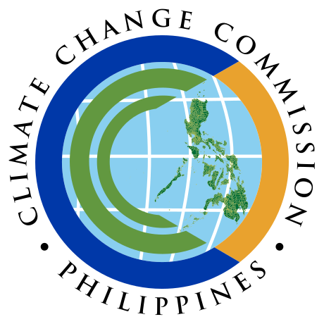
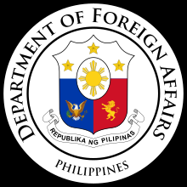
I. Members (Agencies) of the National CTI-CFF Coordinating Committees
Department of Environment and Natural-Biodiversity Management Bureau
Department of Agriculture-Bureau of Fisheries and Aquatic Resources
Department of Foreign Affairs
Department of Finance
Department of Tourism
Department of Interior and Local Government
National Economic and Development Authority
Climate Change Commission
University of the Philippines – Marine Science Institute
Conservation International Philippines
World Wide Fund for Nature Philippines
Notes:
The following are the members of the PH NCC:
Department of Environment and Natural-Biodiversity Management Bureau
Department of Agriculture-Bureau of Fisheries and Aquatic Resources
Department of Foreign Affairs
Department of Finance
Department of Tourism
Department of Interior and Local Government
National Economic and Development Authority
Climate Change Commission
University of the Philippines – Marine Science Institute
Conservation International Philippines
World Wide Fund for Nature Philippines
The PH NCCC is being chaired by the DENR (spell-out) and co-chaired by the DA-BFAR. The rest of the agencies and organizations sit on the different working groups of CTI CFF.

Slide 4
I. Technical Working Group Members / Agencies
TWG | Focal Point
Seascapes | ASec. Ricardo Calderon DENR-Biodiversity Management Bureau Support: Ms. Nilda S. Baling
EAFM | USec. Eduardo B. Gongona DA-Bureau of Fisheries and Aquatic Resources Support: Mr. Rafael V. Ramiscal
MPA | ASec. Ricardo Calderon DENR-Biodiversity Management Bureau Support: Mr. Pablo G. de los Reyes, Jr.
CCA | Comm. Noel Antonio V. Gaerlan Climate Change Commission Support: Mr. Alexis D. Lapiz
TSWG | USec. Eduardo B. Gongona DA-Bureau of Fisheries and Aquatic Resources Support: Mr. Francisco Torres, Jr. ASec. Ricardo Calderon DENR-Biodiversity Management Bureau Support: Mr. Pablo G. de los Reyes, Jr.
Notes:
Here are our representatives for the different working groups. For Seascapes and MPA: Asec Ricardo Calderon of the DENR-BMB, for EAFM: Undersecretary Eduardo Gongona of the DA-BFAR, and for the CCA: Commissioner Noel Antonio Gaeran of the Climate Change Commission.

Slide 5
I. Governance Working Group/ Cross Cutting Themes Members / Agencies
TWG | Focal Point
M&E WG | ASec. Ricardo Calderon DENR-Biodiversity Management Bureau Support: Ms. Luz Baskiñas
IRC | ASec. Ricardo Calderon DENR-Biodiversity Management Bureau Support: Dir. Wilfredo Obien
FRWG | Dir. Wilfredo Obien DENR- Financial Management Service Support: Mr. Francis Castro
LGN | Dir. Anna Liza F. Bonagua DILG- Bureau of Local Government Development Support: Ms. Jenifer Galorport/ Ms. Kristine Carmen Diones
SAG/UP | Dr. Fernando Siringan UP – Marine Science Institute Support: Dr. Porfirio Aliño/ Mr. John Erick Avelino
Notes:
As for the Governance Working Group, representatives will be coming from the DENR-BMB, the DENR Finance Management Service, the Department of Interior and Local Government, and the University of the Philippines Marine Science Institute.

Slide 6
I. Governance Working Group/ Cross Cutting Themes Members / Agencies
TWG | Focal Point
RBF | ASec. Ricardo Calderon DENR-Biodiversity Management Bureau Support: Ms. Luz Baskiñas
WLF | ASec. Ricardo Calderon DENR-Biodiversity Management Bureau Support: Reg. Dir. Remia Aparri/ Ms. Salome Bonnit

Slide 7
II. Progress/Accomplishments towards National Plan of Action
CTI-CFF National Programs
Preliminary preparation for the implementation of South China Sea Project/COBSEA Project and ProCoast Project
Implementation of Coastal and Marine Ecosystem’s Management Program
Implementation of SmartSeas Project
Support in the Finalization of the Sulu-Sulawesi Seascape Sub-Regional EAFM Plan and Regional Strategic Action Plan
Hosted Technical Working Group Meetings of Seascape, EAFM, and CCA.
Notes:
Moving on to the progress and achievements which was implemented through the CTI CFF National Programs, the Philippines is currently in preparation for the implementation of the South China Sea Project or the COBSEA Project and the ProCoast Project which aims for a sustainable coastal protection through biodiversity conservation in coastal ecosystems affected by typhoons in the Philippines.
We are also implementing SmartSeas Project which also aims to establish MPAs and MPANs to reduce threats in coastal and marine ecosystems.
The Coastal and Marine Ecosystem’s Management Program is being implemented by the DENR to effectively reduce the drivers and pressures on coastal and marine ecosystems and improve the ecosystems condition.
Moreover, Philippines is very supportive in the finalization of the Sulu-Sulawesi Seascape Sub-Regional EAFM Plan and Regional Strategic Action Plan and looking forward to its implementation in the coming years.
Further, we have supported the conduct of Seascapes, EAFM, and CCA Working Group Meetings this year.

Slide 8
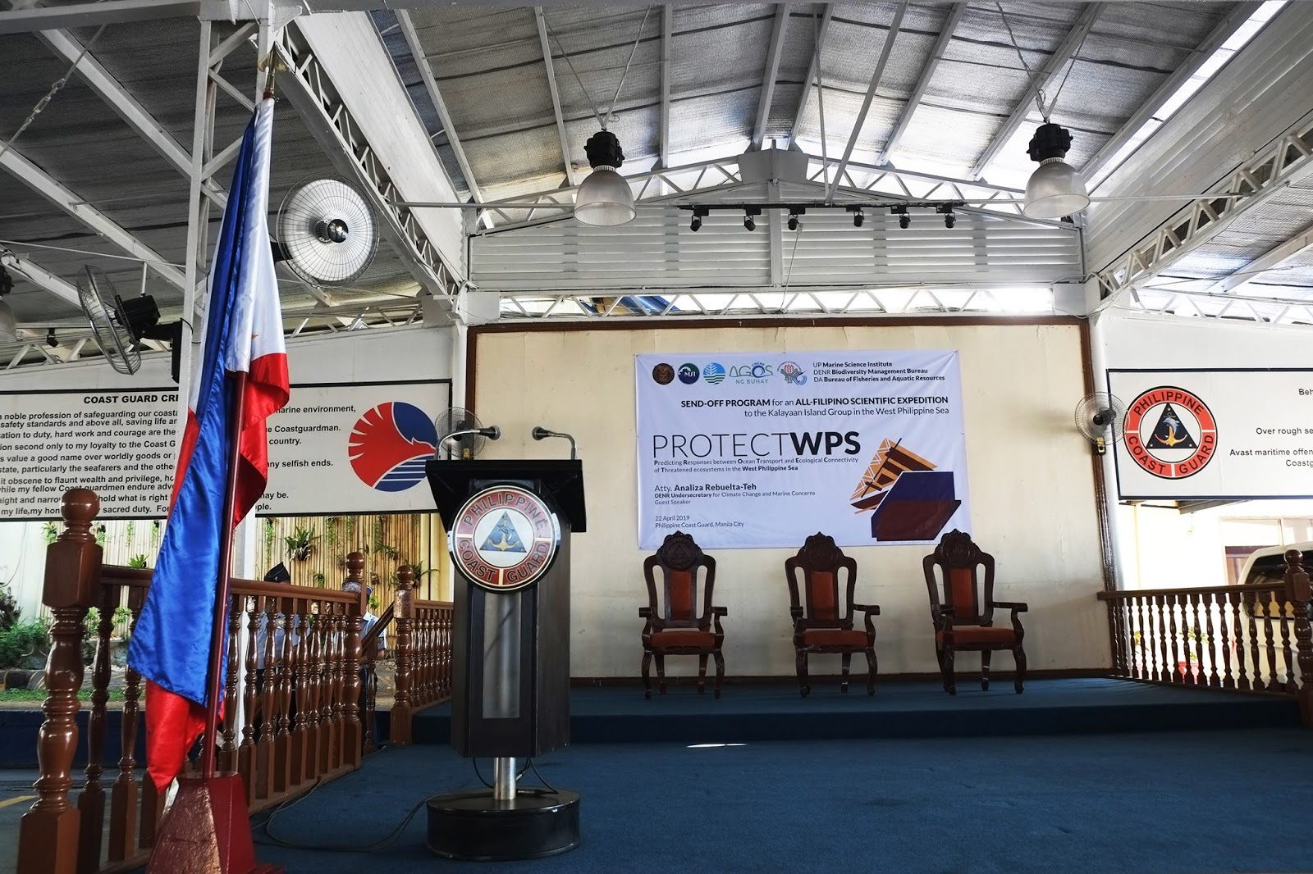
III. Progress/Accomplishments towards National Plan of Action
SEASCAPES
Programs/projects/activities related to CTI-CFF goals (but not directly budgeted under CTI-CFF programs)
Implementation of expanded-National Integrated Protected Area System (e-NIPAS) with Implementing Rules and Regulations and Budget Allocation
Conducted Experts Forum and Marine Research for West Philippine Sea
Development of Philippine Rise Management Plan
Mainstreaming of Sulu-Sulawesi Seascape activities
Conducted National Marine Summit on October 29-30, 2019
Ongoing implementation of the UNEP-SEAFDEC Refugia and WPEA Projects
Passage of Bangsamoro Law
Notes:
For Goal 1 which is on Seascapes, after the finalization of the e-NIPAS IRR this year, we were implementing it and allocated budget for its activities.
To support one of the priority seascapes of the PH which is the West Philippine Sea, there were already researches and forums conducted by the experts and scientists for the WPS to establish baseline data for program/policy recommendation.
Also, we have developed the management plan of the newly discovered protected area, the Philippine Rise.
We also mainstreamed the activities undertaken during the implementation of the Sulu-Sulawesi Seascape Project to our national programs.
Also, we have conducted the National Marine Summit on October 29-30 this year with a theme, achieving a sustainable socio-economic Growth and National Security.
We continue to implement the UNEP-SEAFDEC Refugia and West Pacific East Asia Project.
Lastly, there are on-going discussions on the transfer of the management of PAs and other natural resources under the political jurisdiction of Bangsamoro Autonomous Region for Muslim Mindanao pursuant to Article XIII, Section 9 of the Bangsamoro Organic Law.

Slide 9
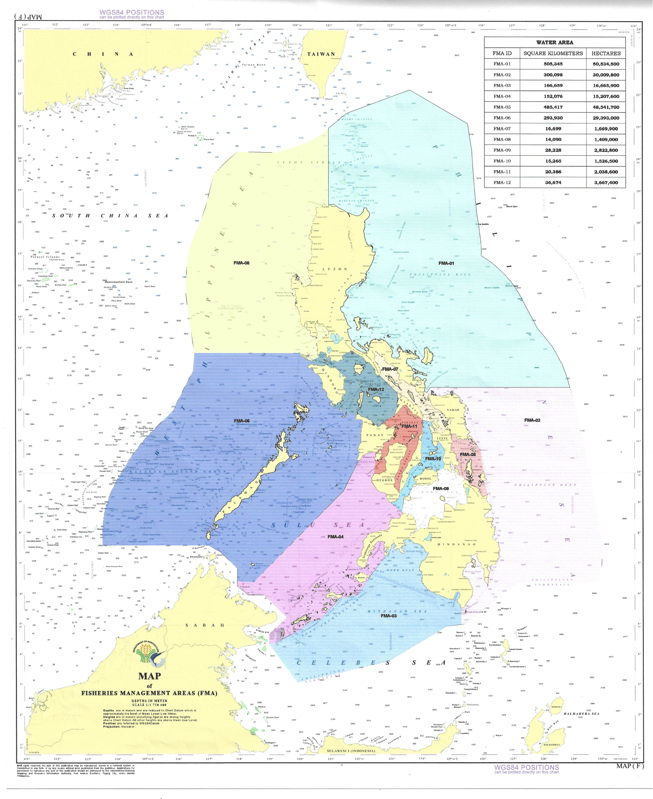
EAFM
Programs/projects/activities related to CTI-CFF goals (but not directly budgeted under CTI-CFF programs)
Establishment of Fisheries Management Area
Implementation of Biodiversity Friendly Enterprises and Special Area for Agricultural Development Program (SAADP)
Continuous conduct of IEC activities such as conduct of summits/ conferences focusing on highly valued commodities i.e., sardines, tuna, shrimp, milkfish, tilapia, etc.
Conducted Fisheries Summit 2019
Drafted Guidelines on the Delineation of Municipalities with Offshore Islands
Progress/Accomplishments towards National Plan of Action
Notes:
Moving on to the next goal which is EAFM, we were able to establish Fisheries Management areas covering all Phil waters, FMA is an area designated/delineated for fisheries resource management.
We are continuously implementing the Biodiversity Friendly Enterprises and SAADP for livelihood provision to the fisherfolks and local communities, examples of these livelihoods are municipal fishing gear/paraphernalia distribution, fingerlings/seed stocks distribution, post-harvest equipment distribution with a total beneficiaries of 200,000 fisherfolks this 2019.i
In order to involve different stakeholders on the policy/program development we are conducting summits, conferences, consultations, etc which focuses on high valued commodities such as, sardines, tuna, shrimp, milkfish and tilapia.
As one of the highlights this year, the BFAR also conducted the Fisheries Summit which aims to redirect the programs and activities of BFAR to incorporate new paradigms of the new administration i.e., modernization, industrialization, farm consolidation, export promotion, roadmap development, infrastructure development, higher budget and investments, and legislative support.
Moreover, there is already a draft of the guidelines on the delineation of municipalities with offshore islands.

Slide 10
EAFM
Programs/projects/activities related to CTI-CFF goals (but not directly budgeted under CTI-CFF programs)
Continuous Implementation of Seasonal fishing closures in Zamboanga Peninsula, Balayan Bay, Visayan Sea, Davao Gulf and Northern Palawan with adaptive measures
Regulation on Wild Juvenile Groupers through an FAO
Establishment of data collection scheme in municipal catch documentation and traceability system in the LGU for management of fishery resources
Support to the implementation of FishRight Program
Establishment of convergence initiatives with DENR Biodiversity Management Bureau
Creation of National Scientific Advisory Group of Experts (NSAGE)
Progress/Accomplishments towards National Plan of Action
Notes:
As one of the effective fisheries management action, we are continuously implementing the seasonal fishing closure in several major fishing grounds.
As for the regulation of the reef fish, a Fisheries Administrative Order on the regulation of wild juvenile groupers was issued.
A data collection scheme in municipal catch documentation and traceability system was established n order to effectively manage the municipal fishery resources.
The Philippines acknowledges that a strong collaboration between the government agencies and other stakeholders are very important, thus it supports the FishRight Program.
Similarly, this strengthens the convergence initiatives between the DENR-BMB and DA-BFAR to harmonize and collaborate in certain areas for cooperation on sustainable fisheries and aquatic biodiversity conservation.
Further, the National Science Advisory Group of Experts was created to assist the government on crafting science-based policies and programs.

Slide 11
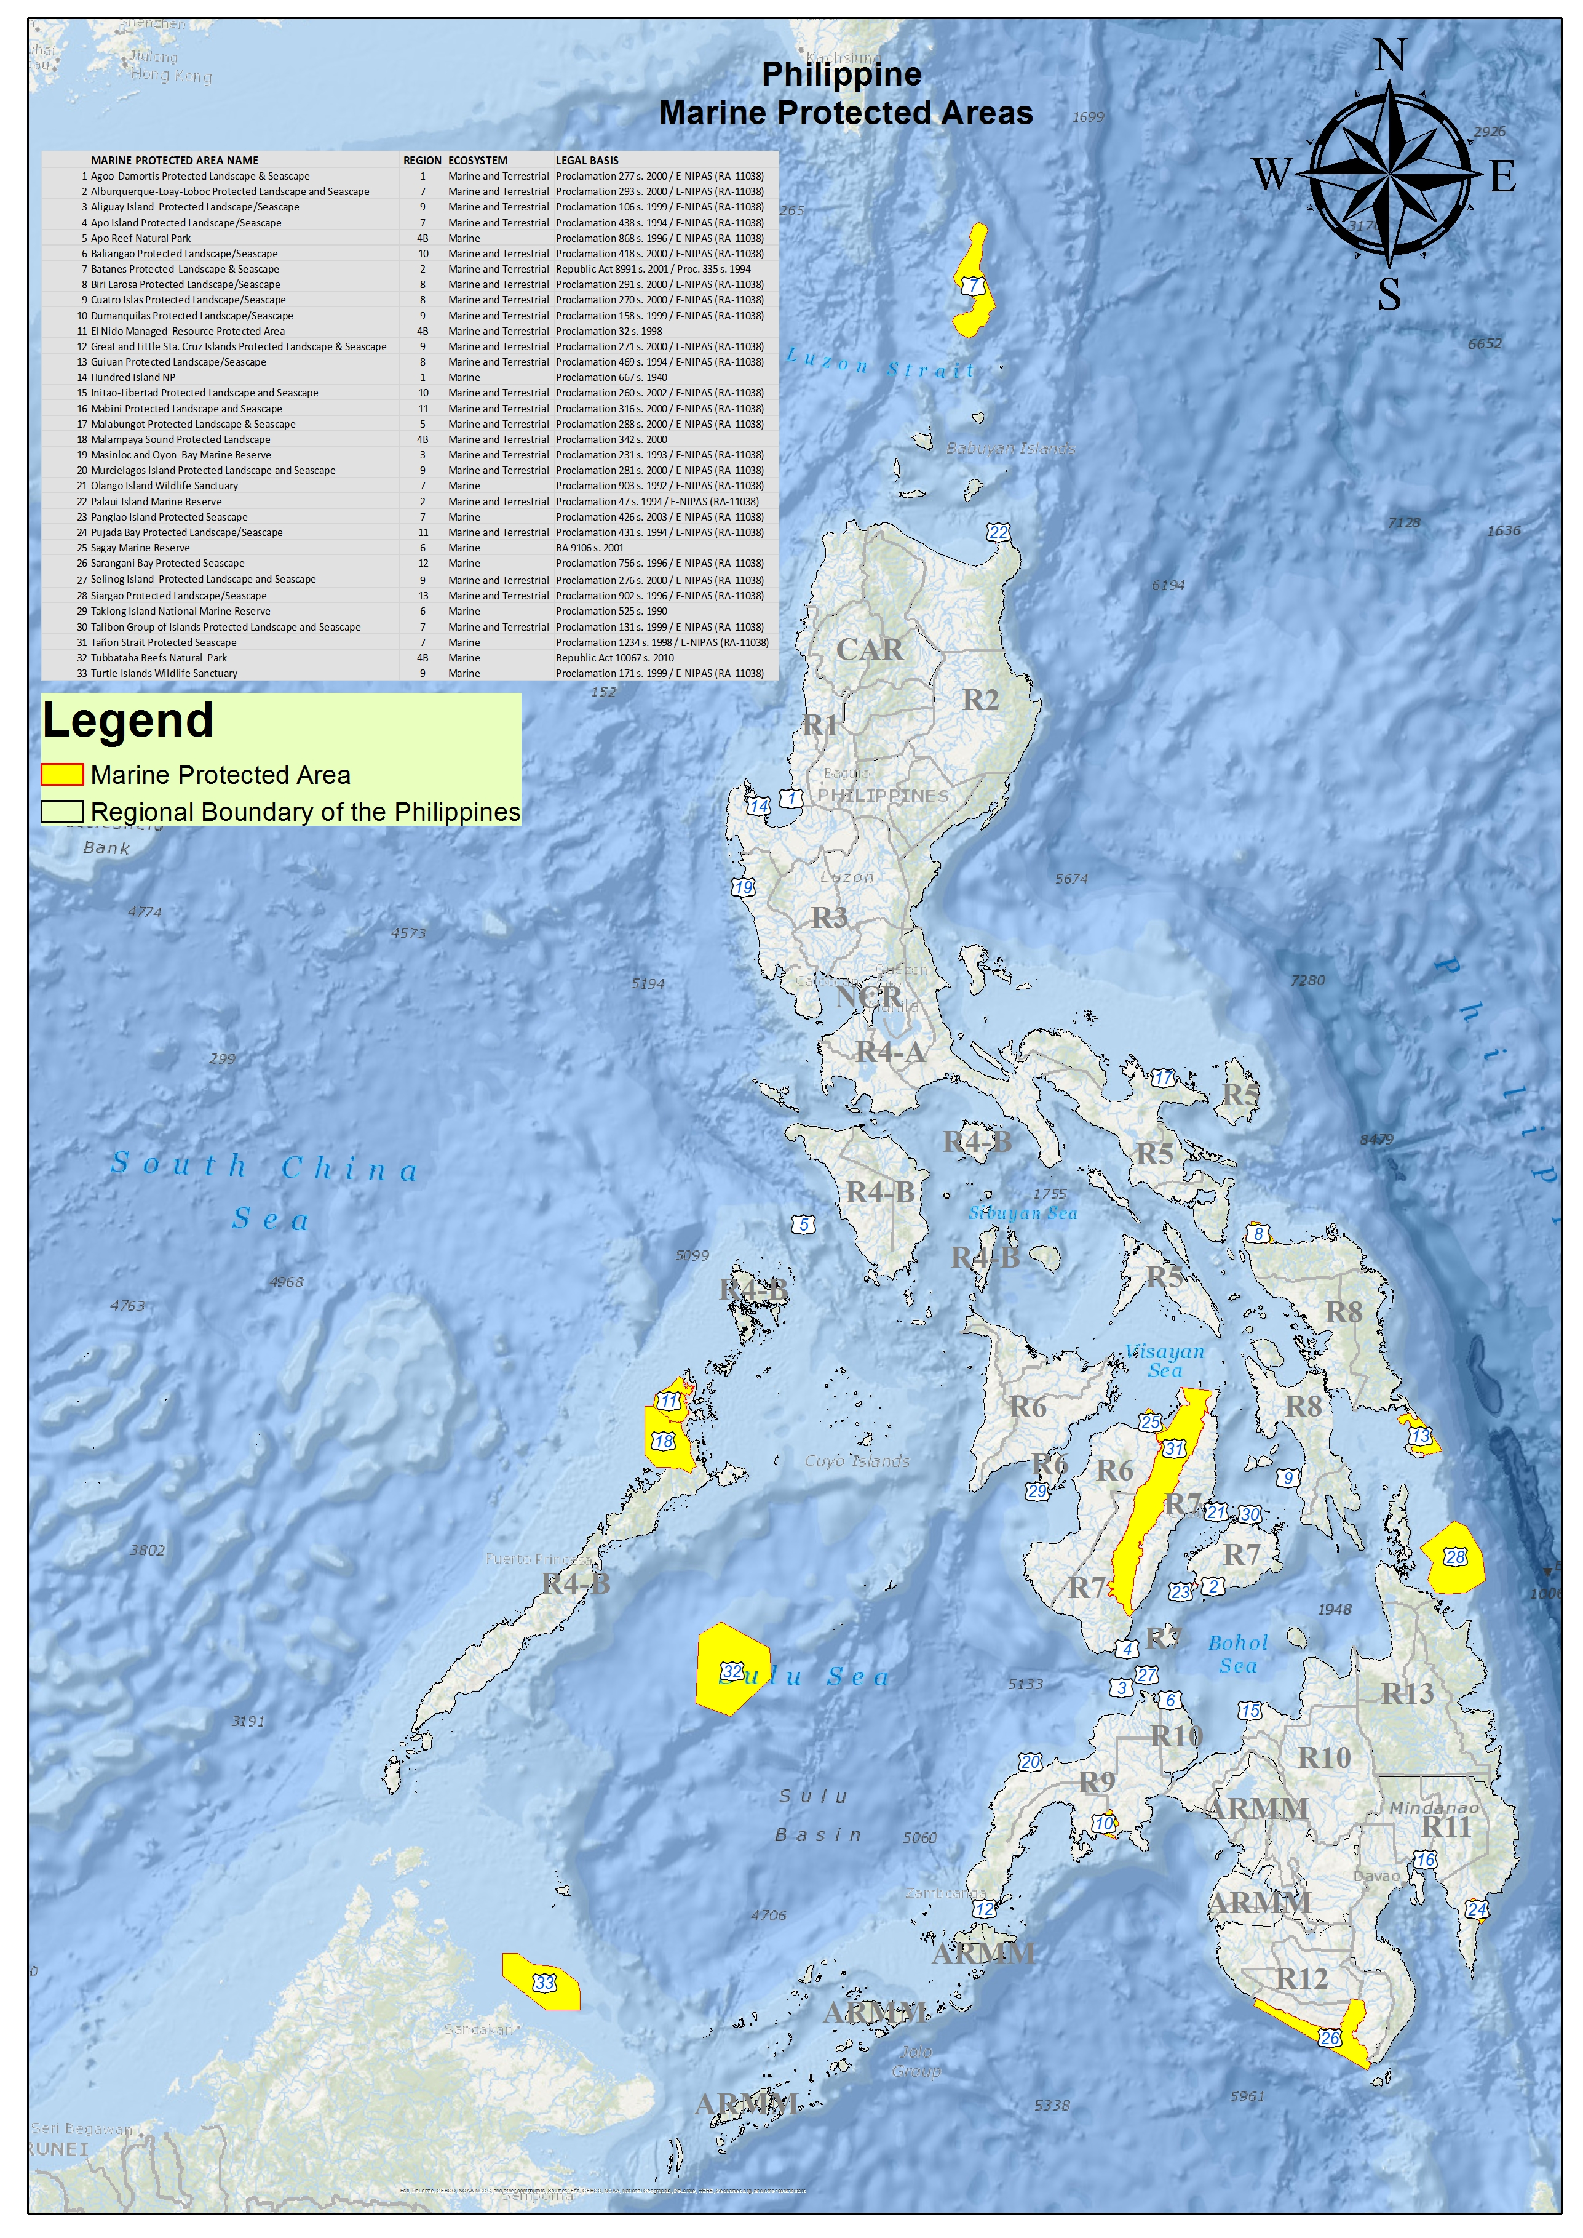
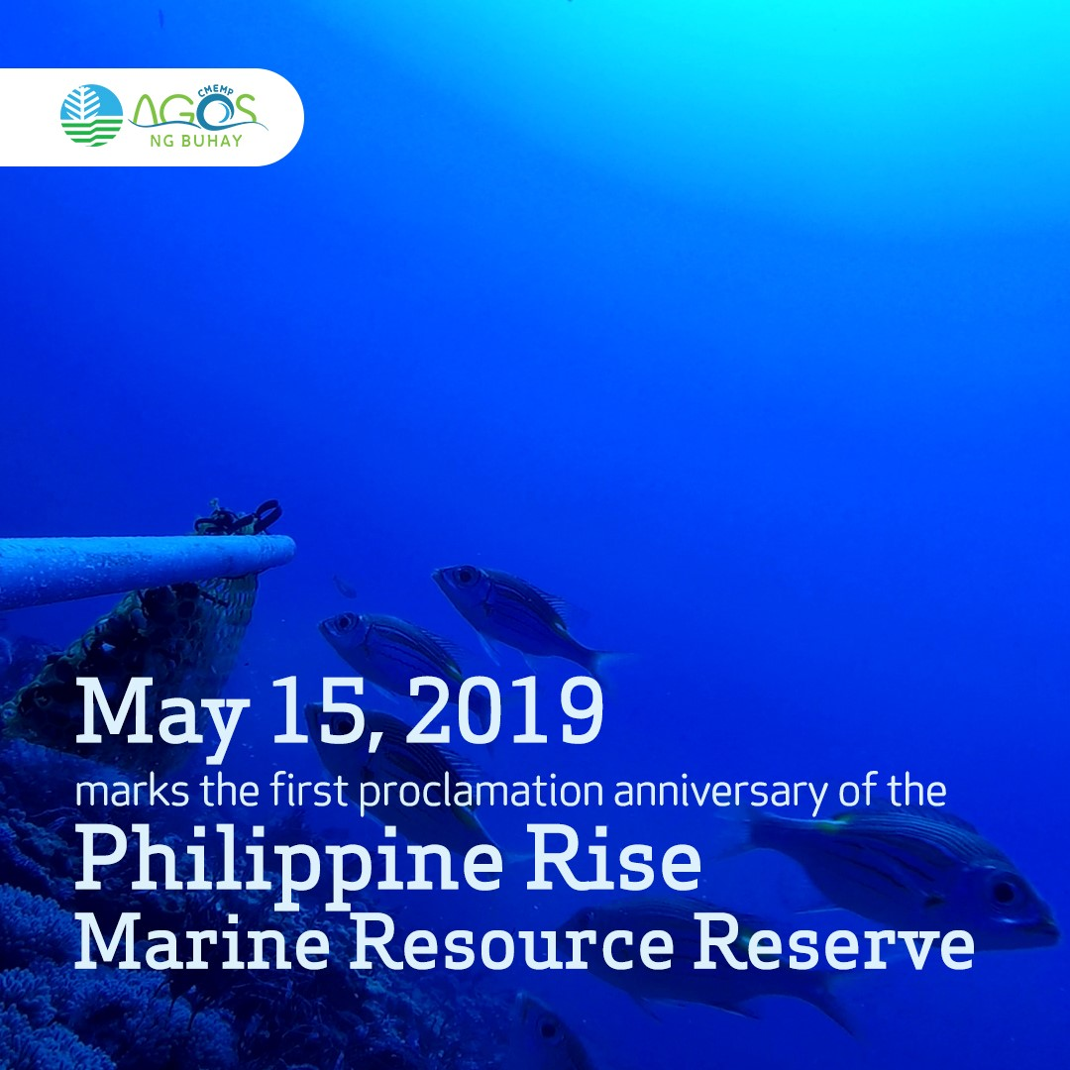
MPAs
Programs/projects/activities related to CTI-CFF goals (but not directly budgeted under CTI-CFF programs)
Passage of Republic Act 11038 and approval of DAO 2019-05
Establishment of MPAN locally managed to form part of buffer zone in Sarangani Bay Protected Seascape
TWG meeting on Marine Turtle Protected Area Network (MTPAN)
MPA Awards and Recognitions (Para El Mar) for MPAs locally managed, Best Mangrove Award, MPA Network Awards and MPA NIPAS Award
Policies Formulation e.g., Vulnerability Assessment (VA), Guidelines on the establishment of Marine Protected Area Network (MPAN), Technical Bulletin on MPAN
National MPA Capacity Building Program
Progress/Accomplishments towards National Plan of Action
Notes:
For Goal 3, Marine Protected Area, we have passed the Republic Act 11038 amending Republic Act 7586, wherein 94 new protected areas under
the NIPAS were proclaimed. Its Implementing Rules and Regulations were also created thru the approval of DAO 2019-05.
Marine Protected Area Networks on locally managed MPAs were established to form part of the buffer zone in Saranggani Bay Protected Seascape.
The Marine Turtle Protected Area Network (MTPAN) held its technical working group meeting.
MPAs, nationally managed or locally managed were recognized and awarded during the Para El Mar Awards and Recognition.
There were also policies formulated and activities undertaken on MPA management such as vulnerability assessment, guidelines on the establishment of MPAN, and technical bulletins on MPAN.
Lastly, we have conducted National MPA Capacity Building Program .

Slide 12
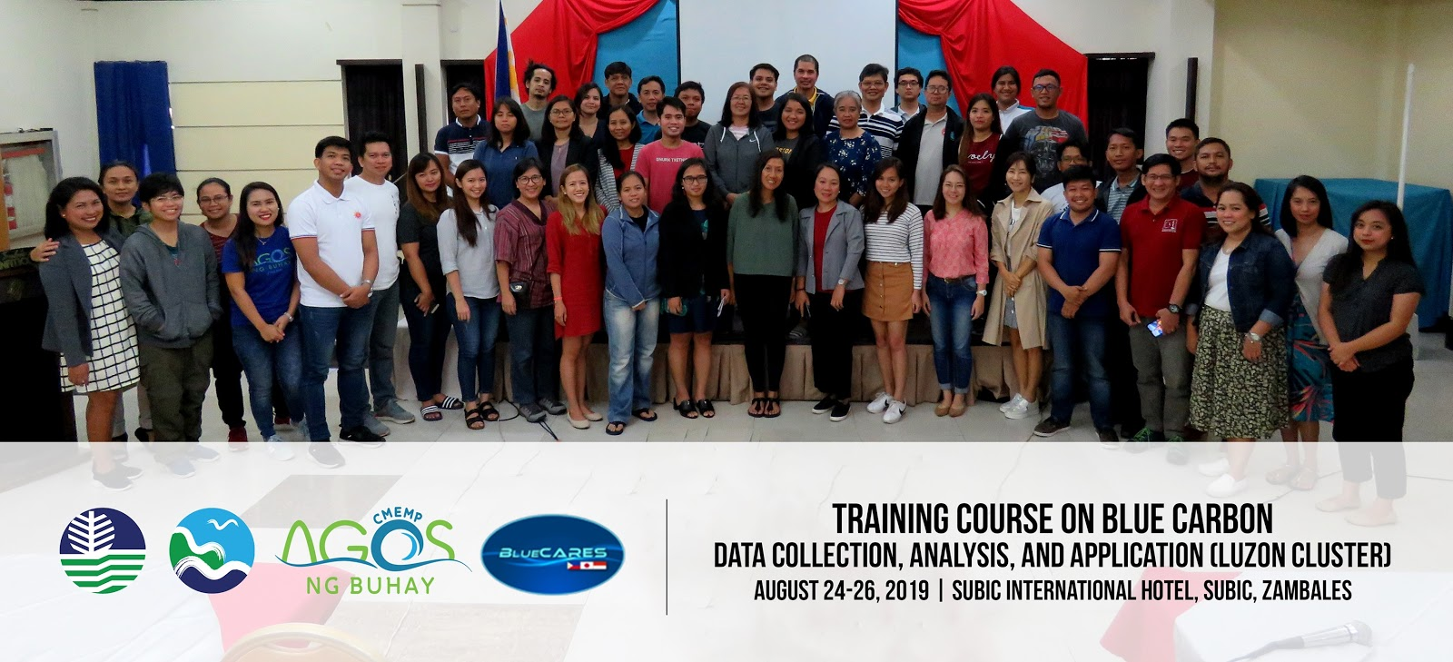
CLIMATE CHANGE ADAPTATION
Programs/projects/activities related to CTI-CFF goals (but not directly budgeted under CTI-CFF programs)
Drafted the Communique on Climate Change for review by the CCA WG
On-going field level implementation on mangrove conservation, rehabilitation, protection and management
Mindoro Mangrove Green Wall Initiative
Green Gray Infrastructure Initiative in Northern Iloilo
Mangrove Rehabilitation and Blue Carbon Assessment in Verde Island Passage
Policy Engagement through the National Blue Carbon WG
National Mangrove Summit (9-10 October 2019)
Blue Carbon Strategy Workshop
Progress/Accomplishments towards National Plan of Action
Notes:
On Goal 4, Climate Change Adaptation, the PH drafted the communiqué on Climate Change for review of the CCA WG, there was also an on going field level implementation on mangrove conservation, rehabilitation, protection and management.
We also have several programs/projects being implemented such as mindoro mangrove green wall initiative, green gray infrastructure initiative in northern iloilo, mangrove rehabilitation and blue carbon assessment in verde island passage.
Through the national blue carbon working group, we strengthen our participation in policy engagements.
We have also conducted national mangrove summit and blue carbon strategy workshop.

Slide 13
CLIMATE CHANGE ADAPTATION
Programs/projects/activities related to CTI-CFF goals (but not directly budgeted under CTI-CFF programs)
Ongoing nationwide CC vulnerability and suitability assessment and mapping of aquaculture and capture fisheries funded by the Philippine Rural Development Project (PRDP)
Issuance of Commission Resolution on the Creation of Blue Carbon Steering Committee and Technical Working Group of the Philippines
Issuance of the Commission Resolution No. 2019-001 “Resolution Adopting a National Climate Risk Management Framework to Address the Intensifying Adverse Effects of Climate Change”
Inter-agency TWG workshops on the development of Blue Carbon Roadmap
Conducted the National Technical Conference on Coastal, Marine and Oceans
On-going updating of the National Climate Change Action Plan (NCCAP)
Progress/Accomplishments towards National Plan of Action
Notes:
In addition, there is an ongoing Climate Change vulnerability and suitability assessment and mapping of aquaculture and capture fisheries.
The Commission Resolution on the creation of blue carbon steering Committee and TWG – the steering committee to provide oversight and approval of the Blue Carbon Roadmap which the TWG will be crafting.
The Resolution Adopting a National Climate Risk Management Framework to Address the Intensifying Adverse Effects of Climate Change Ensures that all policies, programs, and measures classified as climate change, possess the merits of addressing climate risk and also aims to reinforce minimum standards on the nationwide risk assessment
The National Technical Conference on Coastal, Marine and Oceans was conducted to have an Inventory of scientific studies and tools; Policy and Research Recommendation identified as gaps to establish climate risk profiles; Single, unified and standardized platform of the integrated tools aligned to the Climate Risk Management Framework
We have updated the National Climate Change Action Plan (NCCAP) – under the PH climate change act, this plan, should be updated every 5 years from the time of its conception to assess the effectivity, gaps and challenges, and serve as basis for improving the plan of action.

Slide 14
CLIMATE CHANGE ADAPTATION
Programs/projects/activities related to CTI-CFF goals (but not directly budgeted under CTI-CFF programs)
Conduct of trainings on Local Climate Change Action Plan (LCCAP) development, and provided assistance to Department of Interior and Local Government in the formulation of the “LGU Guidebook in the Formulation of LCCAP”
Continuous Technical and policy guidance to the LGUS to access the People Survival Fund (PSF) and Green Climate Fund (GCF)
Continuous mainstreaming of CCA and Climate Risk Management Framework (CRMF) at the national and local level through Training Needs Assessment and Program development and assistance in the development of Climate and Disaster Risk Assessment (CDRA)
Continuous implementation of the BFAR Climate Change - Disaster Risk Reduction Management Strategic Framework.
Progress/Accomplishments towards National Plan of Action
Notes:
Moreover, we have provided technical assistance through the conduct of trainings on LCCAP and in formulation of LGU Guidebook in LCCAP formulation.
We have given continuous assistance and guidance to the LGUs to access the people survival fund and green climate fund.
We pursue the mainstreaming of CCA and Climate risk management framework at the national and local level and develop climate disaster risk assessment. We also implement the BFAR Climate-Change Disaster Risk reduction management Strategic framework.

Slide 15
CLIMATE CHANGE ADAPTATION
Programs/projects/activities related to CTI-CFF goals (but not directly budgeted under CTI-CFF programs)
Conduct of the National Coastal Fisheries Summit and issuance of League of Municipalities of the Philippines (LMP) Resolutions for the President on the ff:
Strengthening of Coastal Fisheries Governance to ensure preferential rights by municipal fisherfolk over the use of coastal and marine resources
Strengthening of coastal and fishery law enforcement in coastal communities
Improving functionality of current MPAs and fish sanctuaries, establish and strengthen new one to ensure sustainable and resilient habitats, fisheries and communities
Mainstreaming of Coastal Resources and Fisheries in the Climate Change Programs and Policies
Prioritization and provision of adequate financing for sustainable coastal resources and fisheries management programs
Progress/Accomplishments towards National Plan of Action
Notes:
Lastly on CCA, the League of Municipalities of the Philippines calls the DA-BFAR, DENR and CCC to form a Technical Working Group (TWG) lodged under the Coastal Fisheries Task Force on Climate Change and coastal resources and fisheries sector to mainstream coastal and fisheries in the government’s climate change programs and policies, on the international, national and local levels. This also shall assess the impacts of climate change on the sector and build the resilience of the sector against climate change effects.

Slide 16
THREATENED SPECIES
Programs/projects/activities related to CTI-CFF goals (but not directly budgeted under CTI-CFF programs)
Finalization of the National Conservation Plan of Action for Marine Turtle and Dugong
Conducted marine turtle conservation and hatchery management training for local stakeholders in Sarangani Province (14-18 October 2019
Trainings on Identification of Sharks and Rays
Turtle Island Heritage Park Protected Area (TIHPA) Bilateral Agreement with Philippines and Malaysia (On-going)
Ongoing IUCN red list assessment of aquatic organisms being conducted by the Philippine Aquatic Red List Committee pursuant to FAO 233
Progress/Accomplishments towards National Plan of Action
Notes:
Moving on the Goal 5, which is the Threatened Species, we have already finalized the National Conservation Plan of Action for Marine Turtle and Dugong.
We have conducted as well, the training on marine turtle conservation and hatchery management for local stakeholders in Saranggani Province.
Together with some of the NGOs, we have conducted trainings on Sharks and Rays identification. This is to raise awareness on the species that should be protected and conserved.
Also, there is an on-going TIHPA Bilateral agreement between the Philippines and Malaysia.
Lastly, we have an on-going IUCN red list of assessment of aquatic organisms including threatened species conducted by the Philippine Aquatic Red List Committee.

Slide 17
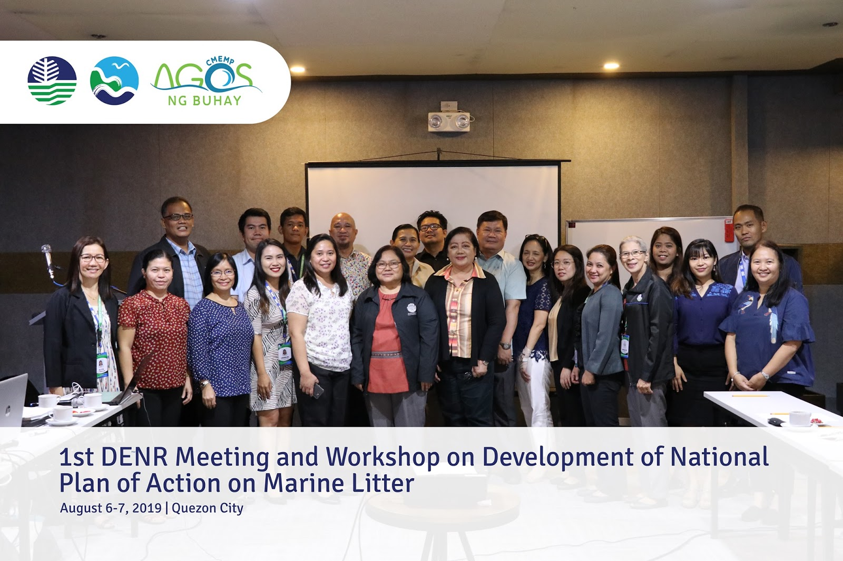
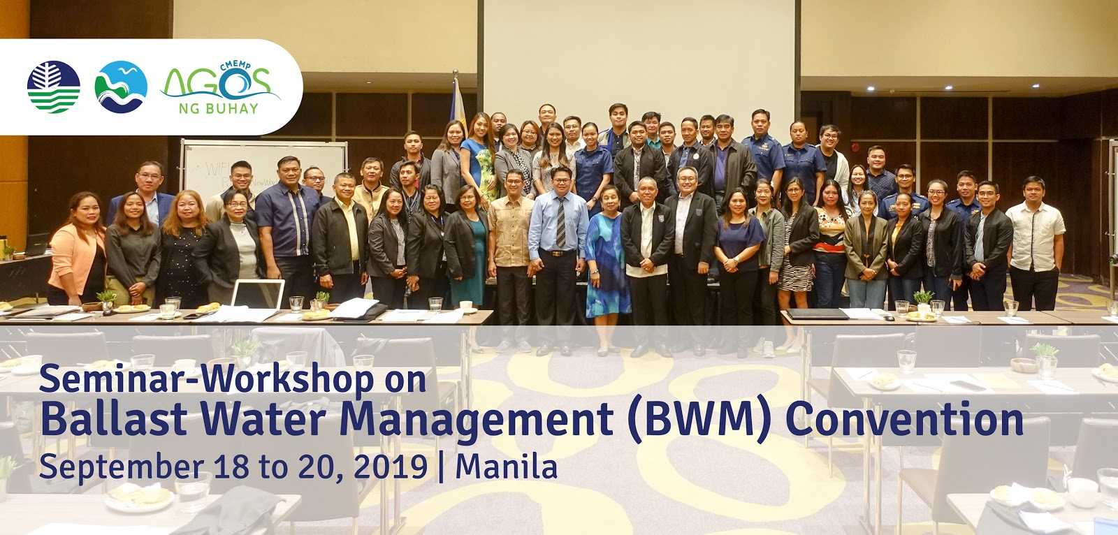
CROSS CUTTING ACTIVITIES
Threat Reduction
Notes:
As part of the Cross-Cutting activities, PH have conducted several workshops such as development of National Plan of Action on Marine Litter and Seminar Workshop on Ballast Water Management Convention

Slide 18
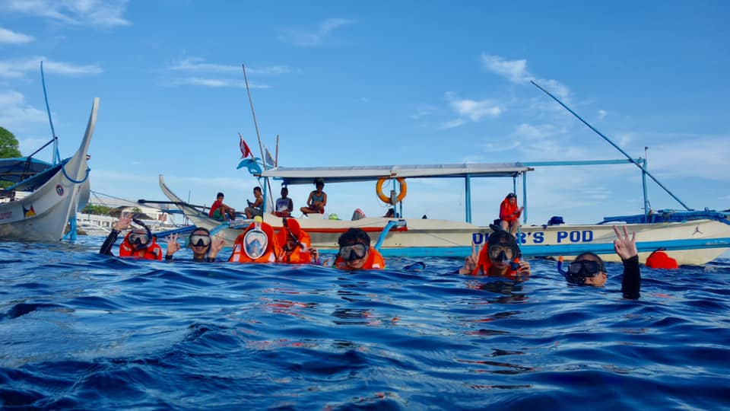
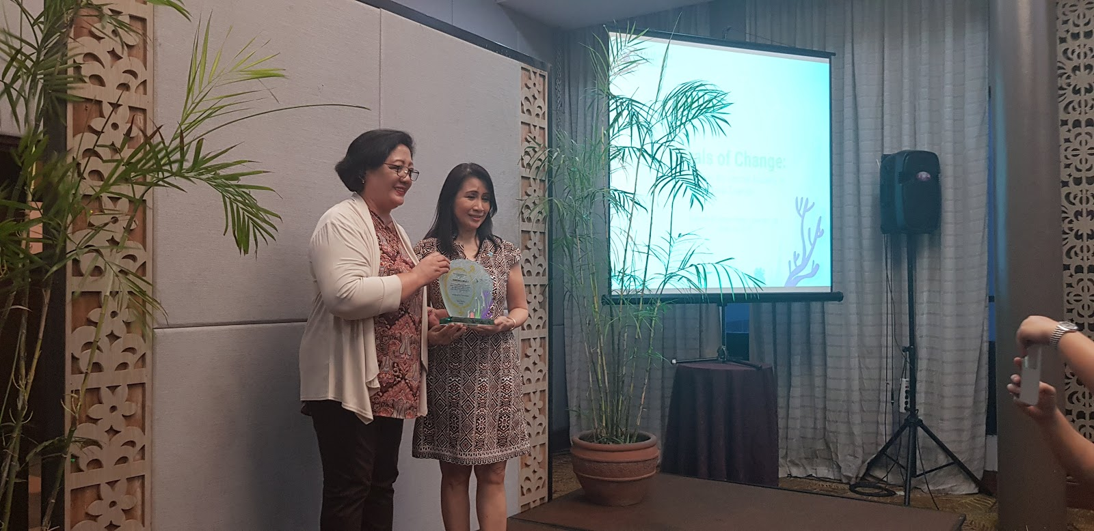
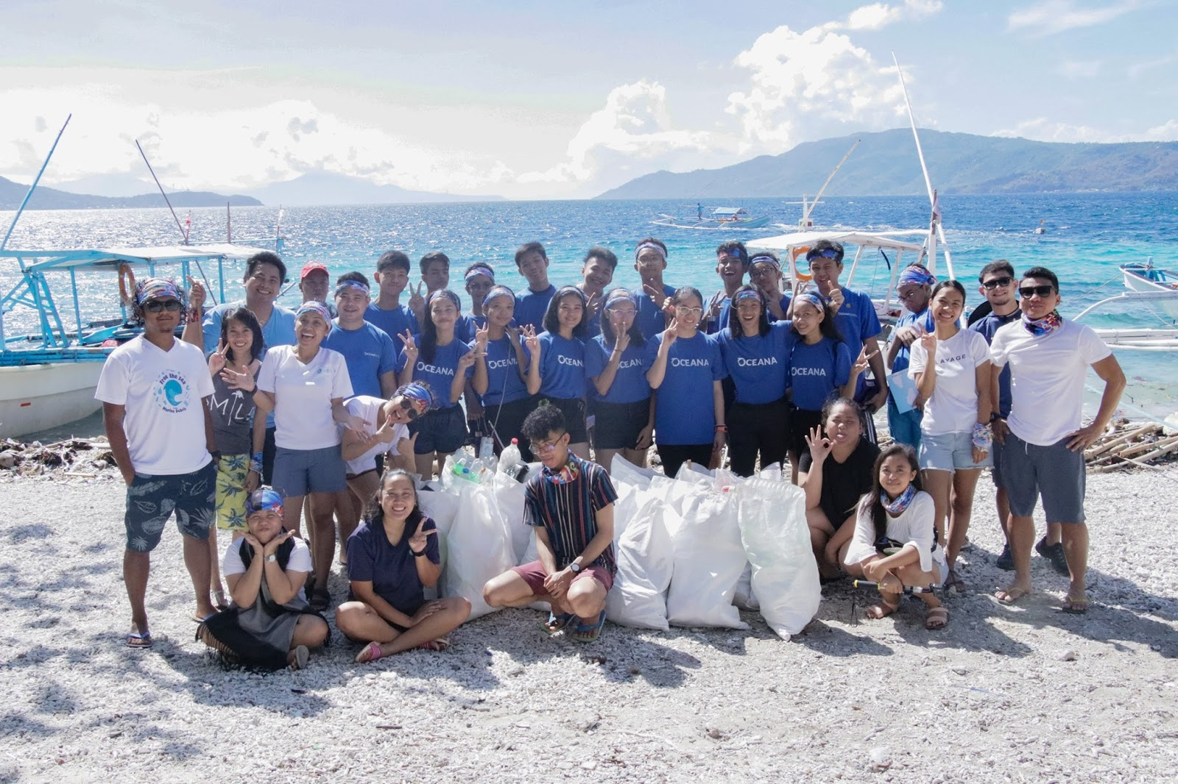
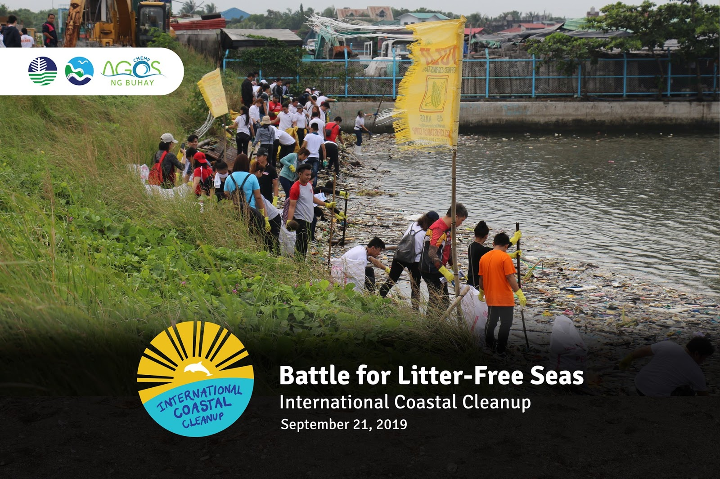
CROSS CUTTING ACTIVITIES
CT DAY CELEBRATION
Notes:
We have conducted activities in line with the CT Day Celebration.

Slide 19
IV. Challenges/Constraints Affecting Implementation of Activities
Institutional
Change in leadership/management of government offices, including political dynamics both at the local and national level
Lobbying with the Local Chief Executives to prioritize conservation and environmental protection and to ensure their strong support on the sustainable localization of programs/projects
Weak linkage between the scientific community and relevant government agencies to formulate a science-based IEC materials/ action/ policy/ strategy
Donor-driven programs must be transformed into programs that are sustainable, promotes community-ownership, and manifests what the community really needs.
Socio-Economic
Poverty in some areas wherein the pressure and threats on the blue carbon ecosystems are high
Notes:
Moving on, among the challenges encountered by the PH NCCC in implementing the NPOA are:
Specifically on institutional aspect: the change in leadership of government offices, including political dynamics both at the local and national level has a great impact on achieving the targets in NPOA.
Noting also that we need to lobby with the local chief executive the importance of conservation and environmental protection to gain their strong support on the sustainability of the programs and/or projects.
We also identify as one of the challenges is the weak linkage between the academe and other research institutions with the government agencies in coming up with a an IEC materials/action/policy strategy that is backed up with science.
We have observed that donor driven programs must be converted into sustainable programs that promotes community ownership, and will manifests the needs of the community.
On socio economic: high poverty in some areas is really affecting the implementation of the activities.

Slide 20
IV. Challenges/Constraints Affecting Implementation of Activities
Funding and investment
Inadequate investment on Communication Strategies to strengthen CEPA at the local level
Insufficient funding on researches and on localization process
Sustainable financing for the baselining (gathering of data and field validation) is urgently needed to conduct CEPA properly and avoid misinformation; which might result to maladaptation.
Others
Natural and anthropogenic disturbances (typhoons, earthquakes, floods, climate change, etc.)
Pollution, habitat loss and over extraction of resources
Establishment of West Philippine Sea as one of the priority seascapes under CTI-CFF
Harmonization and standardization of methodologies and approaches is a must; enable effective monitoring and evaluation
Language/dialect barriers must be overcome in order to translate messages and make them appreciate more
Notes:
Further, on funding and investment: there is really an inadequate investment on communication strategies in strengthening Communication, Education and Public Awareness (CEPA) at the local level.
There is also an insufficient funding on researches and on localization process. We also acknowledge that a sustainable financing for data gathering and field validation is really needed for the proper conduct of CEPA.
We also noted that natural and anthropogenic disturbances can hinder the effective implementation of the programs/projects. Acknowledging also that pollution , habitat loss and extraction of resources contributes to the constraints in delivering the targets of NPOA.
The government agencies have their own methodologies and approaches in several activities. It is very important that these methodologies will be harmonized and standardized to ensure that the results/outputs are correct, reliable, and effective.
Moreover, we also recognize that language barriers must be overcome in order to effectively communicate the message for better appreciation.

Slide 21
V. National Roadmap 2020
Initial planning for NPOA version 2
Management Effectiveness Assessments
Vulnerability Assessment in Marine Protected Areas
Implementation of Fish Right Program
Implementation of RA 11038 and its IRR
Redirecting plans for West Philippine Sea as Priority Seascape to a MPA Network
Implementation of Malinis at Masaganang Karagatan (MMK) Program, a National Search for Outstanding Coastal Community
Roll-out of Fisheries Management Area
Development of Marine Litter National Plan of Action
Notes:
To move forward, the PH NCC plans to conduct initial planning for NPOA version 2 now that the drafting of the RPOA 2.O is on going. We also plan to continue the management effectiveness assessments and looking forward for an appropriate and standardized methodologies to be used. We also believe that vulnerability assessments are very important to be conducted in MPAs. We continue to support the implementation of the FishRight Program and the RA11038 and its IRR. We also plan to redirect the plans for West Philippine Sea on becoming an MPA Network instead of being a priority seascape.
Also, we plan to continue the implementation of the National Search for outstanding coastal community to promote sustainable management of coastal resources and to provide incentives to the local government units. As such, we plan to roll out the management strategies of fisheries management areas.
Further, we plan to pursue the finalization of the Marine Litter National Plan of Action

Slide 22
V. National Roadmap 2020
Implementation of National Conservation Plan for Marine Turtle and Dugong
Implementation of National Plan of Action for Sharks and Rays and Napoleon Wrasse
Conduct of NCCC monthly meetings
Participation in the different Working Group meetings, Regional Exchange of CTI-CFF, SOM and MM
Notes:
In addition, we continue to implement the National Conservation Plan for Marine turtles and Dugong, same with Sharks and Rays National Plan of Action.
We also plan to continue the conduct of NCC monthly meetings to promote active participation of the NCC members and provide venue for updating of NPOA implementation.
We also look forward to actively participate in the different working group meetings, regional exchanges, the 16th Senior Officials Meeting and the 8th Ministerial Meeting of CTI CFF.

Slide 23
VI. Potential Regional Program and Support Required
Capacity Building on Appropriate Methodologies on scientific and management effectiveness
Sulu-Sulawesi Regional Strategic Action Program for Sustainable Fisheries Management
Knowledge sharing on best practices re institutional mechanism of other CT6 NCCs
Notes:
In terms of potential regional program and support required, the Philippines acknowledged that there is a need for a capacity building on appropriate methodologies on scientific and management effectiveness for the NCCs and other key implementers of the NPOA.
Also, we hope to implement the Sulu-Sulawesi Seascape Sub-regional EAFM Plan and the Regional Strategic Action Plan to offer opportunities to further strengthen the regional collaboration and implementation of the RPOA/NPOA targets.
We would also like to mention that knowledge sharing on best practices regarding the institutional mechanism of other CT6 NCCs is also needed.

Slide 24
Notes:
Thank you, terima kasih, maraming salamat, tagio tumas, tank u, obrigado

