Slide 1
SOM14
14th Senior Officials’ Meeting
11-12 December 2018
Manila, Philippines
SESSION 10: COUNTRY REPORT
TIMOR-LESTE
MINISTRY OF AGRICULTURE AND FISHERIES

Slide 2
Outline
Background
Technical Working Group Members / Agencies
Progress/Achievements Towards NPOA
Constraints/Issues/Challenges Affecting Implementation of Identified Activities
National Roadmap 2019 Potential Regional Program & Support Required
Documents/Materials/Publications
Way forward

Slide 3
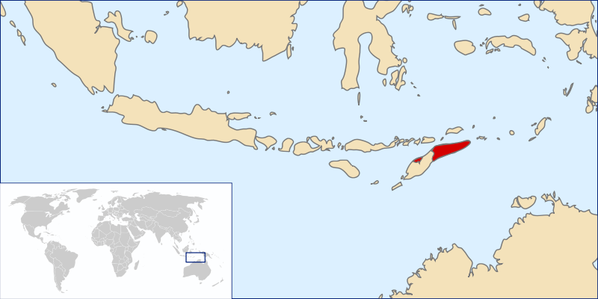
Total Land area of Timor-Leste 14.919 km²
Total Waters area of Timor Leste 79,309 km²
Coastal Line 730 km
Total Fishermen 6000
Total Populations 1.183.643 (2015)
Total Districts 13
Total Sub Districts 64
Total Villages 442

Slide 4
Technical Working Group Members / Agencies
Technical Working Groups
Seascapes | Mr. Antonio de Jesus
EAFM | Dr. Jose Lucas Do Carmo
MPA | Mr. Orlando H. Kalis
CCA | Mr. Rui dos Reis Pires
Threatened Species | Mr. Pedro Pinto

Slide 5
Partners and Status of Partnership
Partners | Status | Projects and Programs
CI | International Agency | MPA( Conservation Area), EAFM(Fisheries Coastal Management Area), Threatened Species(Sea Mammals Conservation), Seascape, Livelihood (Partner with CI & WFC)
UNTL/CCCD | National Institution | Research on climate change and biodiversity
FAO | UN Agency | CCA (Future Plan), ISLME (Transbaundry)
Haburas | National NGOs | Climate Change (Campaign of Marine Environment)
JICA | International Agency | Capacity building (Over Sea Trainings)
CTC | International Agency | MPAs, Woman Leadership , Capacity Building (MPA Connectivity & Learning network), Fisheries Socio Economi Survey,

Slide 6
Partners and Status of Partnership
Partners | Status | Projects and Programs
ROMAN LUAN | National NGOs | MPA (Desimination law and involving local awereness on coastal & marine resources)
PEMSEA | International Agency | Capacity Building (ICM., Manatuto, Dili & Liquica) State of Coast (SOC), NOP
ATSEF (Phase 2 :2017-2020) | International Agency | ICM, EAFM, MPA, Livelihood Program, Pollution

Slide 7
I. Progress/Achievements Towards NPOA
SEASCAPE
CTI-CFF NATIONAL PROGRAMS
Built National Perspectives on the Seascape Management Concept (Seminar and NCC Focus Group Discussion)
Built spatial dataset and its support data through collation available secondary data nationally and globally
Develop scenario area of seascape referred to approximate line on EEZ (not officially) to help better understanding on the mapping and zoning for seascape management
Divided country EEZ into NORTH SEASCAPE and SOUTH SEASCAPE (As indicated in the Map below)
SEASCAPE
PROGRAMS / ACTIVITIES IN RELATION TO CTI-CFF GOALS (but not directly budgeted under national CTI-CFF programs)
Actively engaged in the Lesser Sunda Priority Seascape to be manage as regional seascape with government
Officially endorsed the readiness of the country to propose the country seascape (North and South Seascape into Lesser Sunda regional manage seascape
Commit to provide necessary data required for the completion of its submission processes

Slide 8
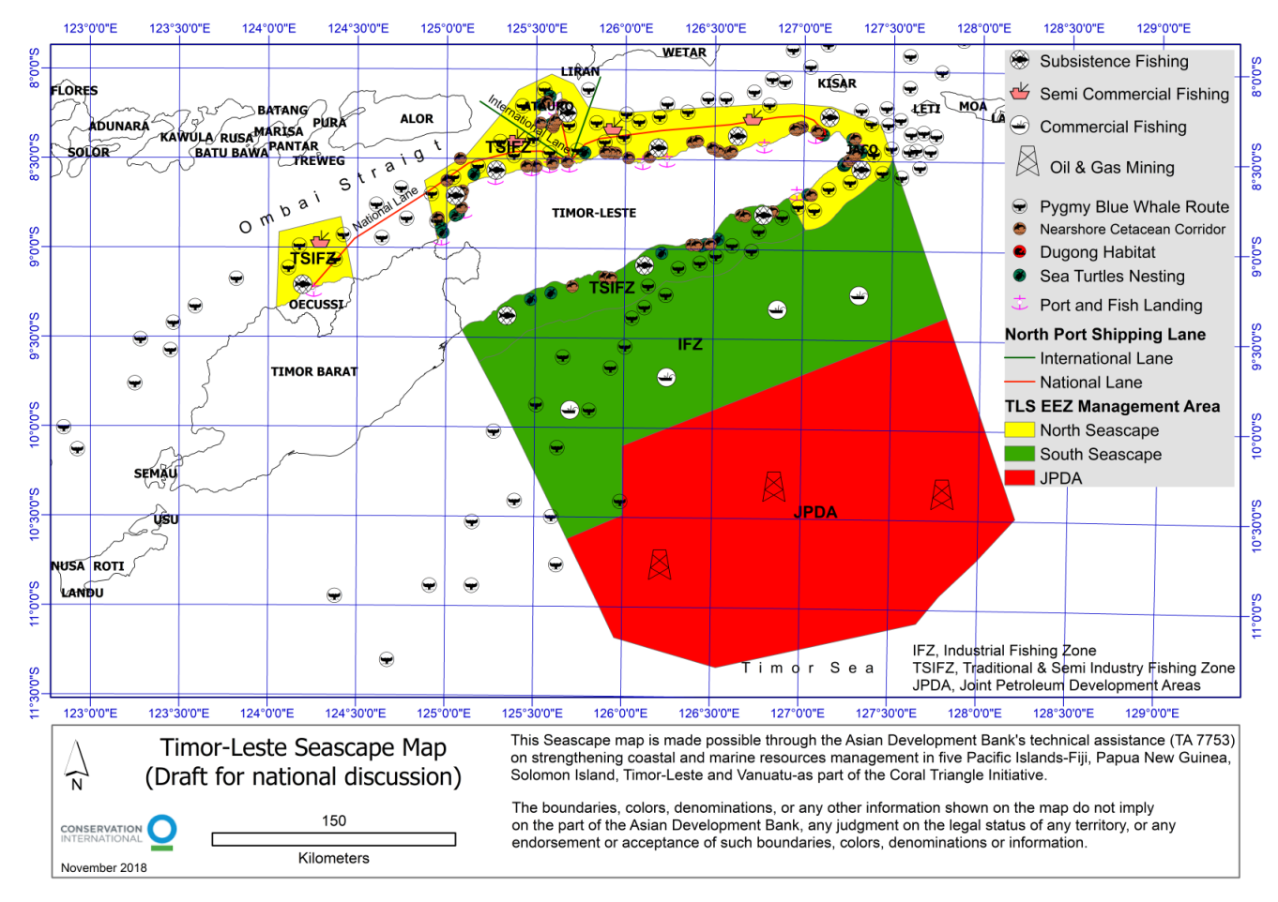
Progress towards NPOA
Goal 1: Priority seascapes designated and effectively managed
North Seascape
ocupied 11,552 Sqkm (21%) of ZEE in the north and small segment of NKSNP Marine Park in the south in distance 12 NM and mainly dedicated for Subsistence fishing, Artisanal Fishing and semi commercial fishing priority for nationals by law (yellow colour on Map)
II. South Seascape:
Comercial Fishing Zone covered area of 25,122 Sqkm (32%) exclude sea within 12NM below (Green on the Map)
Non-Commercial Zone as currently managed as Joint Petroleum Development Area (JPDA) ocupied 37,511 sqkm or 47% of ZEE

Slide 9
Goal 1: Priority seascapes designated and effectively managed (Continue…)
Experiencing Challenges mainly Limited National Experts on the seascape concept and it has limit the national capacity to execute available budget on the seascape)
Lessons Learned (New Concept, synchronize many activities)
Next Steps By 2020, GoTL Should have Resolution on the North Seascape, Seascape Strategy Plan, Expand Resources Mapping & Data Gathering)

Slide 10
I. Progress/Achievements Towards NPOA
EAFM
CTI-CFF NATIONAL PROGRAMS
Installed FAD in selected sites ( Three Municipality)
Initiative value chain function of fishermen
Provide alternative livelihood (processing for diversification of fish product, Seaweed Farm)
Red Snapper Management in South coast
EAFM
PROGRAMS / ACTIVITIES IN RELATION TO CTI-CFF GOALS (but not directly budgeted under national CTI-CFF programs)
1. Desimination of Fisheries Decree law and Regulation
2. Several article review of Fisheries Decree law and
Regulation
3. Coral reef, seagrass and Mangrove monitoring
4. Installed Pelagic Data Systems (PDS) in 8
municipalities

Slide 11
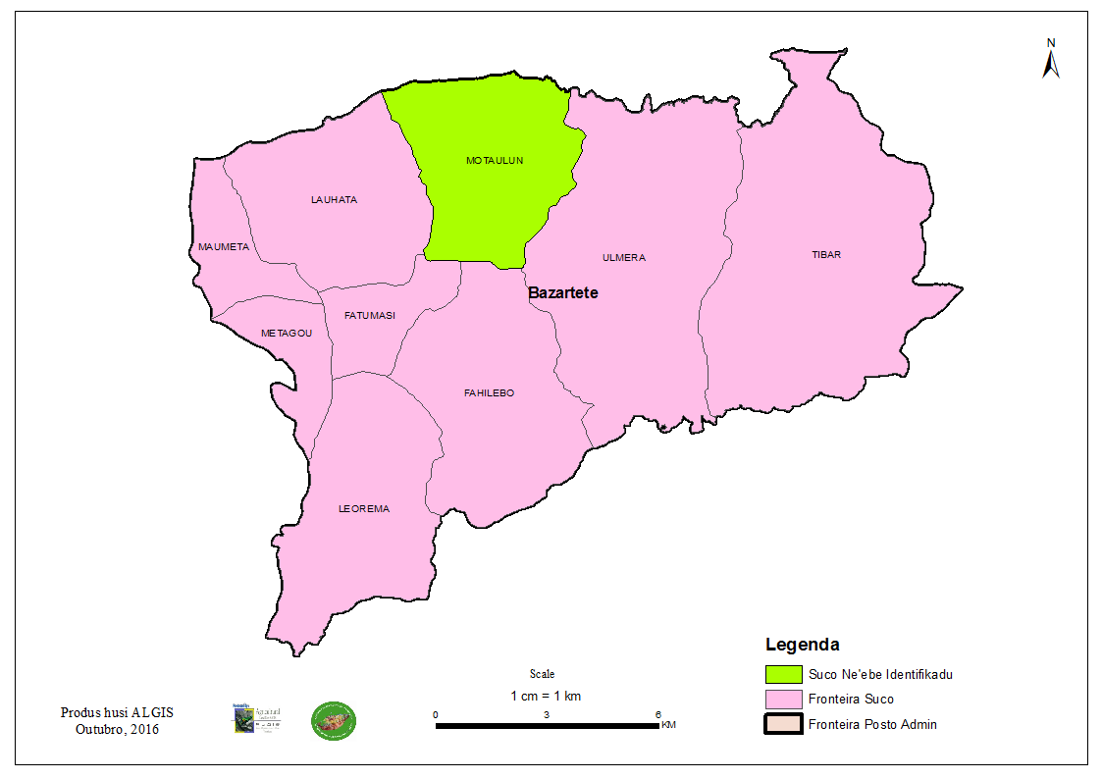
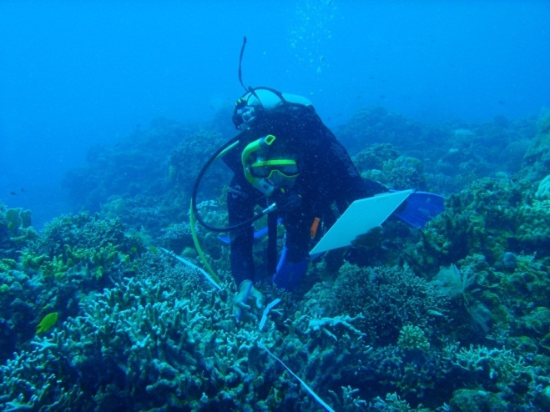
I. Progress/Achievements Towards NPOA
MPAS
CTI-CFF NATIONAL PROGRAMS
By 2018 has increase number of Community Based MPA. Established 12 new MPAs in 2017 and 2018 in Atauro Island and expand existing Vila MPA and its zoning
Established MPA for Dugong and Seagrass in Com in 2018
In total national MPA is 21 stablished
Under progress to be launched 6 MPAs in the next 2 years namely MPA Kaitehu, MPA Maubara Lake, MPA Biacou-Palaka, MPA Be-Malai, MPA Lamsanak, Modomahut and MPA Adarai.
Women’ss household group established (Waste management)
MAF & CTC; Establishment MPA in Atauro Island & Liquica (on progress)
MPAS
PROGRAMS / ACTIVITIES IN RELATION TO CTI-CFF GOALS (but not directly budgeted under national CTI-CFF programs)
Bilateral cooperation under FAO Funded on the ISLME including share management of cross border MPA with Indonesia
NKSNP Marine Park submission as CT MPAs Flagship (But the processes is not completed)

Slide 12
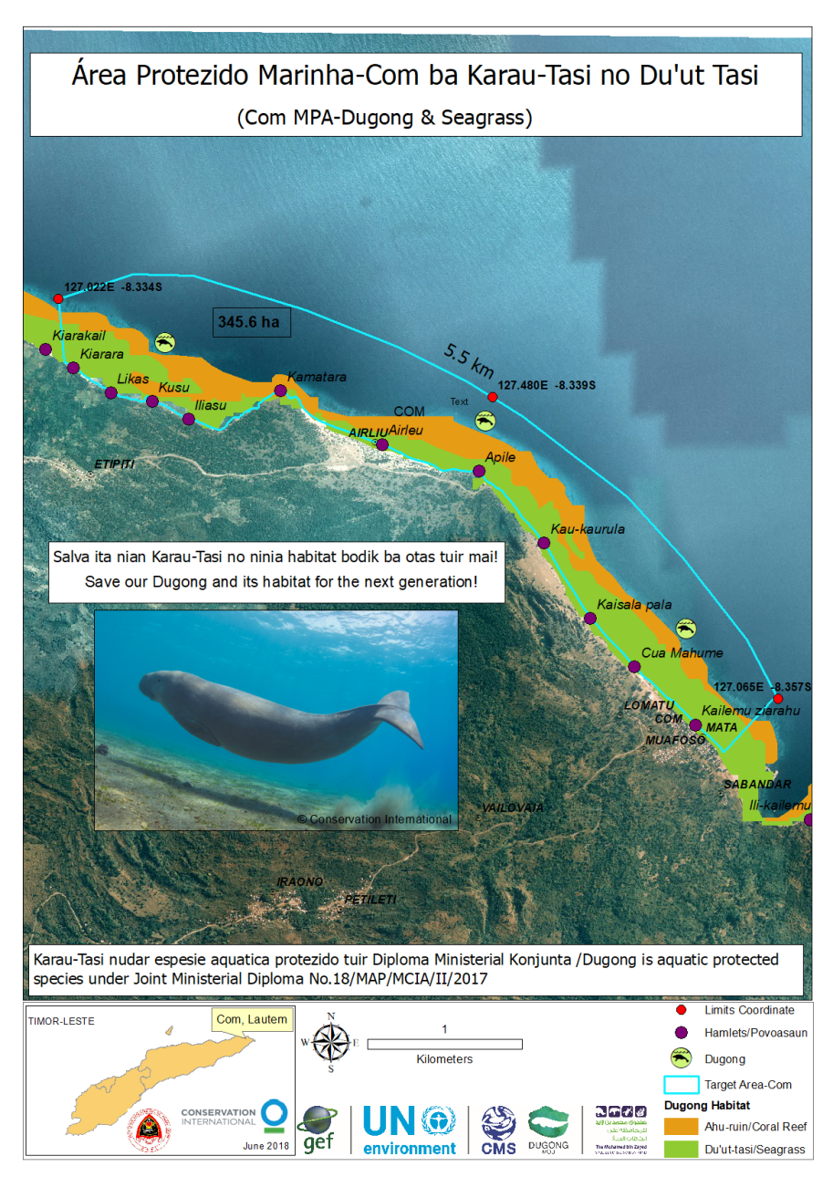
Nino Konis Santana Marine Park MPAs network
7 MPAs in place namly:
MPA Vinano
MPA Souco-Tahimoko
Hilapuna
Pereveno
Djonu
Kusu-Com and
Com-Dugong and Seagrass (345.6 Ha)

Slide 13
Atauro MPAs

Slide 14
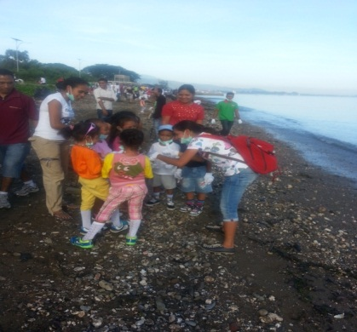
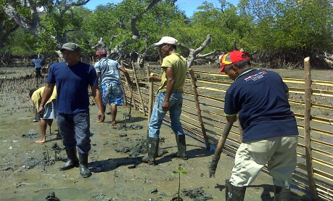
I. Progress/Achievements Towards NPOA
CLIMATE CHANGE ADAPTATION
CTI-CFF NATIONAL PROGRAMS
Establish Center Climate Change and Biodiversity (CCCB-UNTL)
Develop and operate national information network on Climate Changes
Coastal community resilience program in sevens municipality
CLIMATE CHANGE ADAPTATION
PROGRAMS / ACTIVITIES IN RELATION TO CTI-CFF GOALS (but not directly budgeted under national CTI-CFF programs)
Beach Clearning
Zero plastic decree law inplaced

Slide 15
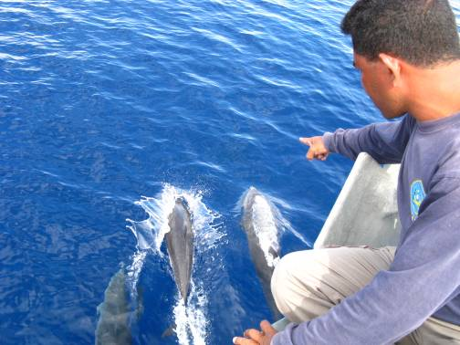
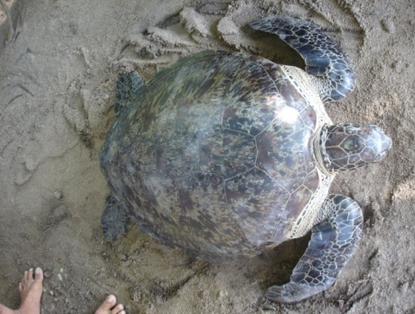
I. Progress/Achievements Towards NPOA
THREATENED SPECIES
CTI-CFF NATIONAL PROGRAMS
Built spatial datasets on cetacean movement in the EEZ Timor-Leste (Megafauna survey, Whale migration, turtles nesting area, dugong seagrass conservation, cetacean scoping survey)
Ministerial Diploma on Protected Aquatic Species
Decree Law on Biodiversity (waiting for promulgation by President of Republic)
Cetacean watching guideline (drafted)
Tourism development policy which included marine based tourism management
THREATENED SPECIES
PROGRAMS / ACTIVITIES IN RELATION TO CTI-CFF GOALS (but not directly budgeted under national CTI-CFF programs)
Participated in the regional TS meeting events but no direct activities implement in the country funds by regional

Slide 16
II. Constraints/Issues/Challenges Affecting Implementation of Identified Activities
Lack of technical assistance & support of
national level due to Limited human resources
IUU-Fishing due to Lack of Inforcemant
Limited of Infracstructure and Public Facilities
Limited of Financial support

Slide 17
III. National Roadmap 2019
CTI-CFF National Programs
Complete Update NPoA
Strengthen NCC CTI CFF (Organizational, Funding, Human Resources)
Coordinate implementation of yearly NPoA priority for 2019
B. National Programs in relation to CTI-CFF RPOA goals but not budgeted as CTI-CFF programs
Contributing to the revision of RPoA 2.0 (Phase 2).
Commit to endorse and promote cooperation on the Lesser Sunda Seascape

Slide 18
IV. Potential Regional Program & Support
Required
Implementing Transboundry MPA Networking
Conectivety Seascape Lesser Sunda ecoregion
Identify potential North and South Seascape of Timor-Leste EEZ

Slide 19
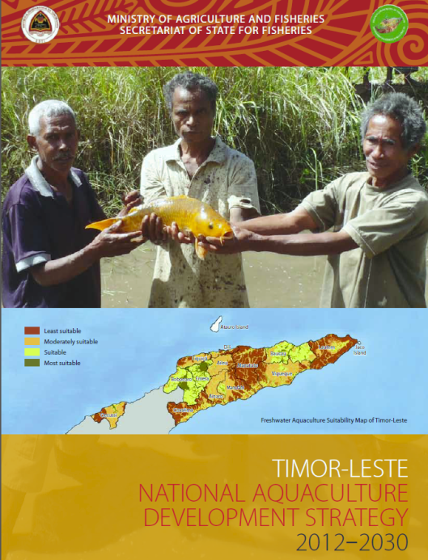
V. Documents/Materials/Publications
CI Marine RAP 2012
CI Marine RAP 2016
NOAA Fish Biomass Assessment
National Ocean Policy (Draft)
5. National Fisheries Strategy Plan (Draft)
6. State of Coast

Slide 20
VI. Way forward:
Need to improve Law Inforcemant
Need to improve capacity building for human resources (Expert and technical )
Need to improve Infracstructure and Public Facilities
Need to Financial support
Mainstreaming seascape
Seascape mapping in high resolution (With details information)

Slide 21
Terima Kasih - Maraming Salamat Tank Iu- Obrigado Tagio Tumas
Photo credits: IYORBank_Rebecca Weeks and Yen-Yi Lee

