Slide 1
© Jürgen Freund / WWF
SESSION 5 :
GOVERNANCE WORKING GROUP – INTERNAL RESOURCE COMMITTEE (IRC)
CHAIR: CHAIR OF IRC (SOLOMON ISLANDS)

Slide 2
Outline
Update of IRC Focal Points
Presentation of HCA Status
Presentation of 2022 Annual Report and 2022 Progress Report
Update of 2022 Country Contribution
Financial: 2021 Audit Report
2022 Financial Utilization
Proposed 2023 Budget and 2024 & 2025 Forecasted Budget
Proposed Country Contribution
RS Governance: Alignment of CTI-CFF Documents
RS Governance: New Staff of the Regional Secretariat
International Events in 2023

Slide 3
UPDATE OF IRC FOCAL POINTS
CHAIR: H.E. DR. MELCHIOR MATAKI PERMANENT SECRETARY MINISTRY OF ENVIRONMENT, CLIMATE CHANGE, DISASTER MANAGEMENT AND METEOROLOGY HONIARA, THE SOLOMON ISLANDS VICE-CHAIR: H.E. ACACIO GUTERRES DIRECTOR GENERAL FOR FISHERIES MINISTRY OF AGRICULTURE AND FISHERIES DILI, TIMOR-LESTE
COUNTRY | FOCAL POINTS | COUNTRY | FOCAL POINTS
INDONESIA | DR. HENDRA YUSRAN SIRY SECRETARY, DIRECTORATE GENERAL FOR MARINE SPATIAL MANAGEMENT MINISTRY OF MARINE AFFAIRS AND FISHERIES, JAKARTA | PHILIPPINES | MR. ANGELITO FONTANILLA DIRECTOR, FINANCIAL AND MANAGEMENT SERVICE DEPARTMENT OF ENVIRONMENT AND NATURAL RESOURCES QUEZON CITY
MALAYSIA | MR. JAMALULAIL ABU BAKAR UNDERSECRETARY, ENVIRONMENTAL MANAGEMENT DIVISION MINISTRY OF ENVIRONMENT AND WATER PUTRAJAYA | SOLOMON ISLANDS | Mr. JACOB AKAO FINANCE CONTROLLER – CHIEF ACCOUNTANT MINISTRY OF FISHERIES AND MARINE RESOURCES HONIARA Alternate : Ms. Ronnelle Panda Deputy Director, Policy and Planning Division Ministry of Fisheries and Marine Resources
PAPUA NEW GUINEA | Mr. JUNIOR HASU Senior Analyst, Renewable Resources Branch, Sectoral Policy Division Department of Treasury Port Moresby, Papua New Guinea Alternate : Ms. Nancy Kavu Manageress, Finance and Revenue Conservation and Environment Conservation Protection Authority | TIMOR LESTE | MR. CELESTINO DA CHUNA BARRETO DIRECTOR OF NATIONAL FISHERIES AND MARINE RESOURCE MANAGEMENT MINISTRY OF AGRICULTURE AND FISHERIES DILI
‹#›

Slide 4
Presentation of HCA Status
Referring to the meeting between Government of Indonesia and the Regional Secretariat on 16 November 2022, there are 2 outstanding articles:
Article 10 : Privileges and Immunities
Article 19 : Entry into force, Duration and Termination

Slide 5
Article 10 : Privileges and Immunities of Executive Director and Deputy Executive Director
Article 10
Privileges and Immunities of Staff Executive Director and Deputy Executive Director
- The Staff Executive Director and Deputy Executive Directors who do not have the nationality of the Host Country, shall, while in the performance of and for the independent exercise of their respective duties, functions and responsibilities, be granted privileges and immunities as stipulated in the Vienna Convention on Diplomatic Relations 1961 and:
a. be immune from legal processes in respect of all acts including words spoken or written performed by him or her while performing in his or her official capacity;
b. be exempt from taxation on the salary and emoluments paid to him or her by CTI-CFF through the Secretariat;
c. Staff’s Executive Director and Deputy Executive Directors’ Immediate Family be immune from immigration restrictions and alien registration;
d. be accorded the same privileges in respect of exchange facilities as are accorded to the official of comparable rank of diplomatic missions;
e. the spouse and immediate families be given same repatriation facilities in times of crisis and as diplomatic envoys;
f. be immune from personal arrest or detention;
g. be immune from seizure of personal and official articles and baggage;
h. have the freedom to maintain, within the territory of the Host Country, or elsewhere, foreign securities, and other movable and immovable property, and while employed by the Secretariat, and at the time of termination of such employment, the right to take out of the Host Country, funds in any foreign currency without restriction or limitation, provided that the said officials can show good cause for their lawful possession of such funds;
i. have the rights to import free of duty and other levies, prohibition and restriction on imports, furniture and personal effects, including one motor vehicle, within six months after first taking up post in the Host Country. The regulations shall apply in the case of importation transfer and replacements of automobiles as are in force for the resident members of diplomatic mission of comparable rank;

Slide 6
Article 10 : Privileges and Immunities of Executive Director and Deputy Executive Director (II)
j. be immune from national service obligations of sending countries.
(1) The Staff Executive Director and Deputy Executive Directors who are not of Indonesian nationality and do not fall under Article 15 (1), shall enjoy:
a. immunity from legal processes in respect of all acts including words spoken or written performed by him or her while in his or her official capacity;
b. exemption from taxation on the salary and emoluments paid to him or her by the Secretariat;
c. immunity from seizure of official articles and baggage;
d. freedom to maintain, within the territory of the Host Country, or elsewhere, foreign securities, and other movable and immovable property, and while employed by the Secretariat, and at the time of termination of such employment, the right to take out of the Host Country, funds in any foreign currency without restriction or limitation, provided that the said officials can show legal document for their lawful possession of such funds;
e. have the rights to import free of duty and other levies, prohibition and restriction on imports, furniture and personal effects, including one motor vehicle, within six months after first taking up post in the Host Country. The regulations shall apply in the case of importation transfer and replacements of automobiles as are in force for the resident members of diplomatic mission of comparable rank; and
f. immunity from national service obligations of sending countries.
(2) Indonesian nationals who are appointed as Executive Director, Deputy Executive Director(s) and Staff shall:
a. comply with the Laws and Regulations of the Host Country and shall not be immune from legal processes within the boundaries of Indonesia; and
b. be immune from seizure of their official articles and baggage.
(3) Staff’s Immediate Family of the Executive Director and Deputy Executive Director, referred to in Paragraph 1 of this Article, shall enjoy privileges and immunities as stipulated in the Vienna Convention on Diplomatic Relations 1961 and Paragraph 1 (v), (vi) and (vii) of this Article.
(4) The Secretariat shall notify the Host Country on matters concerning the employment of its Staff, including the list of names, addresses and nationalities of all its employees.

Slide 7
ARTICLE 10 11
ACCESS, TRAVEL AND RESIDENCE
1. The Secretariat is responsible to arrange for the access, travel and residence of the Executive Director, Deputy Executive Directors, or Professional Staffs, upon the assumption of, or when concluding, their posts or assignment with the Secretariat.
2. The Secretariat must perform such arrangement in consultation and cooperation with the appropriate and relevant authorities of the Host Country in timely manner.
3. The Host Country undertake to facilitate such arrangement, in accordance with the prevailing Laws and Regulations of the Host Country, including in granting where necessary facilities for speedy travel, visas, and staying permits where required promptly to all persons referred in Paragraph 1 of this Article and Staff’s Immediate Family whose members have been duly communicated in advance to the Host Country. (4) The Host Country is required to provide Service Visa to the Professional Staff of the non-Indonesian Nationality engaged by the Secretariat

Slide 8
2. ENTRY INTO FORCE, DURATION AND TERMINATION (Article 18)
1. This Agreement shall enter into force on the date of written notification to the Executive Director by the Host Country of the completion of internal requirements for the entry into force of this Agreement.
2. This Agreement shall remain in force until it is terminated.
3. Either Party may terminate this Agreement by giving a notice in writing of its intention, not less than six (6) months from the intended date of termination.
4. In the event of such termination, this Agreement shall be deemed as in force over a period that the Parties mutually agreed to in writing for the conclusion or settlement of any affairs of the Secretariat and the Host Country which may include the disposal of the Secretariat’s property in the the Republic of Indonesia.
‹#›
2022
Pre-SOM

Slide 9
PRESENTATION OF 2022 ANNUAL REPORT AND 2022 PROGRESS

Slide 10
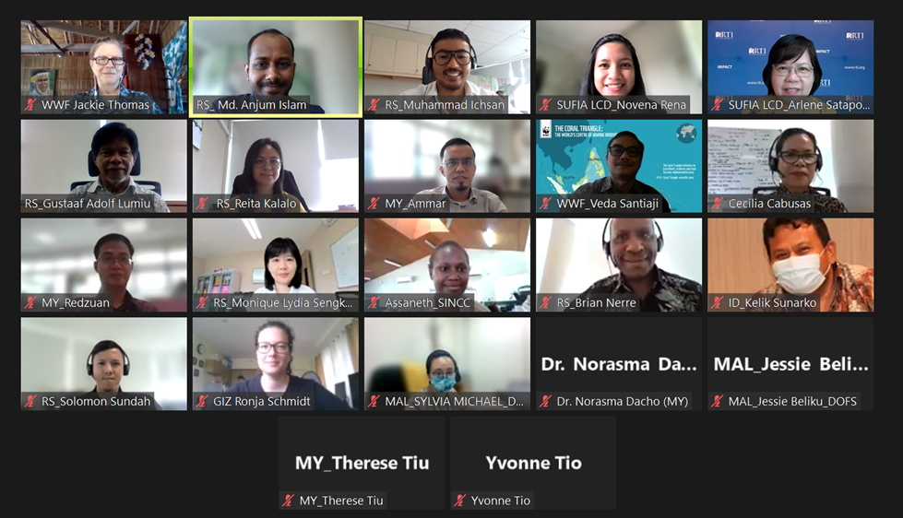
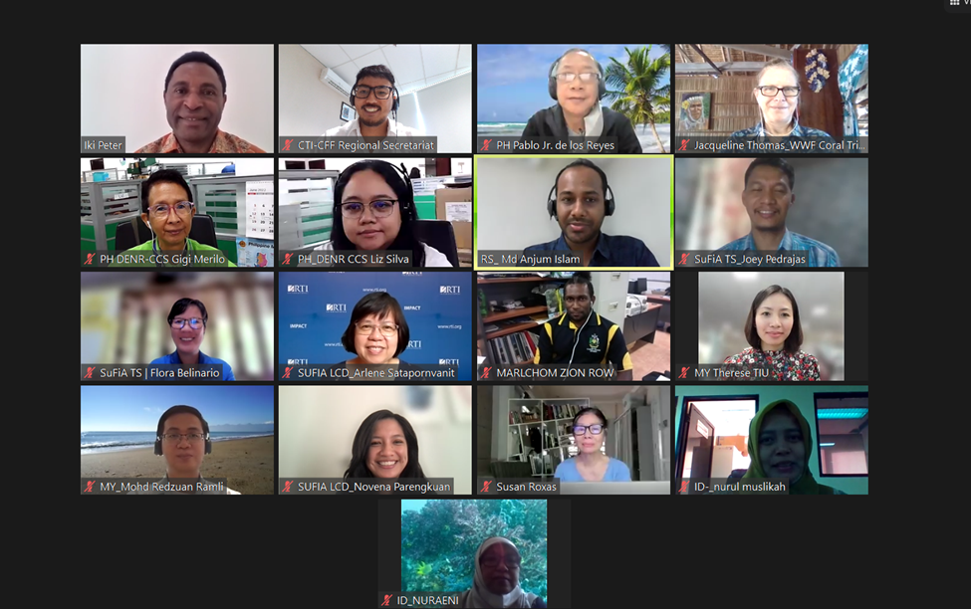
Highlights of 2022 Progress Report
A. RS coordinated and/or facilitated meetings of Technical Working Groups:
2
Seascapes WG virtual meetings
2
Ecosystem Approach to Fisheries Management (EAFM) WG virtual meetings
2
Marine Protected Areas(MPA) WG virtual meetings
2
Climate Change Adaptation (CCA) WG virtual meetings
3
Threatened Species WG virtual meetings
Top: Screenshot of Seascape WG meeting participants
Bottom: Screenshot of CCA WG meeting participants

Slide 11
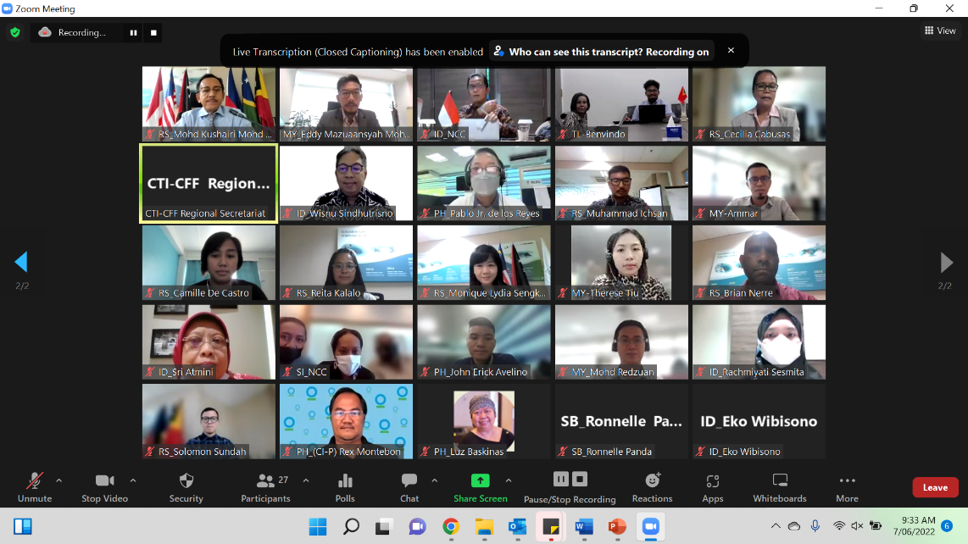
Highlights of 2022 Progress Report
B. RS coordinated and/or facilitated meetings of Governance Working Groups:
1
Internal Resource Committee virtual meetings
()
1
Financial Resources WG virtual discussions
(quorum)
4
Monitoring & Evaluation WG virtual meetings/writeshops
(4 in-situ meetings conducted; 1 postponed)
4
Regional Trust Fund Steering Committee Meeting
Photo: Screenshot of MEWG writeshop participants

Slide 12
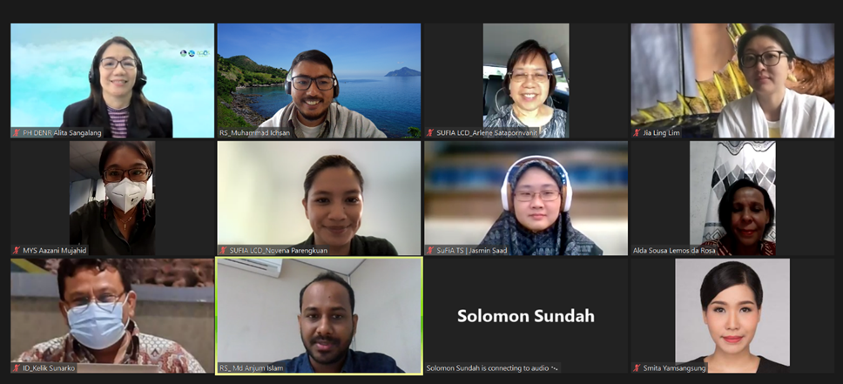
Highlights of 2022 Progress Report
C. RS coordinated and/or facilitated meetings of Cross Cutting Initiatives:
2
Women Leaders’ Forum virtual meetings
(2 conducted)
-
Sustainable Business Forum discussion)
(No discussion so far, coordinated by WWF
and CTC)
1
University Partnership
(Note: 1 meeting with the coordinator)
Photo: Screenshot of WLF meeting participants

Slide 13
Highlights of 2022 Progress Report
D. CTI Partners
USAID RDMA through SUFIA Project
SUFIA Local Capacity Development
Public International Organization Grant (PIO)
SUFIA Technical Support
Wildlife Conservation Society (WCS) and Conservation Finance Alliance
Regional Conservation Trust Fund Development
World Wide Fund for Nature (WWF)
MPA Regional Exchange through the Ocean Governance Project, a workshop in Kinabalu
Plastic Stocktake report
TRIPOD Targeting Regional Investigations for Policing Opportunities & Development
SARRI Shark & Ray Recovery Initiative (SARRI) project

Slide 14
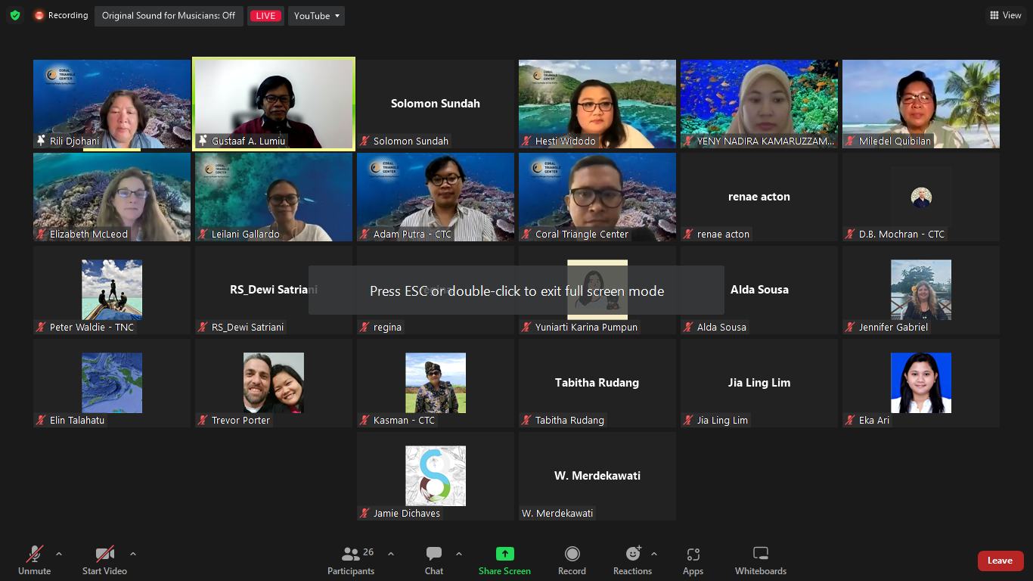
Highlights of 2022 Progress Report
D. CTI Partners (Cont.)
Coral Triangle Center and The Nature Conservancy
CT Day Intervention
Series of Women Leaders Forum Webinars (September and October 2022) in collaboration with TNC:
October: CTC-TNC: Conservation in the Frontlines: Women Leaders Protecting the Coral Triangle’s Endangered and Threatened Biodiversity
November: CTC-TNC: Coral Triangle Women Leaders, Kickstarting Climate Action and Ocean Protection Towards the 30 x 30 Goal
German Agency for International Cooperation (GIZ)
Announced the German Government’s contribution commitment to SOMACORE Programme through the German Federal Ministry for the Environment, Nature Conservation, Nuclear Safety and Consumer Protection (BMUV) under the International Climate Initiative (IKI).

Slide 15
Highlights of 2022 Progress Report
D. CTI Partners (Cont.)
Allen Coral Atlas
Arizona State University and Allen Coral Atlas have performed a presentation during the MEWG meeting, and delivered a draft MOU to RS.
ASEAN Centre for Biodiversity
RS and MPA WG Chair was invited to an event in the Philippines, the MPA WG Chair joined.
The Maritime Institute of Malaysia (MIMA)
RS become one of the speakers in the Seminar on Enhancing Resilience for Sustainable Ocean in the Indo-Pacific: Interventions and Opportunities, on September 2022.
CTI-CFF RS-Partners Hybrid Meeting
In collaboration with CTC and WWF, RS held a meeting with partners (CTC, WWF, WCS, CFA, USAID) discussing the three strategic initiatives: Conservation Trust Fund, Capacity Building Roadmap, and International Policy Engagement.
E. CTI CFF Membership Expansion
- Brunei Darussalam (Follow up on the SOM-12 Decision)
- Singapore
- Thailand

Slide 16
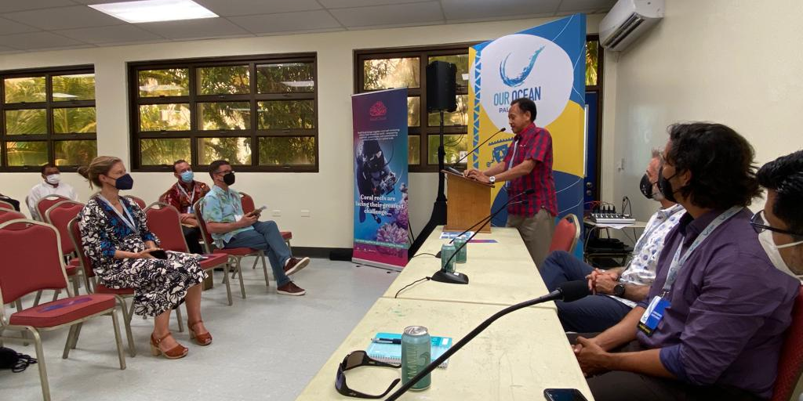
Highlights of 2022 Progress Report
E. Participation in Other International/Regional Activities
Our Ocean Conference, Palau
RS attended the Our Ocean Conference 2022 in Palau and spoke at a side event about the CTI-CFF Regional Trust Fund and initiated communication with potential partners and donors among others the Conservation Finance Alliance.
UN Ocean Conference, Lisbon
RS attended the UN Ocean Conference in Lisbon, Portugal and was invited by the UN Secretary General's Special Envoy for the Ocean, Ambassador Peter Thomson to a high-level breakfast meeting with other head of organizations.
UN Biodiversity COP 15, Geneve
RS attended meetings of the Working Group on the Post 2020 Global Biodiversity Framework and the Subsidiary Body on Scientific, Technical, and Technological Advice earlier in March 2022 at the UN Biodiversity Conference (COP 15) in Geneva. RS participated in two ad-hoc meetings on reef restoration and Resilience Based Management.
UNFCCC COP 27, Egypt
RS attended the UNFCCC COP 27 in Egypt

Slide 17
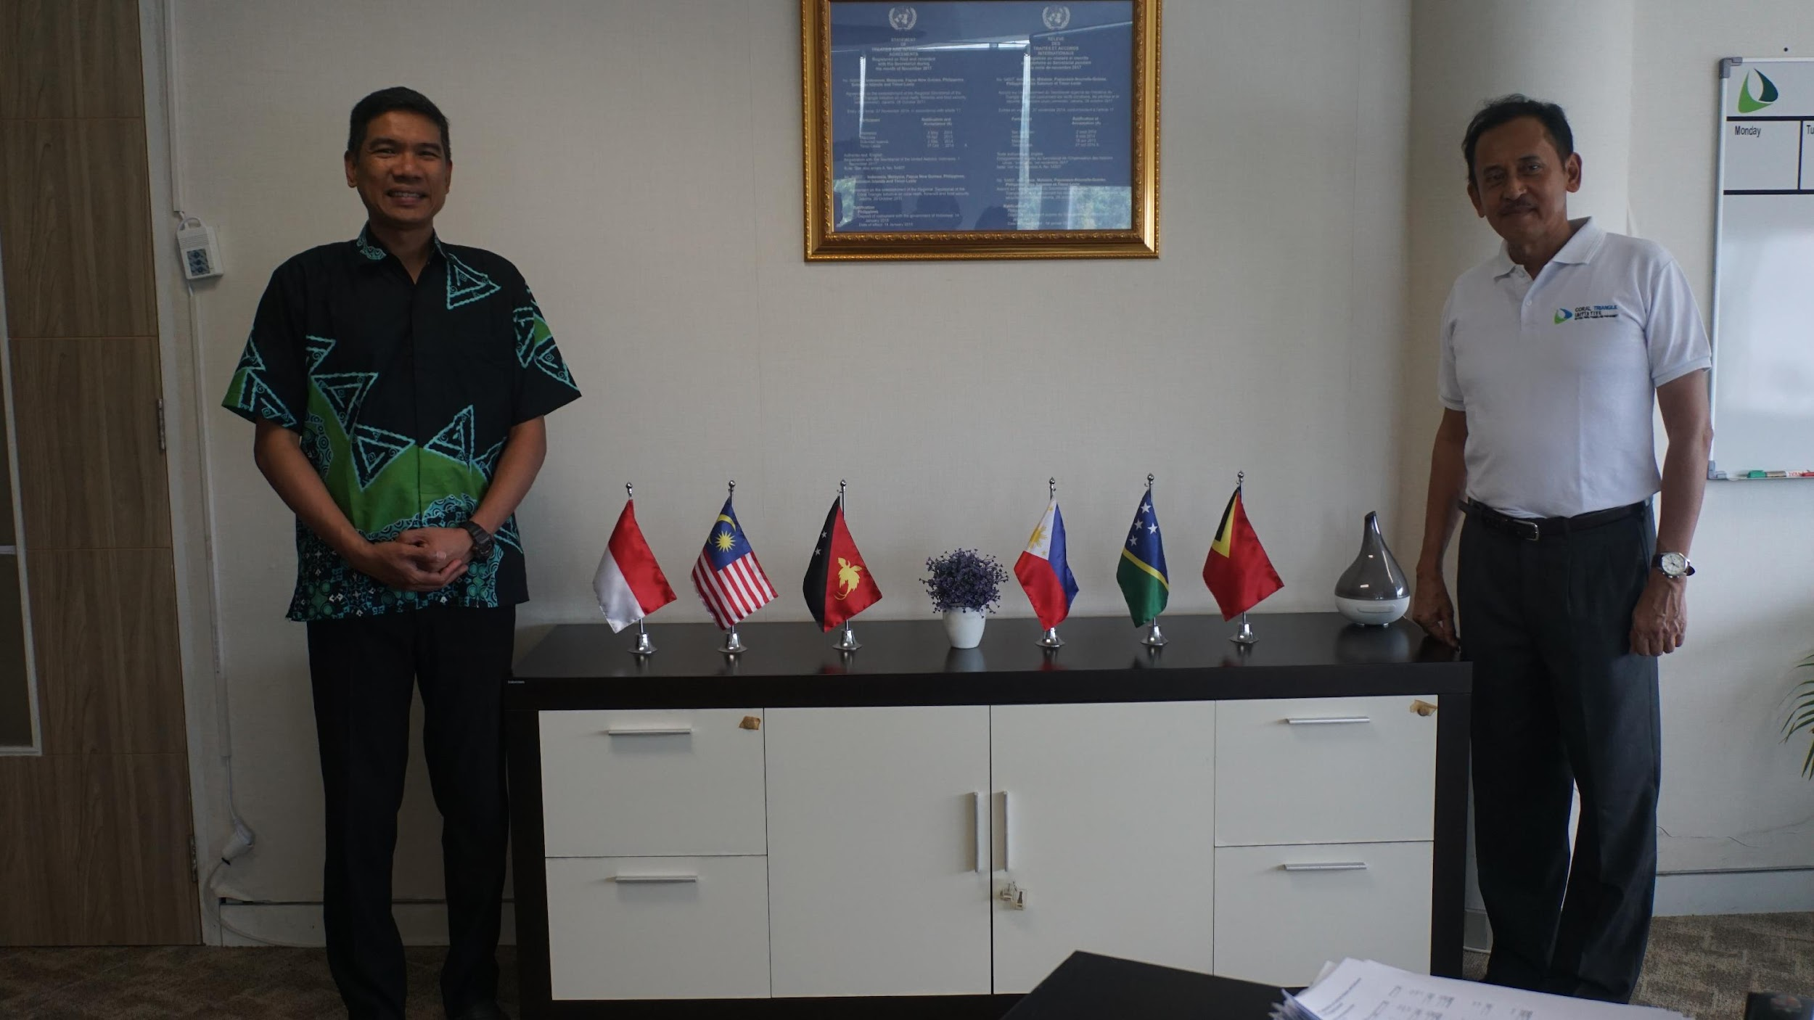
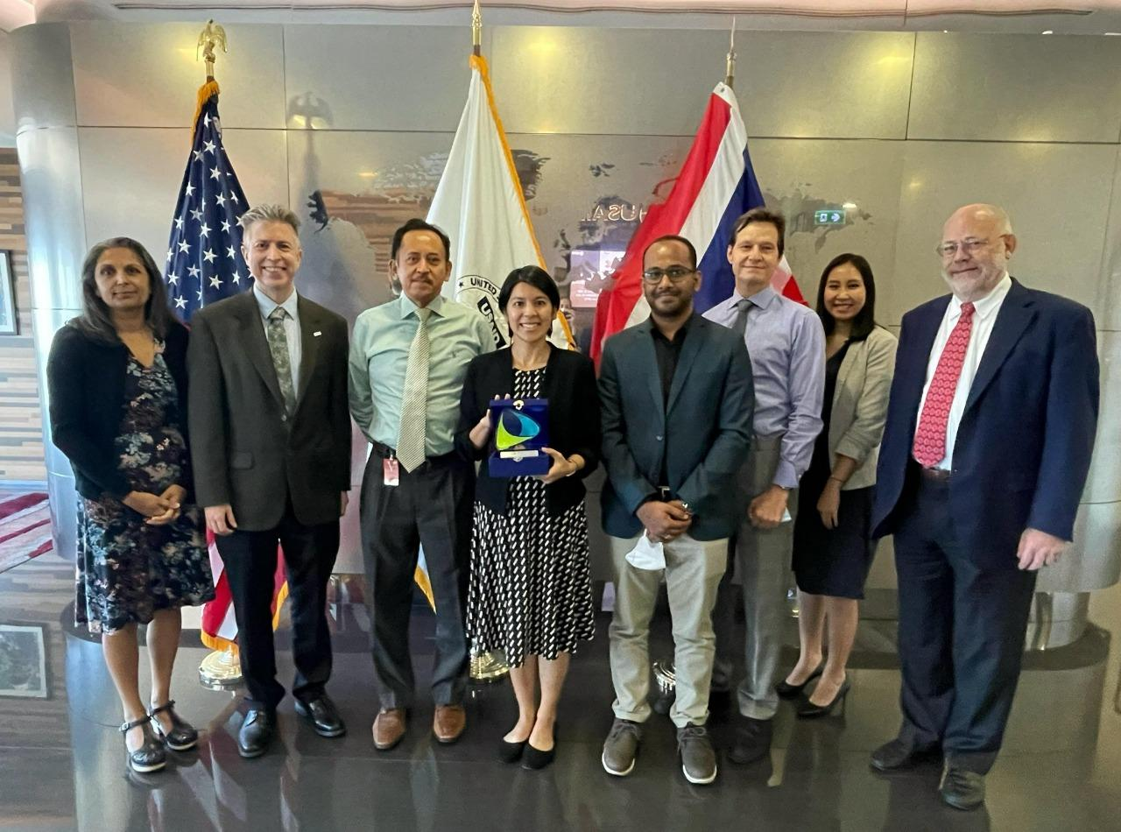
Highlights of 2022 Progress Report
Other Activities
Malaysian Embassy Visit the CTI-CFF RS
The Ambassador of Malaysia and his team paid a friendly visit to RS
The Philippines Consulate General in Manado
RS was invited to the Philippines independent day celebration in Manado
RS was visited by the new Consul General, HE. Angelica C. Escalona of the Philippines
RS visited the Consulate General office in Manado to pay respect to the passing of former President Ramos.
USAID RDMA and SUFIA TS
RS received a visit by USAID RDMA and SUFIA TS to discuss of new projects and activities.
RS visited the USAID RDMA office in Bangkok
Visit to Asian Institute of Technology (AIT)
RS visited AIT to discuss of areas of collaboration including knowledge sharing, capacity building, projects and internships

Slide 18
Highlights of 2022 Progress Report
F. Management of Prime Activities
Host Country Agreement
Organized and facilitated series of virtual meetings for negotiation with the host country
RPOA 2.0
Organized and facilitated the writeshop to finalized the RPOA 2.0 and implementation strategy
Fine-tuned the data collection and information sharing mechanism and finalize the M&E plan framework
CTI-CFF Regional Conservation Trust Fund
Spanning from April to October, the RS coordinated and organized 4 Steering Committee meetings.
Circulated the nomination form for Board of Directors
Screenshot of Participants of Day 2 Special SOM.

Slide 19
Highlights of 2022 Progress Report
Highlights of 2022 Progress Report
G. Corporate & Financial Management
Facilitated and coordinated the conduct the auditing of the 2021 CTI-CFF RS financial statement
Continuous implementation of the COVID-19 Prevention Measures and Response
Some repair works on the 5th floor regarding the leakage, re-painting of the building top of the CTI-CFF RS premises as performed by the MMAF
Coordinated the selection and recruitment process of new DEDPS through the Appointment Committee
Coordinated and facilitated the hiring process for the new CIM, 3 officers (DCDO, Operation Officer, NPPO) and Technical Program Manager (TPM)

Slide 20
Highlights of 2022 Progress Report
H. Communication and Outreach
Involvement of RS in Coral Triangle Day celebration within countries and participated in CT Day event in Perancak, Bali with MMAF and WWF
Assisting the promotion of CT6 activities on CTI-CFF social media platforms
Regular Maintenance of CTI website and social Media platforms
Issuance of Quarterly e-Newsletter
Production and circulation of Annual Report 2021
Publish one article authored by the Executive Director of RS in “A Better World” in conjunction with COP 26.

Slide 21
Highlights of 2022 Progress Report
I. Challenges
Virtual meeting
Postponement of meetings due to absence of quorum
Internet connection in countries
Meeting representation
Schedule of country contribution
J. Way Forward
Socialization of the CTI Regional Plan of Action 2.0
Compilation of CT6 data for M&E plan framework
MOU with Allen Coral Atlas
Finalizing the completion of the governance structure of the CTI-CFF Regional Conservation Trust Fund
Activate the Sustainable Business Forum
International engagement to increase the visibility of CTI globally
Conducting of 2nd Leaders’ Summit

Slide 22
UPDATE OF 2022 COUNTRY CONTRIBUTION

Slide 23
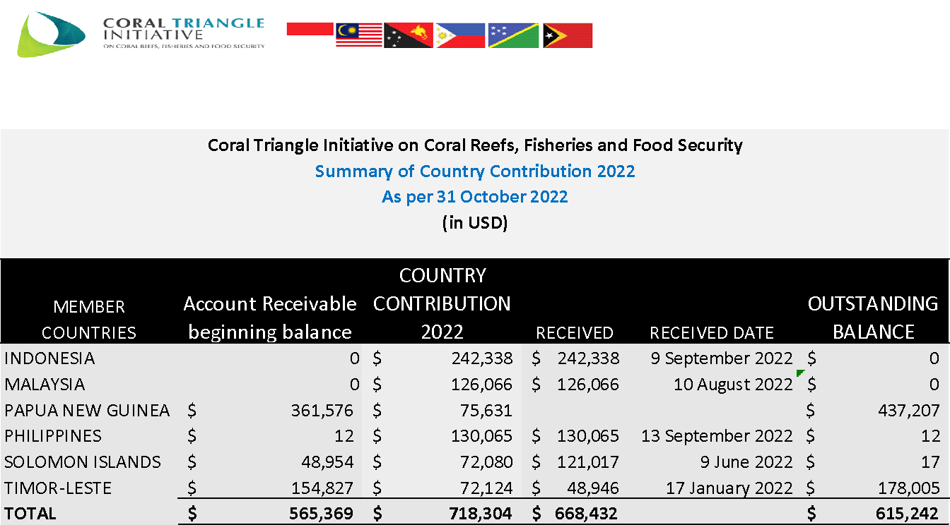
UPDATE ON 2022 COUNTRY CONTRIBUTION

Slide 24
FINANCIAL: 2021 AUDIT REPORT

Slide 25
2021 AUDIT REPORT

Slide 26
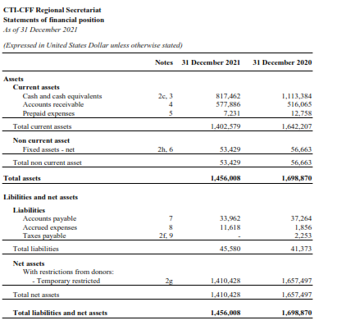
2021 AUDIT REPORT
(CONTINUATION)

Slide 27
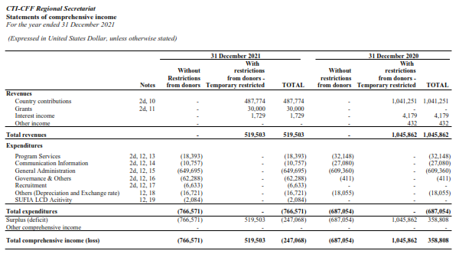
2021 AUDIT REPORT (CONTINUATION)

Slide 28
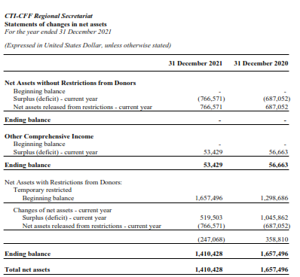
2021 AUDIT REPORT
(CONTINUATION)

Slide 29
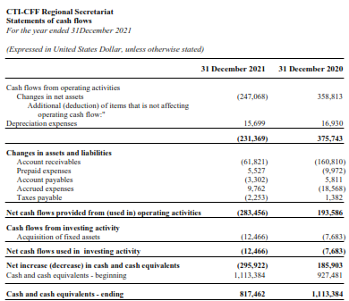
2021 AUDIT REPORT
(CONTINUATION)

Slide 30
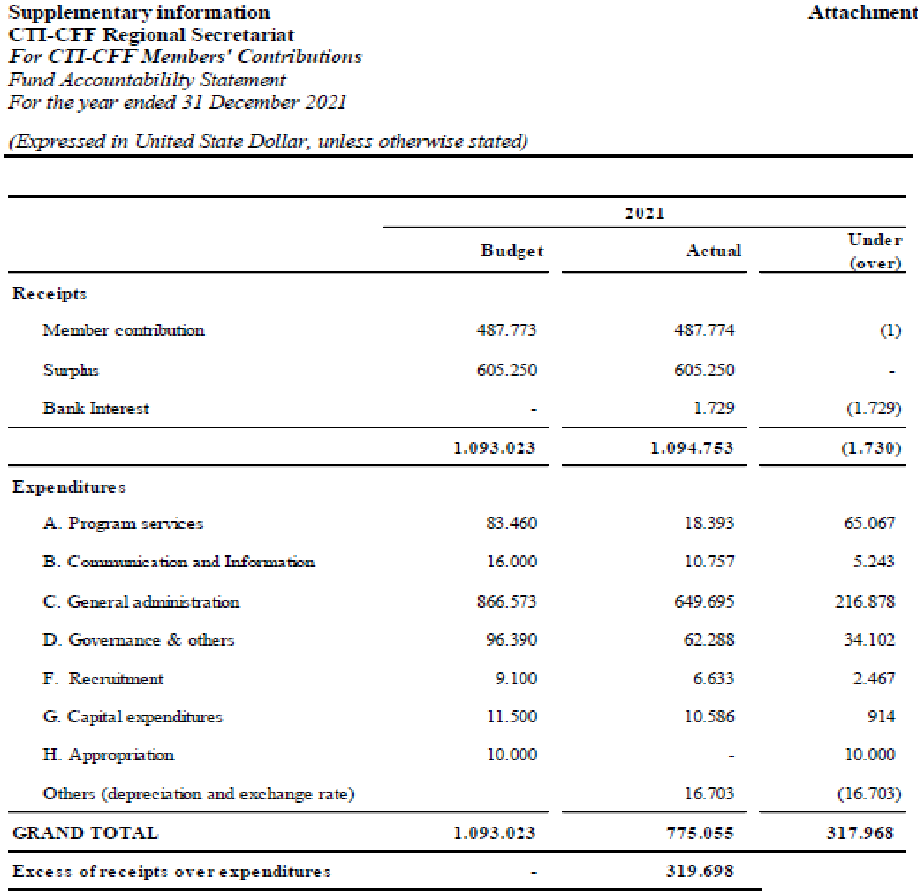
2021 AUDIT REPORT
(CONTINUATION)

Slide 31
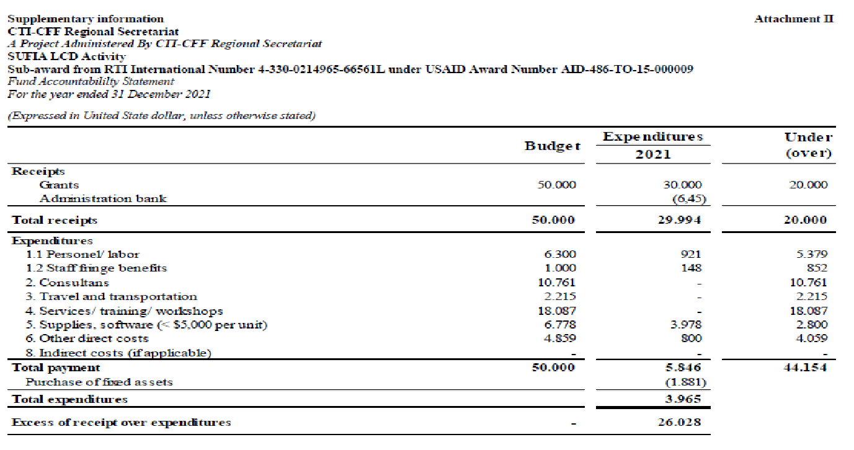
2021 AUDIT REPORT (CONTINUATION)

Slide 32
2022 FINANCIAL UTILIZATION

Slide 33
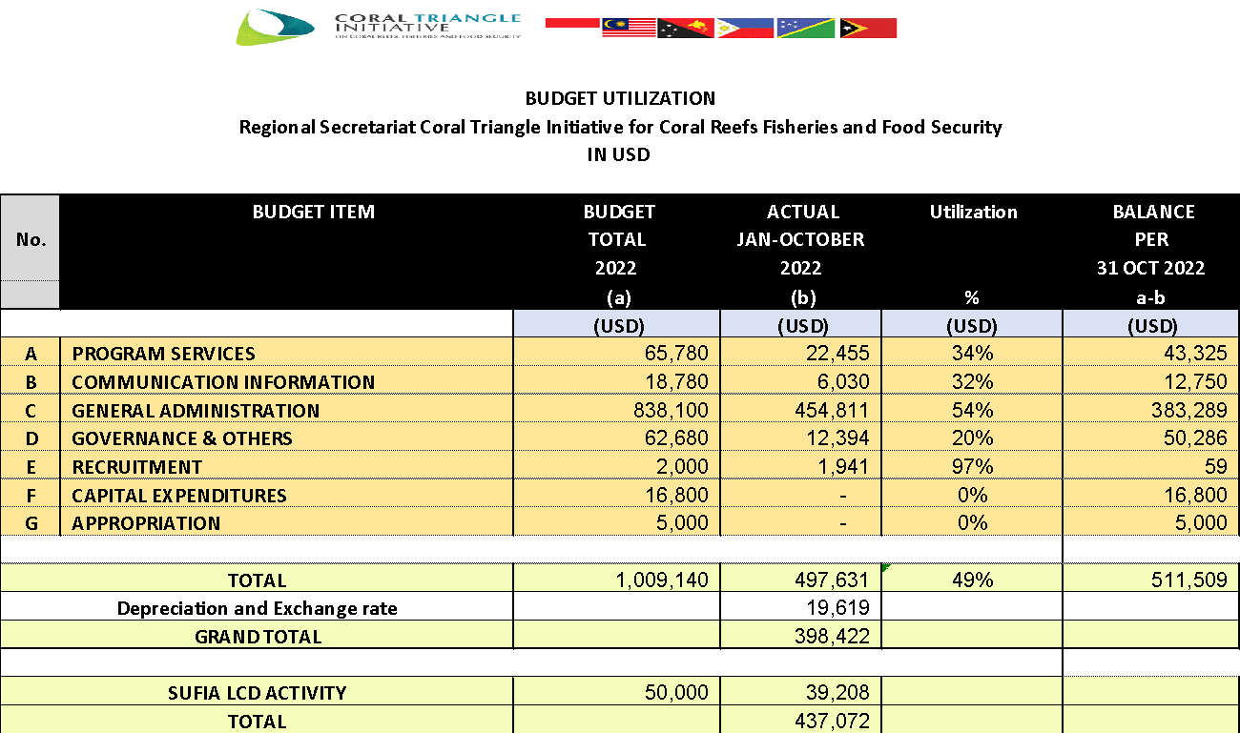
2022 FINANCIAL UTILIZATION

Slide 34
PROPOSED 2023 BUDGET AND 2024 & 2025 FORECASTED BUDGET

Slide 35
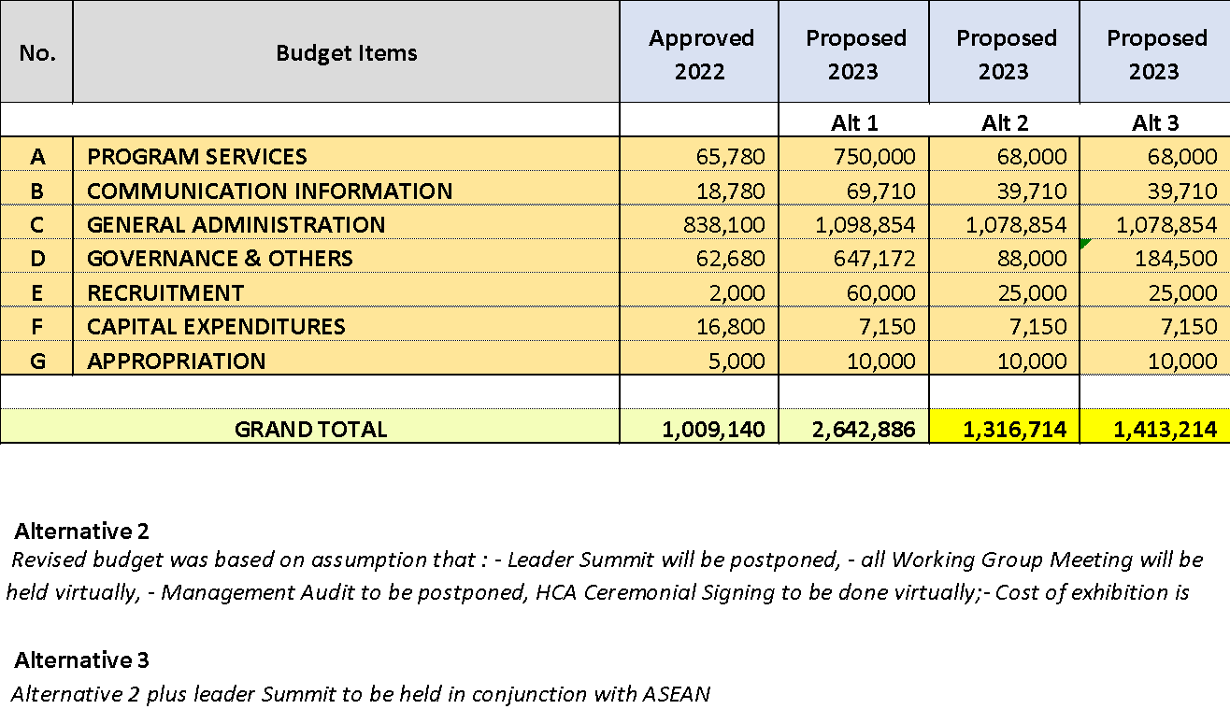
PROPOSED 2023 BUDGET

Slide 36
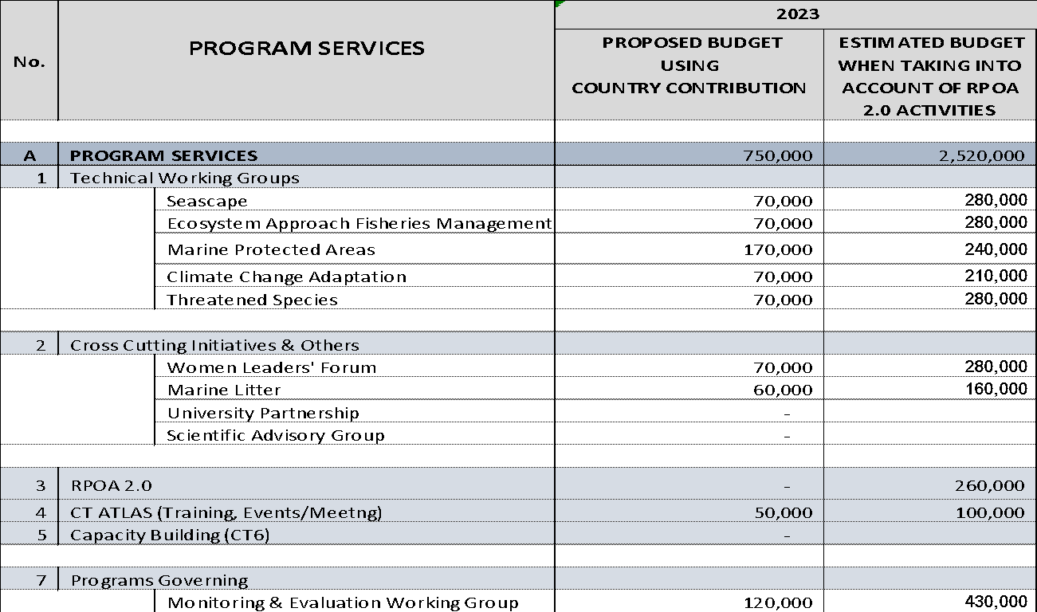
PROGRAM SERVICES
OUTSORCING BUDGET IN SUPPORT COUNTRY CONTRIBUTION
FOR THE IMPLEMENTATION OF RPOA 2.0

Slide 37
PROPOSED 2023 COUNTRY CONTRIBUTION

Slide 38
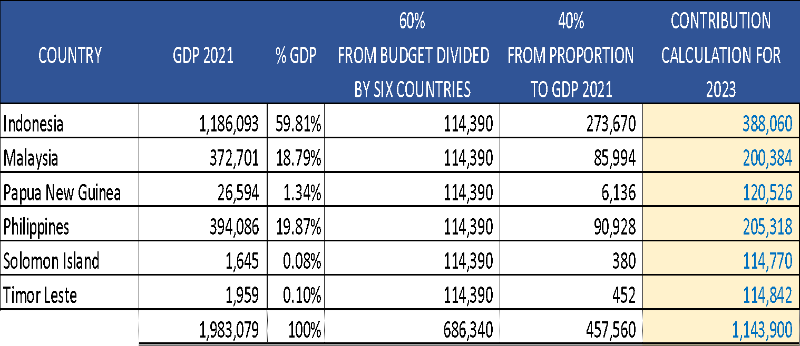
PROPOSED 2023 COUNTRY CONTRIBUTION

Slide 39
RS GOVERNANCE: ALIGNMENT OF CTI-CFF DOCUMENTS

Slide 40
ALIGNMENT OF SOM-15 APPROVED STAFF REGULATION AND FPPM
TO SOM-16 APPROVED SPPM
ORIGINAL TEXTS FROM THE APPROVED SOM-15 STAFF REGULATION | SUGGESTED AMENDMENTS TO BE ALIGNED TO THE SOM-16 APPROVED SPPM
REGULATION 3 DEFINITION
“Staff” means the Executive Director, Deputy Executive Directors, Professional and Support Staff holding a working agreement with the Secretariat. Persons engaged for specific tasks under short-term contract shall not be considered as Staff; and | “Staff” are the Executive Director, Deputy Executive Directors, Professional and Support Staff holding a Working Agreement with the Secretariat, regardless of their nationality. Persons engaged for specific tasks and/or deliverables under short-term service contract shall not be considered as Staff.
“Working Agreement” is an agreement made between the Secretariat and staff that specifies work requirements, rights and obligations of the parties. Based on the relationship of the work, working agreement can be distinguish as follow: i. Working agreement for specified time is an agreement made between the Secretariat and staff for specified time (with a maximum period of three (3) years) or for completion of a specified work or completion of a temporary work. ii. Working agreement for unspecified time is an agreement made between the Secretariat with Staff for a permanent working relationship that is not limited within specified time or specified work. | “Working Agreement” means a written contract between the Secretariat and Staff, which includes work requirements, rights and obligations, both for the Secretariat and Staff and having an expiration date specified in the Working Agreement unless an agreement for a permanent working relationship as per the CTI-CFF Staff Regulations.

Slide 41
ALIGNMENT OF SOM-15 APPROVED STAFF REGULATION AND FPPM
TO SOM-16 APPROVED SPPM (CONTINUATION)
ORIGINAL TEXTS FROM THE APPROVED SOM-15 STAFF REGULATION | SUGGESTED AMENDMENTS TO BE ALIGNED TO THE SOM-16 APPROVED SPPM
REGULATION 3 DEFINITION
“Dependent” includes: i. Any child of a Staff or his or her spouse who is below eighteen (18) years old and who is dependent on a Staff or her or his spouse for their main and continuing support; ii. Any other child who is mentally or physically impaired and is dependent on a Staff or her or his spouse for their main and continuing support; iii. Any other child who is given a home by, and is dependent on, a Staff or her or his spouse for their main and continuing support; and iv. Any person related by blood or marriage for whose main and continuing support a Staff or her or his spouse is legally responsible; | Dependent” means Any child of a Staff or his or her spouse who is (i) below eighteen (18) years old and is dependent on a Staff or her or his spouse for their main and continuing support; and/or (ii) between eighteen (18) and twenty-five (25) years of age, and is attending school or university or vocational training; Any other child, regardless of age, who is mentally or physically impaired and is dependent on a Staff or her or his spouse for their main and continuing support; Any other child, regardless of age, who is given a home by, and is dependent on, a Staff or her or his spouse for their main and continuing support; and Any person related by blood or marriage for whose main and continuing support a Staff or her or his spouse is legally responsible

Slide 42
ALIGNMENT OF SOM-15 APPROVED STAFF REGULATION AND FPPM
TO SOM-16 APPROVED SPPM (CONTINUATION)
ORIGINAL TEXTS FROM THE APPROVED SOM-15 STAFF REGULATION | SUGGESTED AMENDMENTS ALIGNMENT TO THE SOM-16 APPROVED SPPM
REGULATION 12 OVERTIME
The rates of pay for overtime are: 1. For working day, one and half (1.5) times the normal hourly rate for the first hour and double (2 times for) the next hour; and 2. For Saturday and Sundays or public holidays, double (2 times) the normal hourly rate for the first eight (8) hour, triple (3 times) for the ninth hour, quadruple (4 times) for the tenth and eleventh hour.and | 6.The calculation of overtime payment (hourly = 1/173 x a month salary) If overtime is carried out during an office day: For the first hour of overtime, the payment is 1.5 times of an hour salary For the following hour to maximum of 4 hours, the payment is two (2) times the hourly salary Overtime carried out during weekends (Saturday and Sunday) and/or during official holidays not exceeding 8 hours, the payment is two (2) times of hourly salary.
REGULATION 14 : ENTITLEMENTS FOR FIRST REPORTING OF DUTY, RELOCATION AND TERMINATION
The Executive Director shall be entitled to business class travel for international flights exceeding eight (8) hours from his/her last point of residences. All other Staff including the Deputy Executive Directors, and all dependents including the Executive Director’s dependents, will fly economy class unless provided for through arrangements not funded by the Secretariat. | Air travel entitlement for Staff is divided into following domestic and international routes:

Slide 43
ALIGNMENT OF SOM-15 APPROVED STAFF REGULATION AND FPPM
TO SOM-16 APPROVED SPPM (CONTINUATION)
ORIGINAL TEXTS FROM THE APPROVED SOM-15 STAFF REGULATION | SUGGESTED AMENDMENTS TO BE ALIGNED TO THE SOM-16 APPROVED SPPM
REGULATION 18 SICK LEAVE AND MATERNITY LEAVE
2. Host Country Staff shall receive salary during sick leave as according the prevailing regulations. Non-Host Country Staff shall receive full salary during paid sick leave as follows the regulation: a. A Staff who has worked less than one year shall be granted paid sick leave up to two (2) months. b. A Staff who has worked for one year or more shall be granted paid sick leave up to four (4) months on full salary. c. A Staff who is absent from duty because of sickness for a period of more than three (3) consecutive working days, shall produce a certificate from a duly qualified medical practitioner stating the probable duration of his/her incapacity. | Staff who works less than 3 years and who is ill (as proven by physician’s statement) is entitled to 3 months full paid and 3 months half paid. Staff who works over 3 years, in continuous service and does not work due to illness for over twelve (12) months consecutively, is entitled for the next six (6) months full paid and the second six (6) months half paid. This is applicable to all staff despite their nationalities. If the Staff who does not work due to illness for over twelve (12) months consecutively, the Secretariat may terminate the Staff employment at the thirteenth (13th) month. If the foreign staff is in grave health condition (as proven by physician’s statement), the Secretariat shall cover the repatriation of the said staff. This article has been agreed by CT6 considering that RS is an international organization. Complying the rules and regulation of the host country if such article is absent.

Slide 44
ALIGNMENT OF SOM-15 APPROVED STAFF REGULATION AND FPPM
TO SOM-16 APPROVED SPPM (CONTINUATION)
ORIGINAL TEXTS FROM THE APPROVED SOM-15 FINANCIAL POLICIES AND PROCEDURE MANUAL | SUGGESTED AMENDMENTS TO BE ALIGNED TO THE SOM-16 APPROVED SPPM
APPENDIX 11.1 PER DIEM ALLOWANCE

Slide 45
RS GOVERNANCE: NEW STAFF OF THE REGIONAL SECRETARIAT

Slide 46
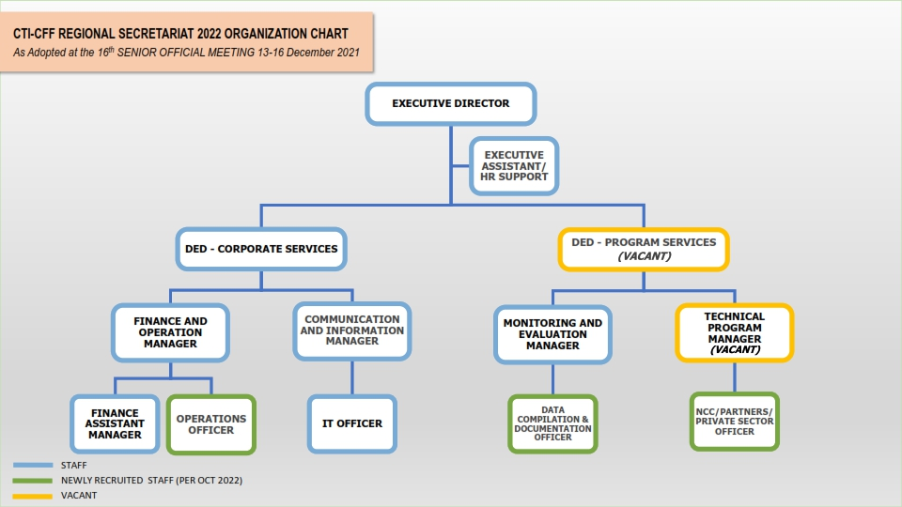
NEW STAFF OF THE REGIONAL SECRETARIAT

Slide 47
NEW STAFF OF THE REGIONAL SECRETARIAT (CONTINUATION)
CONTINUATION OF DEPUTY EXECUTIVE DIRECTOR OF PROGRAM SERVICES (DED-PS) RECRUITMENT IN 2022
DATE | SCHEDULED TIMELINE FOR DED-PS SELECTION (AS AGREED BY APPOINTMENT COMMITTEE ON 16 AUGUST 2021) | ACTUAL ACTIVITIES | REMARKS
NOV 2021 – JAN 2022 | RS TO ARRANGE WORK PERMIT OF NEW DED-PS AND OTHER RELEVANT WORK DOCUMENTATIONS
9 FEB 2022 |  | RS SENT INVITATION FOR THE NEW DATE OF THE 2ND MEETING OF THE APPOINTMENT COMMITTEE ON 22 FEBRUARY 2022
17 FEB 2022 |  | RS FOLLOWED UP WITH PG, PH AND TL ON THEIR SUBMISSION OF SHORTLIST CANDIDATES
20 FEB 2022 |  | RS SENT FOLLOW UP AND LINK TO MEETING | ONLY MY CONFIRMED
21 FEB 2022 |  | RS INFORMED POSTPONEMENT OF THE MEETING AS NO CONFIRMATION AND NO SHORTLIST OF CANDIDATES FROM PH, PG, TL
21 FEB 2022 |  | PG INFORMED THEY WILL SOON SEND THE SHORTLIST OF CANDIDATES AS PER NEW DEADLINE
9 MAR 2022 |  | PH SENT ITS SHORTLISTED CANDIDATES
25 MAR 2022 |  | TL SENT ITS SHORTLISTED CANDIDATES

Slide 48
NEW STAFF OF THE REGIONAL SECRETARIAT (CONTINUATION)
CONTINUATION OF DEPUTY EXECUTIVE DIRECTOR OF PROGRAM SERVICES (DED-PS) RECRUITMENT IN 2022
DATE | SCHEDULED TIMELINE FOR DED-PS SELECTION (AS AGREED BY APPOINTMENT COMMITTEE ON 16 AUGUST 2021) | ACTUAL ACTIVITIES | REMARKS
25 MAY 2022 |  | RS SENT INVITATION FOR THE 2ND MEETING OF THE APPOINTMENT COMMITTEE ON 2 JUNE 2022
26 MAY 2022 |  | MY INFORMED THAT ITS REPRESENTATIVE WON’T BE AVAILABLE ON 2 JUNE AND ASKED FOR NEW DATES
31 MAY 2022 |  | MY INFORMED THAT ITS REPRESENTATIVES WILL BE AVAILABLE ON 14 OR 17 JUNE
1 JUNE 2022 |  | PH INFORMED (THROUGH WA) THAT ITS REPRESENTATIVE HAS A CONFLICTING SCHEDULE TO ATTEND THE 2ND MEETING ON 2 JUNE RS SENT AN ANNOUNCEMENT TO POSTPONE THE MEETING SINCE 3 COUNTRIES (MY,PG,PH) HAD OTHER COMMITMENT
2 JUNE 2022 |  | RS SENT A LETTER TO AC ASKING PREFERRED DATE AMONG NEWLY PROPOSED DATES, BETWEEN 17, 20, OR 21 JUNE 2022
8 JUNE 2022 |  | PH OPTED TO HAVE THE MEETING EITHER ON 17 OR 21 JUNE 2022
10 JUNE 2022 |  | MY REPLIED SAYING ITS REPRESENTATIVES WILL ONLY BE AVAILABLE ON 21 JUNE 2022

Slide 49
NEW STAFF OF THE REGIONAL SECRETARIAT (CONTINUATION)
CONTINUATION OF DEPUTY EXECUTIVE DIRECTOR OF PROGRAM SERVICES (DED-PS) RECRUITMENT IN 2022
DATE | SCHEDULED TIMELINE FOR DED-PS SELECTION (AS AGREED BY APPOINTMENT COMMITTEE ON 16 AUGUST 2021) | ACTUAL ACTIVITIES | REMARKS
13 JUNE 2022 |  | SB REPLIED STATING IT GOES ALONG WITH ANY DATES CHOSEN
13 JUN 2022 |  | RS SENT INVITATION FOR THE 2ND MEETING OF THE APPOINTMENT COMMITTEE ON 22 FEBRUARY 2022 WITH A NEW DATE, 17 JUNE 2022
17 JUN 2022 |  | THE 2ND MEETING OF THE APPOINTMENT COMMITTEE | FIVE (5) CANDIDATES TO BE INTERVIEWED DECIDED
7 JUL 2022 |  | RS SENT AN INVITATION FOR INTERVIEW ON 21/22 JULY 2022 TO THE SELECTED FIVE (5) CANDIDATES
19-20 JUL 2022 |  | TWO (2) DAY INTERVIEW OF 5 CANDIDATES OF DED-PS | AC RANKED AND MADE RECOMMENDATION OF THE CHOSEN CANDIDATES
21 JUL 2022 |  | RS SENT TO CSO CHAIR THE RECOMMENDATION OF CANDIDATE BY AC, AWAITING DECISION FROM THE COMMITTEE OF SENIOR OFFICIALS TO DETERMINE IF AN OFFER SHOULD BE MADE (STAFF REGULATION, REGULATION 7.8)

Slide 50
RECRUITMENT OF ED AND DED-CS
PROCESS AND TIMELINE

Slide 51
ED and DED CS will end their contract on 8 November 2023
As Stipulated in the Staff Regulations 7.1 The responsibility for the appointment of the Executive Director and Deputy Executive Directors is vested in the CTI COM, and the CTI COM has the power to appoint the Executive Director and Deputy Executive Directors.
Further, The CTI COM may delegate the responsibility and power of appointment referred to in paragraph (1) of this Regulation to the CTI CSO. (Ref. Staff Regulation 7.2)

Slide 52
The Appointment Process and Timeline
1. Delegation of Power
2. Confirmation from Council of Ministers
3. Establish the Appointment Committee
4. Criteria Development
RS informs COM to delegate responsibility and power of appointment to Council of Senior Officers (Staff Regulation 7.1 and 7.2
COM confirms RS about the delegation of responsibility and power of appointment of ED and DED CS to CSO and request RS to commence the recruitment process
Upon CSO directive, RS establishes the Appointment Committee, sending letter to CT6 requesting the names to be sitting in the appointment committee. (Ref. Staff Regulations 7.3)
Appointment Committee establish the selection criteria (Ref. Staff Regulations 7.5). It will include: Qualifications and experiences; nationality of the candidate as a national party, such other merit-based criteria as deemed appropriate by COM and CSO.
‹#›
2022
Pre-SOM

Slide 53
The Appointment Process and Timeline (cont.)
5. Advertisement
6. Shortlisting Applicants
7. Endorsement and Appointment
RS advertises the vacant position in prime newsletter of CT6 and in the CTI CFF website. Parties may nominate candidates or candidates apply individually.
RS receives the applications and send to Appointment Committee. The Appointment Committee shall meet, whether in person or by electronic means, in order to short-list applicants. Short-listed applicants shall be invited to attend interviews at the Secretariat’s premises, or at any other location as determined by the Appointment Committee (Ref. Staff Regulations 7.7)
The Appointment Committee after interviewing the short- listed candidates must select candidate/s. The selected candidate/s shall be endorsed to the Chair of the CTI CSO who will convene a meeting to determine if an offer should be made. If a Ministerial Meeting is due to be convened within three (3) weeks of the appointment committee selecting a candidate, the CTI COM may exercise this function of the CSO. (Ref. Staff Regulations 7.9)
‹#›
2022
Pre-SOM

Slide 54
Timeline
COUNCIL OF MINISTERS
 | Tuesday, 17 Jan 2023 | Power of delegation | RS sends a letter of power delegation to COM about the application process for ED and DED CS
 | Tuesday, 24 Jan 2023 | Response from COM | RS receives a confirmation letter from COM to delegate its power of appointment to CSO
COMMITTEE OF SENIOR OFFICIALS
 | Tuesday, 24 Jan 2023 | Informing CSO | RS sends a letter to CSO about the confirmation from COM
 | Tuesday, 31 Jan 2023 | Establish an Appointment Committee | Upon CSO directive, RS establishes the Appointment Committee, sending letter to CT6 requesting the names to be sitting in the appointment committee
‹#›
2022
Pre-SOM

Slide 55
Timeline
ADVERTISEMENT TO ANNOUNCE THE VACANCIES
 | Monday, 13 Mar 2023 | Advertisement | Placement of ED and DED CS vacancy in two prime newspapers of CT6 and also upload in the CTI CFF website within two-week time to submit
 | Saturday, 1 Apr 2023 | Deadline for applications | RS close the application letters and prepare a table to summarize them.
SHORTLISTING THE APPLICATIONS
 | Monday, 17 Apr 2023 | Submission of application to Appointment Committee | Submission of application to Appointment Committee
 | Monday, 17 Apr 2023 | Letter to Appointment Committee | Together with the list of candidates, RS sends a letter to Appointment Committee for the meeting to select the candidates for interview
 | Tuesday, 2 May 2023 | Appointment Committee Meeting | 2nd meeting of the Appointment Committee with proposed agenda: 1. Identification of best candidates for interview based on the shortlist; 2. Date and place for the interview; 3. Interview process in physical or online: presentation, questions and answer
‹#›
2022
Pre-SOM

Slide 56
Timeline
INTERVIEW PROCESS
 | Friday, 5 May 2023 | Notify the Candidates for interview | RS sent a letter to shortlisted candidates about the interview, the process, date and place
 | Monday, 15 May 2023 | Interview the Candidates | Appointment Committee interview the candidates; Physical or virtual Interview; Appointment Committee to discuss the result of the interview and identify recommended ED and DED CS.
 | Thursday, 18 May 2023 | RS informs CSO | RS sent a letter to the chair of CSO the result of interview and ask guidance for further process
COMMITTEE OF SENIOR OFFICIALS/ COUNCIL OF MINISTERS ENDORSEMENT
 | Thursday, 25 May 2023 | Response letter from CSO | RS received a letter from Chair of CSO about the endorsement of the candidates of ED and DED CS
 | Wednesday, 31 May 2023 | RS arranges the meeting of CSO (optional) | CSO discussed and endorsed the selected candidate of ED and DED CS
‹#›
2022
Pre-SOM

Slide 57
Timeline
CONFIRMATION OF THE SELECTED CANDIDATES
 | 6 June 2023 through Nov 2023 | RS sends a letter to the selected candidate | RS sends a letter each to the selected candidate of ED and DED CS about the decision of the CSO. The selected candidate confirmed his/her acceptance of the letter from RS. RS sent the candidate the letter of offer along with the requested documents to be submitted to RS. The selected candidate fulfill all the required Documents
INAUGURATION
 | 2nd week of November 2023 | Inauguration | The selected candidate is invited to attend the SOM meeting where she/he will be officially appointed by Chair of CSO as endorsed by COM as newly appointed Executive Director and Deputy Executive Director of Regional Secretariat of CTI CFF. Signing the working contract as signed by Chair of CSO and the candidate
‹#›
2022
Pre-SOM

Slide 58
LIST OF SOME INTERNATIONAL EVENTS FOR CTI-CFF/RS POSSIBLE PARTICIPATION IN 2023

Slide 59
List of International Events of Importance to be attended by RS/CTI-CFF in 2023 for global visibility/Trust Fund/CT6 way forward
Date and Venue | Organizer | Participant: RS or WG/CSO CTI | Activity | Objectives/Description/Proponent
 | RS and CT6 | RS | CT6 and Trust Fund Way Forward | - To discuss the needs and perspectives from each Member Country in term of organization, project and proposal to be carried out under the current global fund under USAID and other funds
 |  |  |  | - new membership of CTI-CFF: Brunei Darussalam, Singapore, Thailand
14-15 Jan 2023 |  |  | International Conference on Coral Reefs Ecosystems and Climate Change ICCRECC – Bali, Indonesia
3-9 Feb 2023 | IUCN, UBC, Govt. of Canada, CPAWS | RS/WG, countries (MPA champions) | 5th International Marine Protected Area Congress (IMPAC5) – Vancouver, Canada | International Marine Protected Areas Congresses (IMPAC) are an opportunity for the global community of marine conservation managers and practitioners to exchange knowledge, experience and best practices to strengthen the conservation of marine biodiversity and to protect the natural and cultural heritage of the ocean.
27 Feb – 1 Mar 2023 | The Economist | RS, RBF, partners | 10th World Ocean Summit & Expo – Lisbon, Portugal | Panel – Changing the way business is done in the ocean. Panel – Steering national and international ocean governance to minimize anthropogenic impact on the ocean’s resources. Panel – Marine protected areas (MPAs): addressing climate change, biodiversity loss and pollution
2-3 Mar 2023 | UN & PANAMA | RS/WG, RBF, partners | Our Ocean Conference – Panama | Our Ocean, Our Connection (the follow up of Palau Our Ocean Conference in which discussion will linger on global ocean fund and support from possible donors and philanthropist)
27-30 Mar 2023 | UN ESCAP |  | Asia-Pacific Forum on Sustainable Development – Bangkok, Thailand | Accelerating the recovery from the corona virus disease (COVID-19) and the full implementation of the 2030 Agenda from Sustainable Development at all levels” (SDG #6, 7, 9, 11, 17)

Slide 60
List of International Events of Importance to be attended by RS/CTI-CFF in 2023 for global visibility/Trust Fund/CT6 way forward
Date and Venue | Organizer | Participant: RS or WG/CSO CTI | Activity | Objectives/Description/Proponent
17-21 Apr 2023 | International Council for the Exploration of the Sea (ICES) | RS/CCA WG, countries | 5th Effects of Climate Change on the World’s Ocean (ECCWO5) – Bergen, Norway
5-8 Jun 2023 | Oceanic Engineering Society, University of Limerick |  | Oceans Conference & Exposition – Limerick, Ireland | Blue Ocean Planet Earth. The event for global maritime professionals to learn, innovate, and lead in the protection and utilization of the world’s largest natural resource – our Oceans.
19-23 Jun 2023 | NUS, Singapore | RS, countries, partners | 5th Asia Pacific Coral Reef Symposium 2023 | Impacts of plastic pollution on Asia-Pacific coral reefs. Interventions for reef recovery. Integrated management and solutions: Advancing marine area-based conservation in Coral Triangle – a practitioner forum. Form and by the community: Community-driven management strategies for enhancing coral resilience. Coral reef ecotourism: Towards a carbon neutral destination. Outreach and education as a vehicle for reef conservation.
18-19 Oct 2023 | Coral reef countries |  | International Conference on Corals and Coral Reefs – Rome, Italy | Looking at and discussion on the status of current scientific application of coral reef and the involvement of CT6 to look into the perspective on the condition of the coral reefs
6-17 Nov 2023 | UN |  | UNFCCC COP 28 – UAE | Extension of UNFCCC COP-17 in Egypt,

Slide 61
PROPOSED IRC RECOMMENDATIONS

Slide 62
PROPOSED IRC RECOMMENDATIONS
IRC RECOMMENDATIONS
2.1. Acknowledged the updated IRC Focal Points
2.2. Acknowledged and accepted the status of the Host Country Agreement with 3 outstanding articles (Article 10,11,18) need to be discussed internally among the Government of Indonesia and noted on Indonesia and Regional Secretariat’s commitment to finish the Host Country Agreement before end of January 2023;
2.3. Acknowledged the 2022 progress report and noted its highlights and recommendation that will guide RS prioritization for implementation and support;
2.4. Acknowledged the update on 2022 Country Contributions from Member Countries present and SOM-17 to note the outstanding country contributions yet to be remitted to RS (Annex 2.3.1).
2.5. Acknowledged and noted the 2021 Financial Audit Report (Annex ).
2.6. Acknowledged and noted the 2022 Financial Utilization presentation with the surplus amounting to USD 172,815 to be deducted in the 2023 Budget (Annex 2.3.2).
2.7. Acknowledged and noted the proposed 2023 Budget for USD 1,316,714 and Budget Forecast 2024-2025 (Annex 2.3.3).

Slide 63
PROPOSED IRC RECOMMENDATIONS
IRC RECOMMENDATIONS (Cont)
2.8. Acknowledged and noted the proposed 2023 Country Contribution by using GDP 2021 after deduction of the 2022 surplus (Annex 2.3.4).
2.9. Acknowledged the status of the DED-PS Recruitment and endorsed the recommendation made by the Appointment Committee of preferred candidate so that the DED-PS will be on board January 2023.
2.10. Acknowledged and accepted the recruitment process and timeline of the Executive Director (ED) and Deputy Executive Director for Corporate Service (DED-CS) (Annex 2.4.1).
2.11. Acknowledged the update on RS’ recruitment of the three (3) new staff as per SOM-16 Decision 5.18 namely Data Compilation and Documentation Officer (DCDO), NCC/Partners/Private Sectors Officer (NPPO), and Operation Officer (OO).
2.12. Acknowledged and accepted the proposed alignment of the Staff Regulations and Financial Policies and Procedure Manual by the Regional Secretariat to the SOM-16 approved Staff Policies and Procedure Manual (Annex 2.4)
2.13. Acknowledged the proposed amendments made under Staff Regulations including Regulation 3 on Definition, Regulation 12 on Overtime, Regulation 14 on Entitlements for First Reporting of Duty, Relocation and Termination, Regulation 18 on Sick Leave and Maternity Leave, and the amendment under FPPM including Appendix 11.1 on Per Diem Allowance.

Slide 64
THANK YOU
Regional Secretariat of CTI-CFF
regional.secretariat@cticff.org
www.coraltriangleinitiative.org
‹#›
SOM

