Slide 1
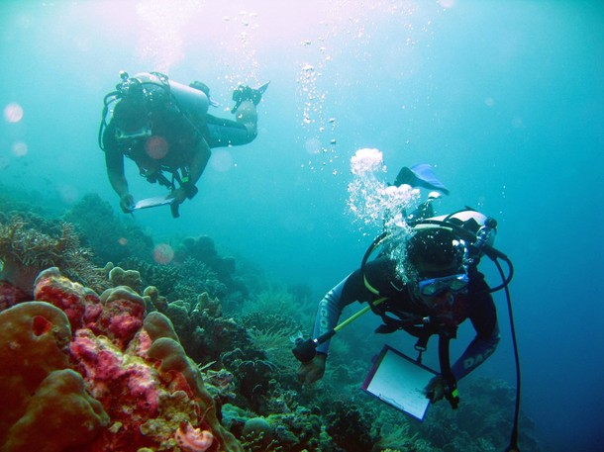
CTI-CFF Monitoring and Evaluation System and S.M.A.R.T. Indicators
Alan White, Ph.D.
Chief of Party
USAID Sustainable Ecosystems Advanced (SEA) Project, Indonesia
July 9-10, 2020
Photo CTSP/James Morgan

Slide 2
M&E WG Workshops and Meetings
2008:
CCC 1, Jakarta (May)
CCC 2, Manila (October)
SOM 2, Manila (October)
2009:
SOM 3, Port Moresby (March)
SOM 4, Kota Kinabalu
2010:
SOM 6, Manado
2011:
SOM 7, Jakarta
2012:
Workshops, Manila & Jakarta
SOM 8, Jakarta
April 2013:
Workshop, Manila (M&E Manual development)

Slide 3
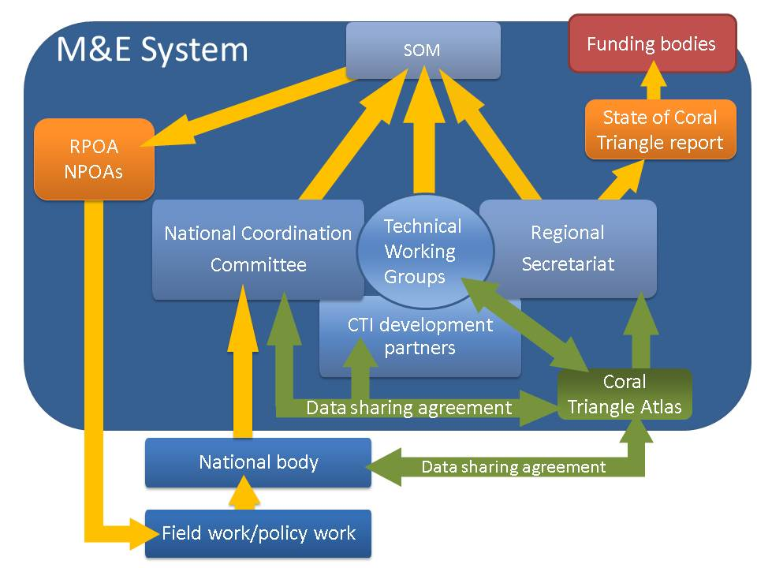
The M&E System in place – Roles, Reporting and Accountability
Notes:
Overview of the roles of each of the entities in the M&E System.
The Coral Triangle Atlas plays a central role in the system by collecting data that is directly measured at the regional level, compiling data from the six countries into regional measures, serving as an intermediary link between organizations outside of the CT region and the TWGs, and providing analysis to the TWGs, NCCs and the Regional Secretariat.
The CTI development partners, NCCs, TWGs and Regional Secretariat work in close collaboration to analyze, endorse and make recommendations to the SOM according to the measures obtained every year.

Slide 4
Types of Indicators
INPUT
Resource: Funding and capacity building
PROCESS
Action 4: Establish and enforce additional marine sanctuaries (no-take zones)
OUTPUT
Intermediate result: Region- wide Coral Triangle MPA system in place and fully functional
OUTCOME
Result: Marine protected areas established and effectively managed and critical habitats protected and productive in support of fisheries
IMPACT
Food Security and economic benefits to coastal communities
Notes:
Example from the Malaysian NPOA, Goal 2: Marine Protected Area.

Slide 5
Two higher level outcomes are measured by RPOA indicators and additional outcome indicators.
Impact: Improvement in the affordability, availability and quality and safety of food coming from coastal and marine resources
RPOA outcomes for each country roll into a higher regional outcome.
Third higher level outcome, the Impact of the CTI on the people of the six countries. Most indicators are embedded in RPOA outcomes
Outcomes showing final success of RPOA
Higher level outcome 1:
Coral reef ecosystem integrity and services maintained.
Higher level outcome 2:
Fish stocks improved and sustained.
Outcome Indicators
Outcome Indicators
Outputs showing progress against RPOA
Each goal has a set of indicators according to the RPOA targets (outputs) and RPOA goals (outcomes)
Output Indicators
Priority Seascapes
CCA
MPAs
EAFM
Endangered Species

Slide 6
S.M.A.R.T. Indicators—”S” Specific
Should be narrow and focus on the ‘who’ and ‘what’ of the intervention. Data collected directly relates to the achievement of an objective and not to any other objective.
Clear exactly what is being measured?
Does indicator capture the essence of the desired result?
Is it specific enough to measure progress towards the result? Example: “increase by 20% in number of blast fishing incidents filed” may reflect more effective policing OR an increase in crime?
Specific: The indicator clearly and directly relates to the outcome. It is described without ambiguities. Parties have a common understanding of the indicator.

Slide 7
S.M.A.R.T. Indicators—”M” Measureable
The indicator has the capacity to be counted, observed, analyzed, tested, or challenged.
If one cannot measure an indicator, then progress cannot be determined.
How will one know if the outcome has been achieved?
Once an indicator is clear and specific, they can be measured in numerous ways.
Almost any indicator is measurable but the feasibility of measurement is also a critical factor.

Slide 8
S.M.A.R.T. Indicators—”A” Achievable and Attributable
The M&E system and related indicators identifies what changes are anticipated as a result of the intervention and whether the results are realistic. Attribution requires that changes in the targeted developmental issue can be linked to the intervention.
The indicator is achievable if the performance target accurately specifies the amount or level of what is to be measured in order to meet the result/outcome.
The indicator should be achievable both as a result of the program and as a measure of realism.
Target attached to the indicator should be achievable.

Slide 9
S.M.A.R.T. Indicators—”R” Relevant
An indicator should be a valid measure of the result/outcome and be linked through research and professional expertise. The best way to think about relevance is to ensure that there is a relationship between what the indicator measures and the theories that help create the outcomes for the program or system. The best method to find relevant indicators is to consult expert input and proper research.

Slide 10
S.M.A.R.T. Indicators—”T” Timely and Time-Bound
Must be timely in terms of the time spent in data collection (resources that are available--staff and partner time being critical).
Indicator must reflect the timing of collection.
The time-lag between output delivery and the expected change in outcome and impact indicators must also be reflected in the indicators chosen.
Time-Bound, Timely, Trackable, and Targeted: The M&E system and related indicators allows progress to be tracked in a cost-effective manner at the desired frequency for a set period.

Slide 11
Impact: Improvement in the affordability, availability and quality and safety of food coming from coastal and marine resources
Impact
Higher level outcome indicators
Coral reef ecosystem integrity and services maintained
Condition of coral reefs
Extent of mangroves and seagrass
Fish biomass
Coral reef ecosystem integrity and services maintained.
Total regional area of coral reefs and associated habitats in fully protected (no take) areas.
Outcome indicators
3.1.2 Percent/Area of total marine habitat are in marine protected or managed area
3.1.3 Percent/area of each major marine and coastal habitat type in strictly protected “no-take replenishment zones”
Output indicators
3.1.1 CTMPAs Framework developed and adopted by CT6
3.1.5 Percent/Area of marine protected/ managed areas included in CTMPAs
Goals
Goal 3: Marine Protected areas established and effectively managed

Slide 12
MPA Goal and Indicators: Goal 3: Marine Protected Areas (MPAs) Established and Effectively Managed
1. CTMPAS Framework developed and adopted by CT6
2. Percent/Area of total marine habitat area in CT region in marine protected or managed areas
3. Percent/area of each major marine and coastal habitat type in strictly protected “no-take replenishment zones”
4. Percent/Area of marine protected areas under “effective” management
5. Percent/Area of marine protected/ managed areas included in CTMPAS
Process or input indicator and regional action
Output indicator—aggregate of each country
Output indicator—aggregate and “qualified”
Outcome indicator—adds dimension of ecological, social and governance
Outcome indicator which sums results thru CTMPAS

Slide 13
Impact
Impact: Improvement in the affordability, availability and quality and safety of food coming from coastal and marine resources
Higher level outcome indicators
Fish stocks improved and sustained
Change in conservation status (international) of commercially important fish species (coastal and pelagic)
Change in catch per unit effort (CPUE) by gear
Change in species composition relative to trophic level
Change in size distribution by fish species
Change in exploitation status for pelagic and other species
2.2.1 Percent change in ave. income (fishing & non-fishing) of coastal households compared to baseline
2.2.2 Percent change in poverty and food threshold compared of coastal households by livelihood compared to baseline
2.2.3 Stable price of fish
2.3.2 Change in conservation status of tuna and live reef fish
2.4.2 Number and area (sq km) of locally managed areas for live reef fish trade
Outcome indicators
Output indicators
2.1.1 Number of policies and regulations promoting EAFM at regional and national levels with regulatory framework and budget allocated for their operationalization
2.1.2 Number of projects and programs implementing EAFM and components thereof
2.3.1 Number of policies and agreements among the CT6 countries for the management of tuna
2.3.3 Number of countries adhering to markets/certification standards of tuna fisheries agreed upon by CT6 countries
2.4.1 Number of policies and agreements adopted on LRFFT among CT6 to decrease the level of destructive fishing practices linked to the trade
2.4.3 Number of countries adhering to markets/certification (LRFFT and ornamental fisheries) agreed by CT6
Goals
Goal 2: Ecosystem approach to management of fisheries (EAFM) and other marine resources fully applied

Slide 14
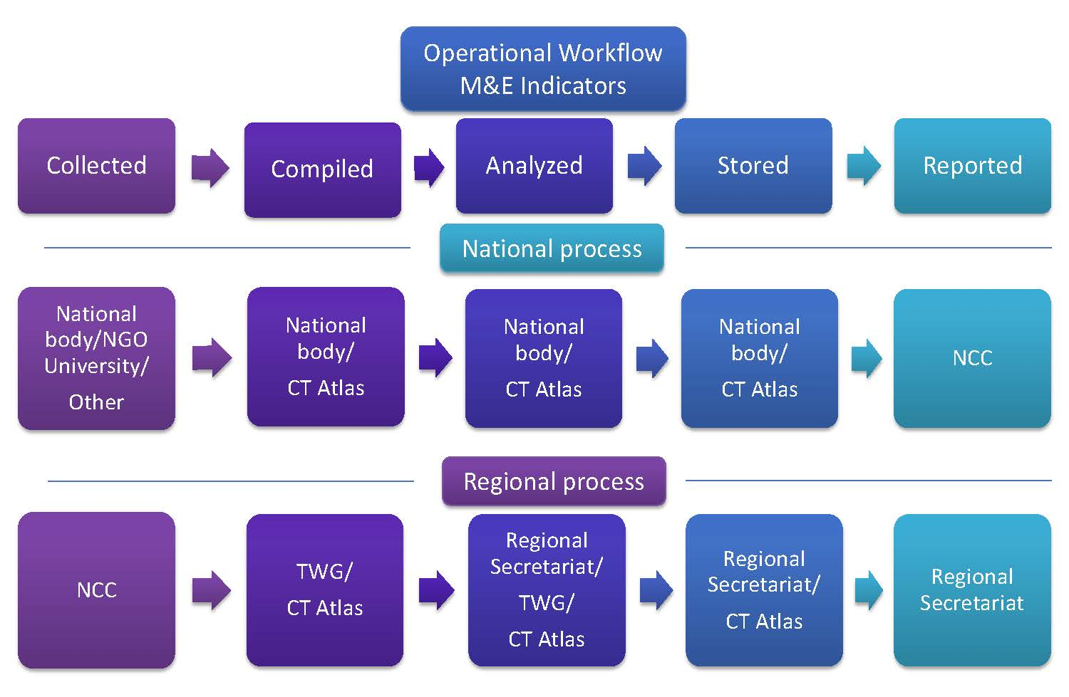
The M&E System in place – Operational Work Flow
Notes:
The data pathway is a key tool to map who will be responsible, and even more importantly, who will be accountable for each step of the indicator: collect, measure, compile, analyze, store and report. It can also serve as a means of information for the entities that have been identified in the pathway to ensure their collaboration.
Starting with the field at the national level to the data compiled, analyzed, stored and reported, we can see that different entities are responsible for transferring the data to the NCC so it can be compiled with the other national data as a regional indicator. The NCC has a pivotal role since it is responsible for this intermediate link.
At the regional level, the same process (compiling, analyzing and storing) is supported by the TWGs, the CT Atlas and the Regional Secretariat.

Slide 15
The M&E System in place – Capacity (and cost) Assessment
 | Goal | Estimated cost | Capacity Score
Indonesia | EAFM | Low | High
 | MPA | Medium | Medium
 | CCA | Low to Medium | Medium to High
 | Threatened Species | Medium | Medium
Solomon Islands | EAFM | Low to High | Low to High
 | MPA | Low to High | Low to Medium
 | CCA | Low to High | Low to Medium
 | Threatened Species | Low to High | Low to Medium
Notes:
A preliminary capacity assessment was carried out. First an assessment of the cost of tracking indicators was carried out for each country. If a system already existed and the indicator was already tracked, the cost was estimated as low, if the system was in place but the indicator was not already tracked (or some other piece of the system was missing) the indicator was estimated as medium, if the system did not exist and everything had to be put in place (people hired, trained, budget allocated etc..) then the cost was estimated as high.
The capacity score was derived from these costs and the capacity of the country to meet them or set up the system,

Slide 16
Lessons from MPA Goal Tracking
It takes time to get it right—e.g. what is relevant and possible to track at regional scale? Dialogue in MPA-TWG
Do the indicators elaborate the REGIONAL Goal?
What is possible to track (e.g. theory vs reality)
What data will likely be possible for each country to provide at a national scale? Not much usually…!
Who will collate the data nationally and in what form?
Where will it go regionally? For MPA to CT Atlas—a spatially oriented database in a regional institution…
Once data is in, can analysis be easily performed to inform on regional progress? Yes, for MPA indicators…

Slide 17
USAID SEA Project 5 Year “SMART” Indicators
(within one country and work in 3 provinces)
OUTPUT
OUTCOME
Long Term Result (IMPACT)
I2 Innovations
Innovations designed (tools,
products, and innovative approaches) to support the
implementation of improved
marine and fisheries management
1200 Persons
with behavior change
Number of individuals who have positive attitude towards conservation efforts
1000 Hectares
Size of marine and fisheries areas (ha) that shows improved biophysical conditions: coral reef, fish stock, biomass and biodiversity
240 Persons
active in LE
Number of individuals/groups actively involved in law enforcement and surveillance efforts
10 %
Percentage of change of Catch Per Unit Effort based on type of fishing gear in targeted areas
1200 Vessels
Number of fishing vessels registered.
10 %
Percentage of biomass increase of coral reef fishes in protected areas
2000 Persons Trained
Number of individuals who have improved knowledge,
understanding and attitude
$ 3 million
Value of leveraged investments in conservation
450
Number of People with increased in economic benefit
Improved marine and fisheries management is implemented in marine areas (Ha) through :
5.1 Million Ha EAFM
1.1 Million Ha MPA
17.1 Million Ha MSP
15 Policies
Number of evidence-informed and analysis-based policies and supporting law
6000 Persons
Number of individuals who have improved access and tenure to marine resource areas

Slide 18
Challenges/Opportunities for CTI-CFF M&E System
M&E System in place—can be tested
Building the CT Atlas database with data verification requires active country participation
A need for both financial support and capacity building over the long term
How to address the gaps and variation of data quality from each country?
Who will track the progress and performance of the M&E System?
MEWG, Secretariat, Coordinator, CT Atlas or combination thereof?

