Slide 1
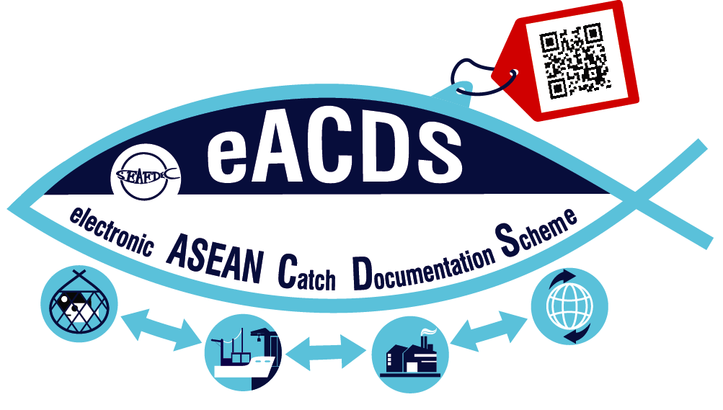
eACDS An Effective Fisheries Management Tool in EAFM
SEAFDEC
TRAINING DEPARTMENT
Yuttana Theparoonrat and Namfon Imsamrarn
Notes:
My presentation is on the effective Fisheries Management Tool in Ecosystem Approach to Fisheries Management through the implementation of the Electronic system of the ASEAN Catch Documentation Scheme..
The presentation will focus on how the eACDS improve the Governance in Fisheries and how linkage to the Monitoring, Control and Surveillance (or MCS) as well as the EAFM.

Slide 2
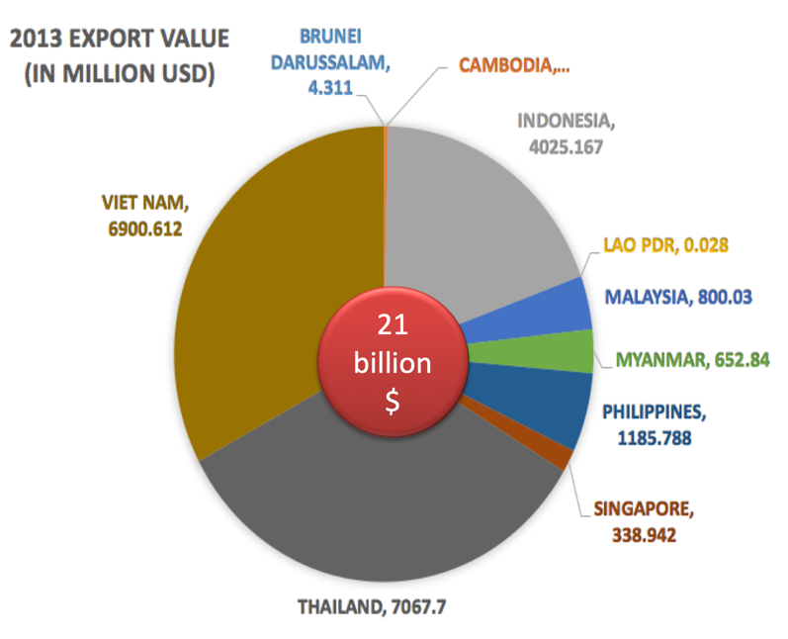
Development of Fisheries in Southeast Asian Region (1970s-2010)
Fisheries sector plays an important role for food security,
About 21 billion USD for Export Value of Fisheries Products in 2013
Contributes to economic and social betterment, to the nutrition and wellbeing of the peoples;
>20 million persons employed in fisheries-related industries;
Increasing Fishing Capacity
Notes:
Taking into accounts the Development of Fisheries in the Southeast Asia which has been rapidly grown during the past 1970 till 2010
It was about 21 billion USD for export value of fisheries products in 2013,
and that because contribution of fisheries sectors alone to the economic and social betterment as well as to the nutrition and well being of the peoples;
It was about 20 million persons employed in fisheries –related industries.
It addition, please also noted that the Fishing Capacity during the said periods also rapidly increased.

Slide 3
KEY THREATS FROM
UNSUSTAINABLE FISHERIES DEVELOPMENT
OPEN ACCESS
OVERFISHED
BIODIVERSITY LOSS
HABITAT LOSS
IUU FISHING
FISH STOCK DEPLETED
FAILURES OF FISHERIES
GOVERNANCE
Notes:
There are many key Threats from fishing activities to the marine habitats which are caused from failures of fisheries governances during the past few decades such as
Open access : results in increasing of fishing capacity;
And that become overfished, biodiversity loss, habitat loss to the marine ecosystem;
In addition, many iuu fishing are in practices
Finally because failures of fisheries governance, the fish stock are declined in many part of the world.

Slide 4
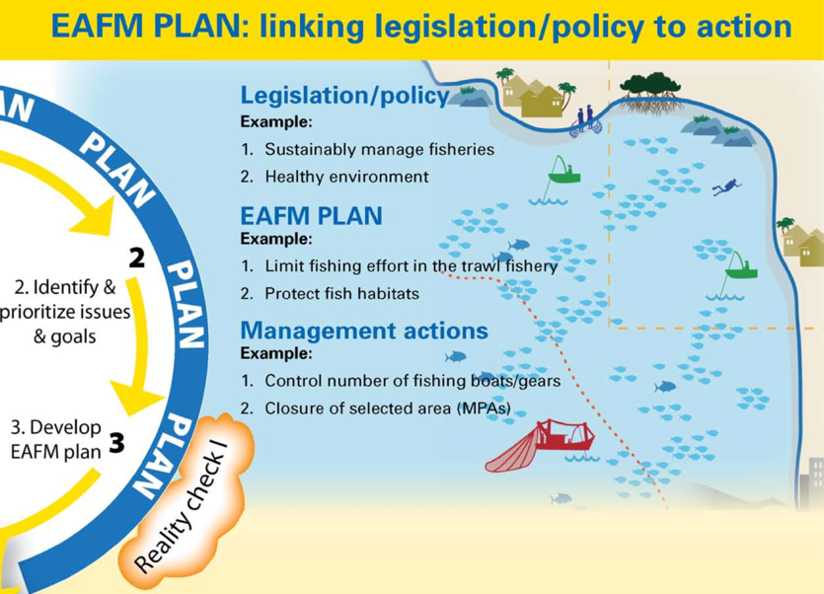
IMPROVING THE GOVERNANCE IN FISHERIES
Combating illegal, unreported and unregulated (IUU) fishing through monitoring, control and surveillance initiatives (NOAA)
Adoption and Application of EAFM Tools as a Basis for Fisheries Management
(NOAA/ASIA PACIFIC)
strengthening catch and traceability schemes (NOAA/Caribbean)
Through innovative technology : aims to bridge the information gap observed among science, fishermen and final consumers in relation to the biology, natural availability, fishing regulations, market opportunities and traceability of marine resources (NOAA/CHILE)
In ASEAN-SEAFDEC
Notes:
Improvement the Governance in Fisheries have been introduced in general by several international organizations such as FAO, and some institutions such as NOAA plays the important role to support many parts of the world on combating IUU fishing through the MCS initiatives:
In addition, NOAA also support different region in the world to improve the governance in fisheries by strengthening catch and traceability schemes (NOAA/Caribbean);
And Through innovative technology : aims to bridge the information gap observed among science, fishermen and final consumers in relation to the biology, natural availability, fishing regulations, market opportunities and traceability of marine resources in CHILE; and
Introduce the application of EAFM tools as a basis for fisheries management for ASIA Pacific.
While, please be noted that SEAFDEC in cooperation with ASEAN Member States develop the electronic system of ASEAN Catch Certification Scheme for not only to enhance the intra-regional trade and international trade, but enhance the traceability system of fish and fisheries products. How does eACDS link to EAFM and MCS will be shown in the following slides.
….......

Slide 5
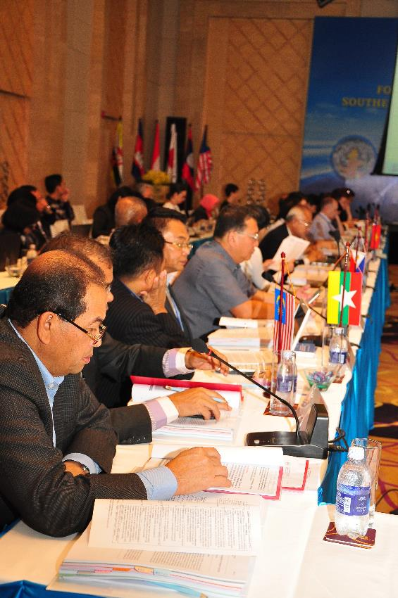
What’s ACDS and eACDS ?
ACDS
ASEAN Catch Documentation Scheme
was adopted by ASEAN Ministers to prevent the access of IUU fish into the ASEAN supply chains
eACDS
-Software supports the implementation of ASEAN Catch Documentation Scheme
- Implementing eACDS required Good Governance, and Good Practices on Fisheries Management.
Notes:
ACDS : ASEAN Catch Documentation Scheme was adopted by ASEAN Ministers to prevent the access of IUU fish into the ASEAN supply chains
eACDS : -Software supports the implementation of ASEAN Catch Documentation Scheme
- Implementing eACDS required Good Governance, and Good Practices on Fisheries Management.

Slide 6
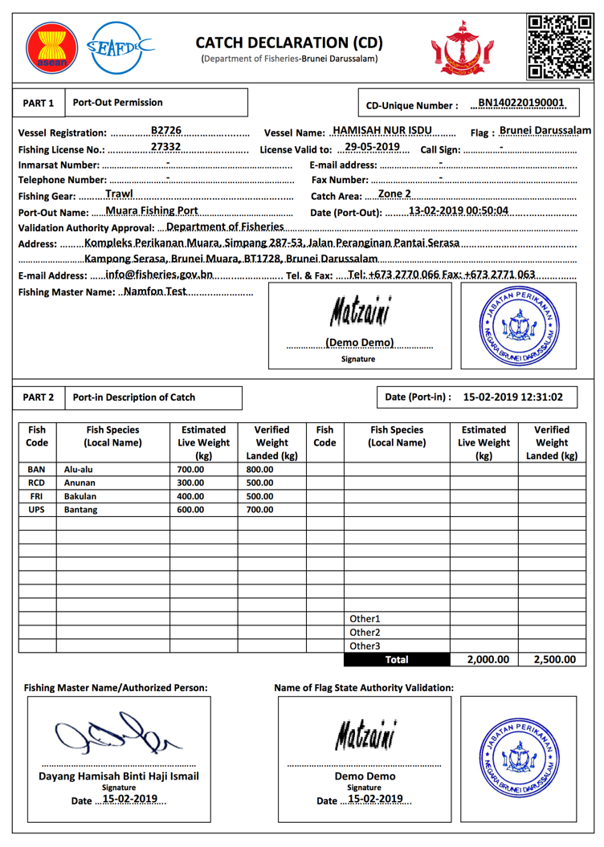
from KEY DATA ELEMENTs (KDEs) to CERTIFICATION
Fishing boat/ License
Fish Species Code
Boat Owner/ Captain
Fish Buyers
eACDS
Database
Server
Fishing port
Processors
HS Product Code
Importer/ Exporter
Others
Logistic Info.
CERTIFICATE
Notes:
The most important part of the eACDS are the powerful of the Database Modules that recorded all required Key Data Elements (KDEs) into the system, the database module will create user friendly in implementation of the eACDS especially generating the Certifications based on the processes in the supply chains. The important database module and Key data elements are such as:
Fish species database which is including not only the scientific name, common name and local name, but also include the standard fish code.
Next is the Fishing Boat owner or company profile including fishing master
List of Fishing boat and gears license validation;
List of Fishing port
List of fish buyer, brokers
List of processing plants or processors
The HS Product Code
Harmonied System (HS) product code
List Exporter/importer
Logistic information, and
Others.

Slide 7
eACDS software links all supply chains
from Catching to Plate
CD: Catch Declaration (to Fishermen)
generates certificates:
MD: Movement Document (to buyers)
CC: Catch Certification (Fish Processor)
Notes:
eACDS software is designed to link all supply chains from catching to plate :
In addition, the software can generate the Certificates such as
1)_ Catch Declaration (CD) for fishing master;
Movement Documents (MD) for all registered fish buyers;
Catch Certificate (CC) for fish processors

Slide 8
eACDS also enhances intra-regional trade
Taking into accounts, EAFM aims to maximise ecosystem benefits that all lead towards increased food security and reduced poverty.
The ecosystem benefits that can be achieved through EAFM include fish for food, income, employment, and livelihoods, resulting in increased food security and reduced poverty, as well as through increased foreign exchange and trade from fish and fishery products, providing that the increased foreign revenue trickle down to the poorer people.

Slide 9
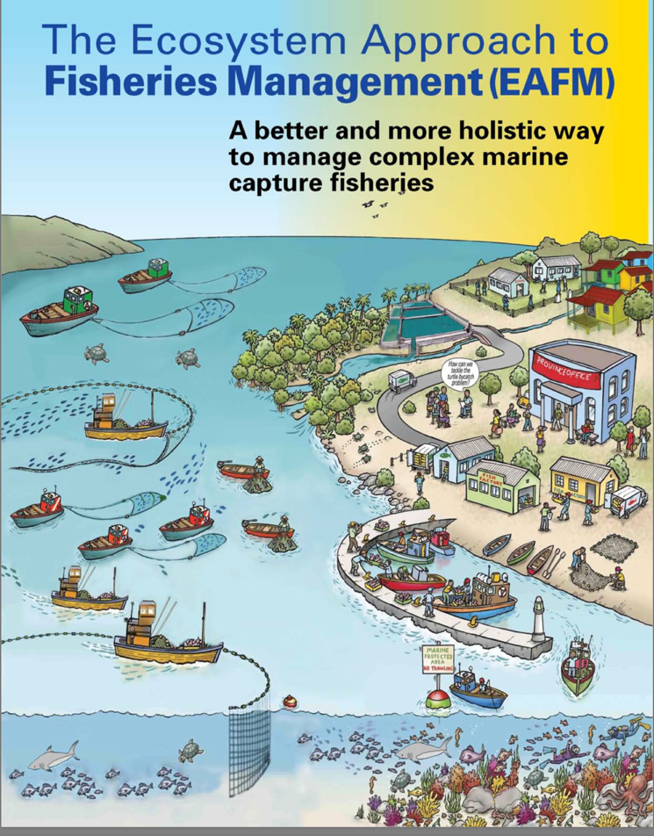
Applying eACDS supports M-C-S & EAFM
MONITORING
Catch reporting at sea
Catch Verifying at port
Vessels/fishing monitor
Fishery Policy
CONTROL
License validation
Fishing areas via VMS
Catch Quota
Fishing effort/ days
Port-out / Port-in
Management Plan
Scientific
Research
MCS
Strategy
SURVEILLANCE
Movement of fishing vessel/ transshipment vessels
Anti-IUU fishing
Stock
Assessment
Monitor
Surveillance
Control
Notes:
EACDS is a powerful tool, not only to enhance the intra-regional trade and international trade, but the implementation will also support the Monitoring Control and Surveillance as shown on this screen.
In addition the Implementation of the eACDS required good governance, meaning that the Government have to improve their fishing vessels registration, fishing licenses, control and monitoring of port-out and port-in, catch reporting at sea is very useful in term of fishing quota management, verification of fish landing, monitoring of fishing vessels movement including the transshipment vessels via VMS system..
Furthermore, the eACDS also support the EAFM Implementation. EAFM required fishery Policy and management plan in which many parameters to come-up with Management plan are from Scientific based when implementing the eACDS. Data from these implementation of eACDS such as catch landing, fishing efforts from controlling of port-in, port-out are very useful information for stock assessment. The stock assessment and risk assessment will create management measures which are used for fishery policy for sustainable management.
These all linakage information will enhance the Governance in Fisheries in which support the EAFM implementation.

Slide 10
THANK YOU

