Slide 1
SOM14
14th Senior Officials’ Meeting
12 - 13 December 2018
Manila, Philippines
SESSION 11.4: Capacity Building
Capacity Building
Presented by Regional Secretariat (Program Services)
Place here Country Logo

Slide 2
Outline
RS new allocated budget for attending capacity building programs
Capacity Building under CT Atlas

Slide 3
1. RS new allocation budget
Regional Secretariat for the first time allocates for capacity building a sum that can be flexibly used for one NCC participant from each CT6 for attending conferences or training courses. E.g. Online course by UN on Climate Change Negotiation and Diplomacy.

Slide 4
2. Capacity Building under CT Atlas
Regional Secretariat proposes that under CT ATLAS Concept Note, to provide training for members of NCC for CT Atlas

Slide 5
Expected Output
an independent CT Atlas database from ReefBase with new interface capture additional/change feedbacks collated from CT Atlas inception/consultation workshop. It offers downloadable open data that users can incorporate into their own analyses, and restricted data accessible by CTI partners only.
sustainability of CT Atlas to continue supporting CTI National Coordination Committee (NCC), Technical Working Group (TWG), CT partners and all users, will be fully managed by CTI Secretariat in two years time. WorldFish will also act as key partner for utilizing the CT Atlas database for future marine spatial planning in fisheries research project.

Slide 6
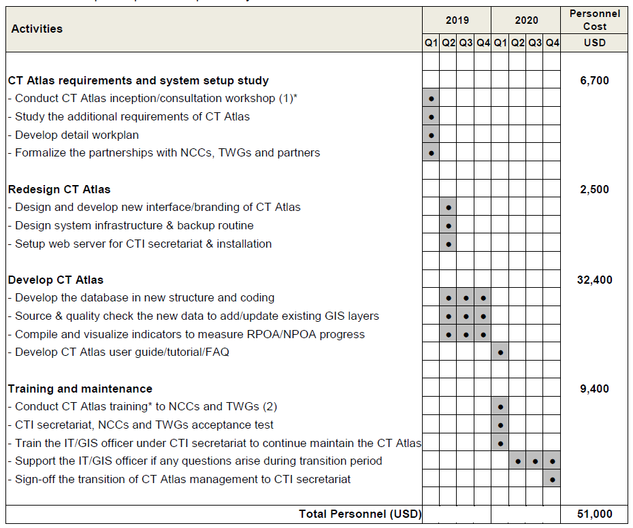
Activities and Timeline
The transition shall take over a span of two (2) years [2019 and 2020]

Slide 7
SOM-14 Recommendations

Slide 8
SOM-14 Recommendations
Accept the proposed budget provided for capacity building opportunities for CT6 members (subject to RS budget approval);
Task the RS to work with NCCs and TWGs to submit priority training needs for RS to organize and conduct specific trainings;
Task Regional Secretariat to recall past SOM decisions on capacity needs of CT6;
Task Regional Secretariat to revisit the recommendations in the Capacity Building Needs Assessment by GIZ;
Task Regional Secretariat to consolidate capacity needs from various TWGs and CCTs as reported in SOM-14;

Slide 9
Terima Kasih - Maraming Salamat Tank Iu- Obrigado Tagio Tumas
Photo credits: Pixabay & IYOR Bank/JayneJenkins/FabriceDudenhofer/Yen-YiLee

Slide 11
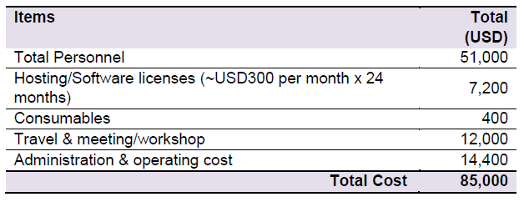
Proposed Budget
The total cost of USD85,000 excluding two (2) workshops and an IT/GIS officer, of which cost shall be incurred by the Regional Secretariat.
The Regional Secretariat proposed a total budget of USD150,000 for CT Atlas.
WorldFish [USD85k] + two workshops + IT/GIS Officer = USD 160,000

