Slide 1
SOM14
14th Senior Officials’ Meeting
12 - 13 December 2018
Manila, Philippines
SESSION 11.5: RBF/OOC
Presented by Regional Secretariat

Slide 2
Outline
Regional Business Forum (RBF)
Our Ocean Conference (OOC)
Proposed SOM-14 recommendations

Slide 3
Regional Business Forum
Malaysia has withdrawn from hosting the Regional Business Forum (RBF) due to recent change of new government.
The Conflict Bay Lodge

Slide 4
Our Ocean Conference
NCC Indonesia

Slide 5
Our Ocean Conference
Regional Secretariat

Slide 6
Regional Secretariat’s Ocean Talk #1
This Ocean Talk discussed some findings of the recent RPOA review, highlighting the continued high relevance of this important multi-national collaborative initiative and invites the audience to join development of the next Regional Plan of Action.

Slide 7
(From left to right) Jackie Thomas from WWF Coral Triangle Programme; Mr. Maruf Farid, USAID Ocean Specialist on Catch Documentation and Traceability; Dr. Lida Pet-Soede, PT Hatfield Group Marine Unit Leader; Dr. Sharifah Nora Ibrahim, CTI Regional Secretariat Deputy Executive Director; Dr. Nagulendran Kangayatkarasu, Undersecretary of Strategic Technology and S&T Application Division at MOSTI; and Prof. Dr. Ove Hoegh Guldberg, Director of the Global Change Institute at the University of Queensland

Slide 8
Regional Secretariat’s Ocean Talk #2
CTI-CFF conducted the second Ocean Talk on "Legacy for Coral Triangle - Towards International Recognition for Marine Megabiodiversity Area." The Ocean Talk explored how special status for selected Coral Triangle areas could contribute to both conservation of the natural world linked to responsible use and sustainable economic development.

Slide 9
Speakers include Dr. Fanny Douvere, the Coordinator for World Heritage Marine Programme of UNESCO; Carl Gustaf Lundin, Director for IUCN Global Marine and Polar Programme; Dr. Vladimir Ryabinin, Executive Secretary for IOC and Assistant Director General of UNESCO; and Dr. Sharifah Nora Ibrahim, the CTI-CFF Regional Secretariat's Deputy Executive Director for Program Services who is also responsible for organizing the Ocean Talk.

Slide 10
SOM-14 Recommendations

Slide 11
SOM-14 Recommendations
5th Regional Business Forum
Note on Malaysia’ withdrawal from organizing the 5th Regional Business Forum (RBF);
Task the RS to work with potential organizations/collaborators to redesign the RBF with the objective of attracting private organizations;
Task the Regional Secretariat to plan for RBF with strong coordination with MPA WG as well as with other TWGs as relevant and Development Partners.

Slide 12
SOM-14 Recommendations
Our Ocean Conference
Appreciate the participation of the Regional Secretariat in representing CTI-CFF and CT6 countries during the OOC2018;
Acknowledge the following:
Acknowledge the outcomes of the Our Oceans Conference (OOC2018) as presented by the NCC Indonesia;
Acknowledge the goal of Regional Secretariat’s Ocean Talk #1 on RPOA Review findings, highlighting the continued high relevance of this important multi-national collaborative initiative; and
Acknowledge the objective of Regional Secretariat’s Ocean Talk #2 on "Legacy for Coral Triangle - Towards International Recognition for Marine Megabiodiversity Area." on how special status for selected Coral Triangle areas could contribute to both conservation of the natural world linked to responsible use and sustainable economic development.
Encourage Regional Secretariat to share information on relevant events to University Partnership members through the respective NCCs.
Acknowledge CTI-CFF USD1.3mill commitment made during the OOC in Bali, Indonesia (29-30 October 2018); and
Task Regional Secretariat to prepare a Tracking Commitment Report on commitments put forward in the recent OOC2018 to the next OOC2019 (Nov 24-25, 2019).

Slide 13
Terima Kasih - Maraming Salamat Tank Iu- Obrigado Tagio Tumas
Photo credits: Pixabay & IYOR Bank/JayneJenkins/FabriceDudenhofer/Yen-YiLee

Slide 14
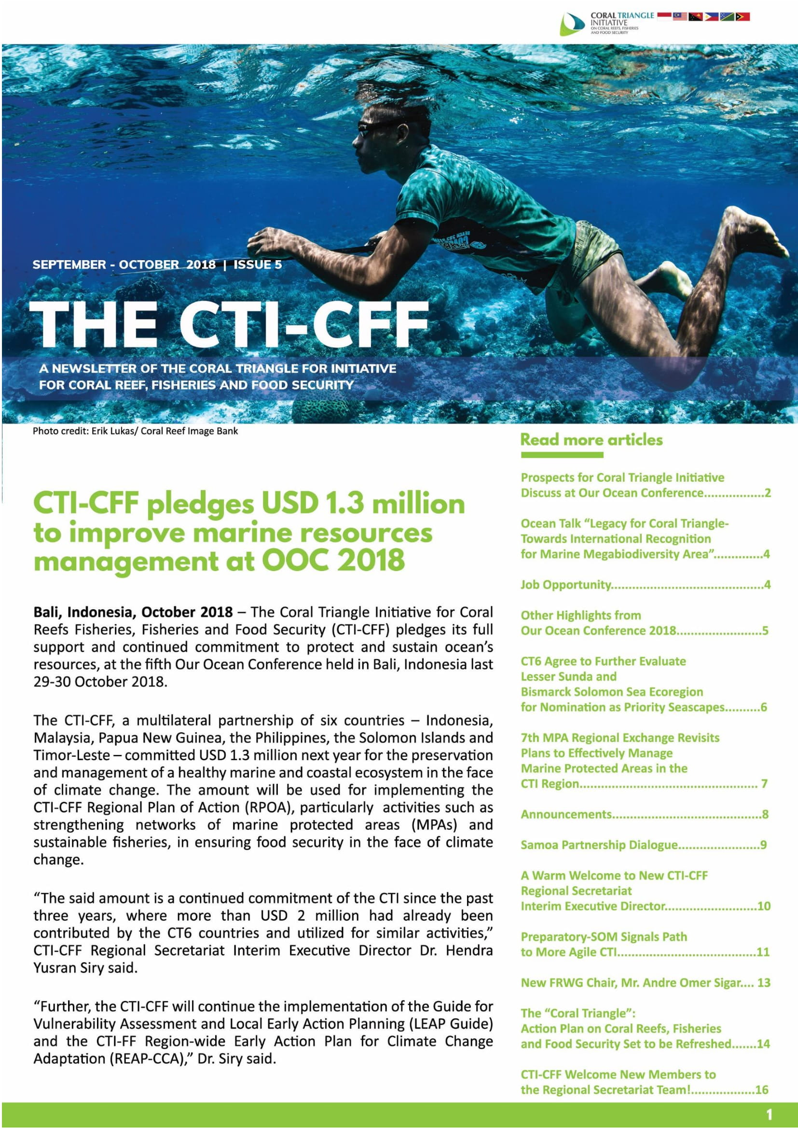
CTI-CFF Commitments / Pledges
The CTI-CFF, a multilateral partnership of six countries – Indonesia, Malaysia, Papua New Guinea, the Philippines, the Solomon Islands and Timor-Leste – committed USD 1.3 million next year (2019) for the preservation and management of a healthy marine and coastal ecosystem in the face of climate change. The amount will be used for implementing the CTI-CFF Regional Plan of Action (RPOA), particularly activities such as strengthening networks of marine protected areas (MPAs) and sustainable fisheries, in ensuring food security in the face of climate change.

Slide 15
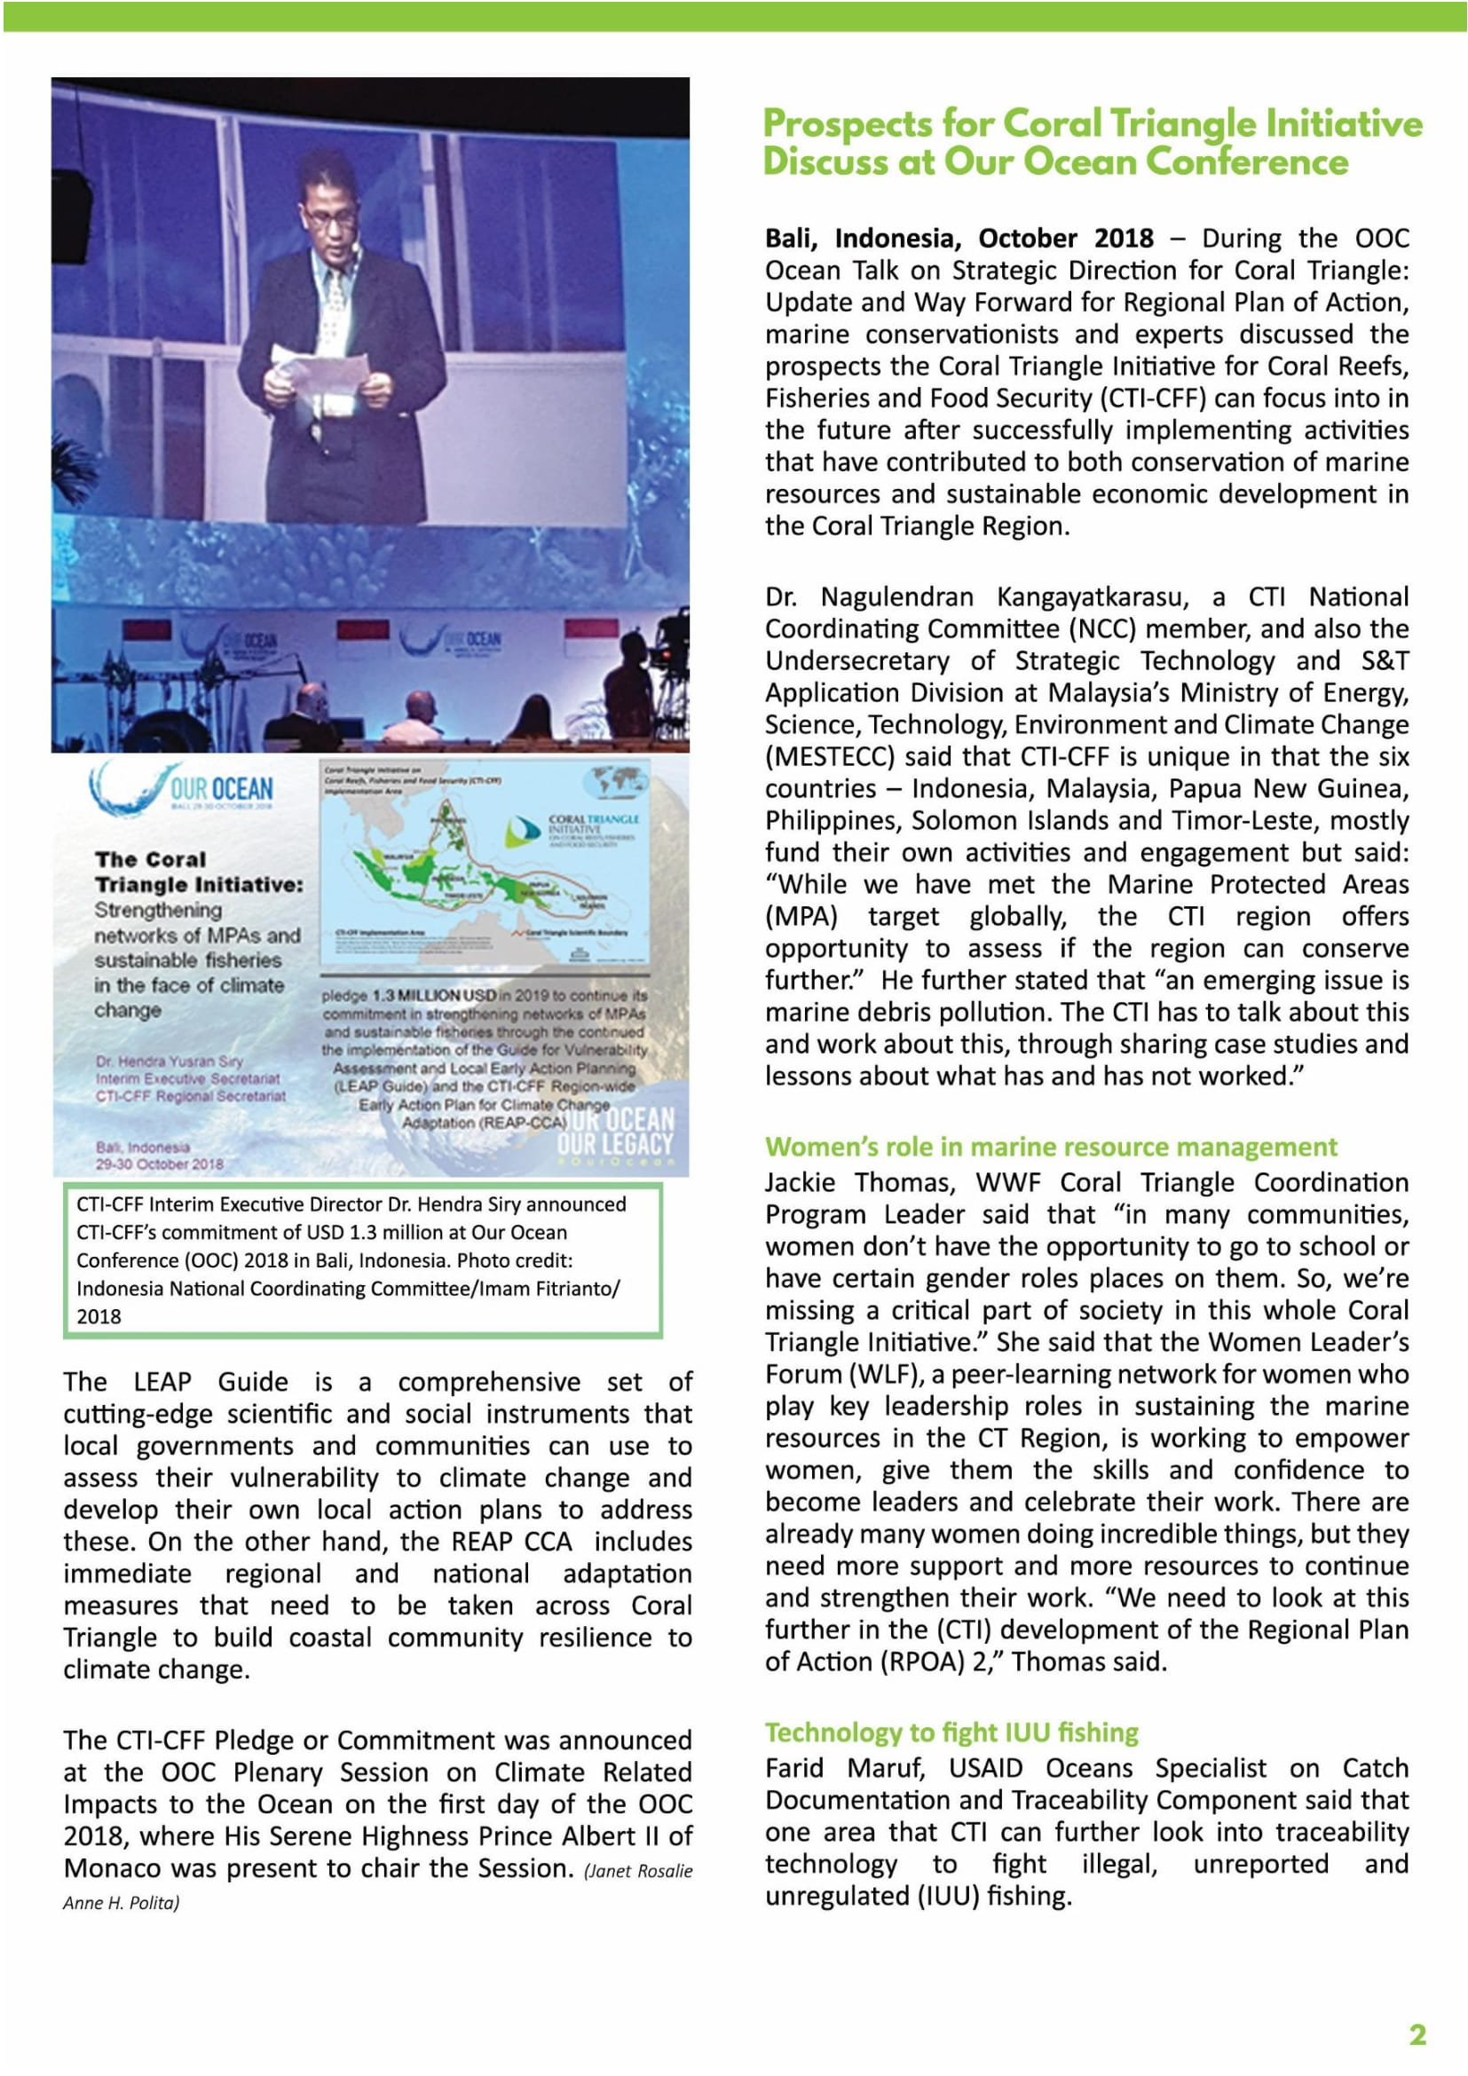
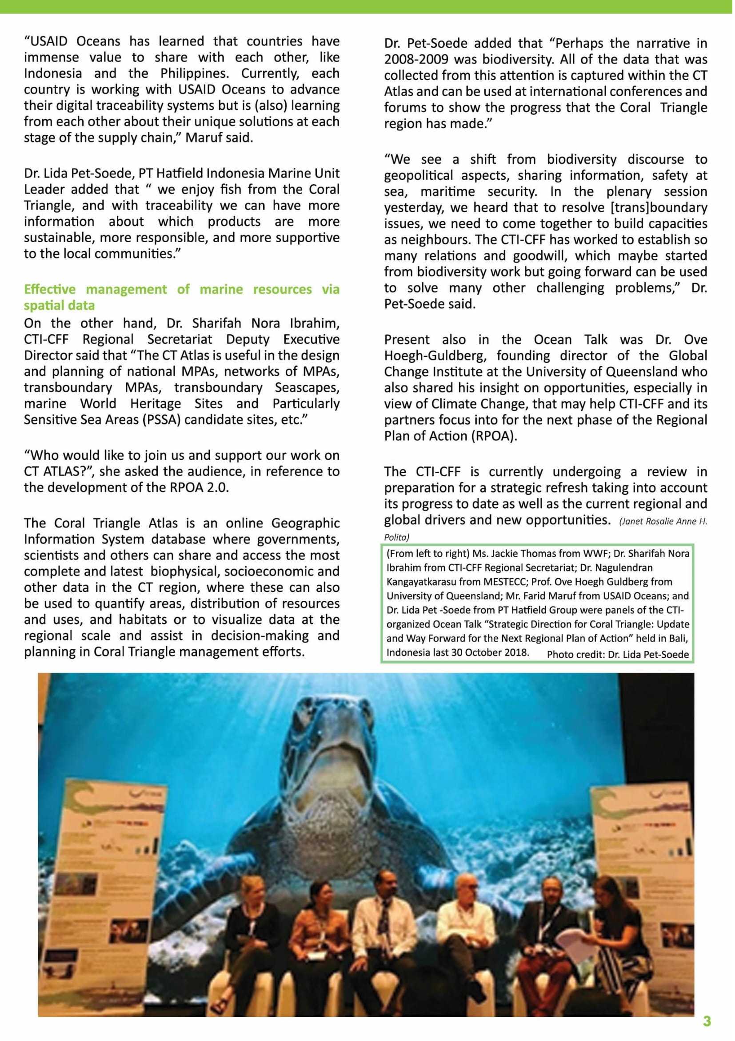

Slide 16
