Slide 1
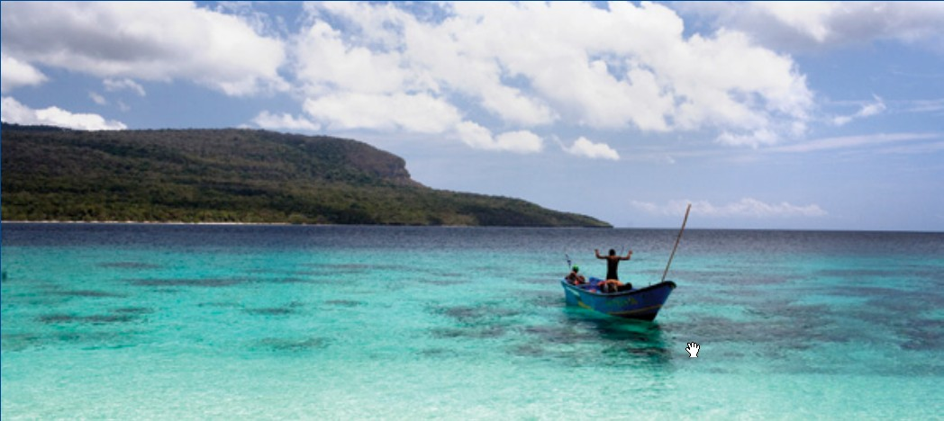
COUNTRY REPORT of TIMOR-LESTE
Acacio Guterres,
Director General of Fisheries
Ministry of Agriculculture and Fisheries
Timor Leste

Slide 2
Country TWG Focal Points
TWG | Focal Point
Seascapes | Mr. Antonio de Jesus
EAFM | Mr. Lino de Jesus Martins
MPA/Threatened species | Mr. Jose Monteiro
CCA | Mr. Rui dos Reis Pires

Slide 3
Partners and Status of Partnership
Partners | Status | Projects and Programs
CI | International Agency | MPA( Conservation Area), EAFM(Fisheries Coastal Management Area), Threatened Species(Sea Mammals Conservation)
UNTL/CCCD | National Institution | Research on climate change and biodiversity

Slide 4
Partners and Status of Partnership
Partners | Status | Projects and Programs
ADB | International Agency | MPA Batugade and Ataouro Island (Demarcation)
Haburas | National NGOs | Climate Change (Campaign of Marine Environment)
JICA | International Agency | Capacity building (Over Sea Trainings)
OXFAM | International Agency | Conducted a series of vulnerability assessment (Vas) in communities in the highlands as well coastal areas

Slide 5
Partners | Status | Projects and Programs
ROMAN LUAN | National NGOs | MPA (Desimination law and involving local awereness on coastal & marine resources)
PEMSEA | International Agency | Capacity Building (ICM., Manatuto, Liquica)
ATSEF | International Agency | ICM, EAFM, MPA (Phase 2 :2017-2020)

Slide 6
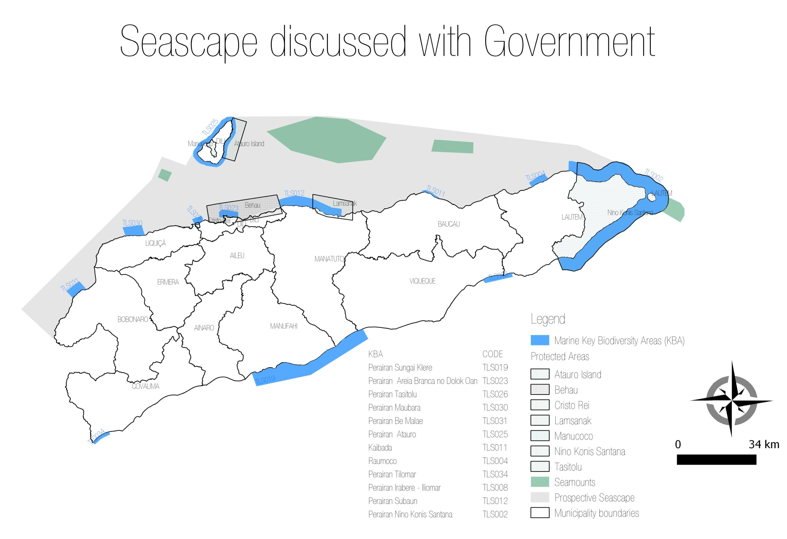
Goal 1: Priority Seascapes Designated and Effectively Managed - On-Going
Rapid Assessment to identify priority seascape for investment (Consultation, Data Collection)

Slide 7
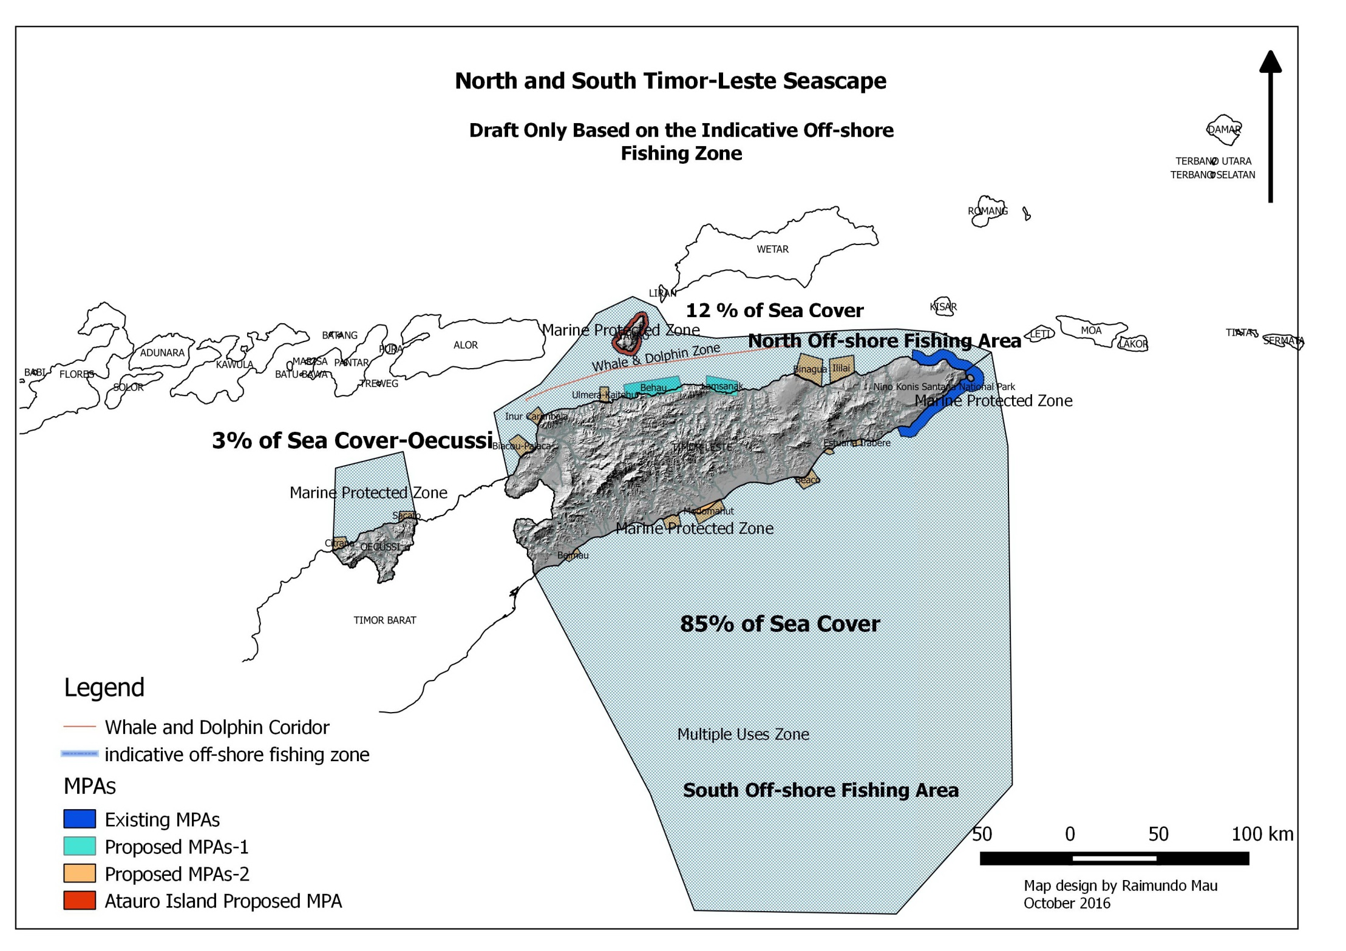

Slide 8
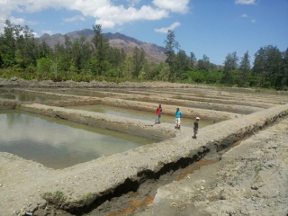
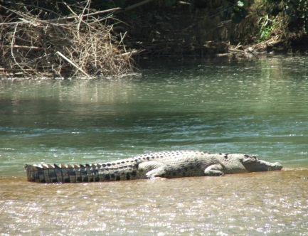
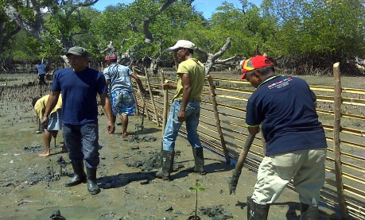
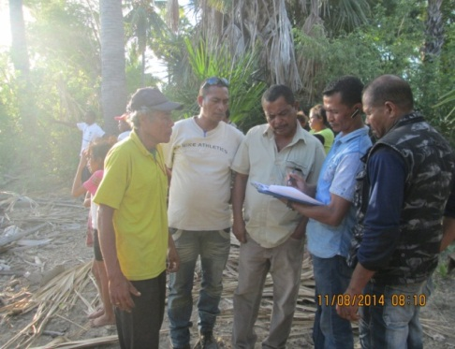
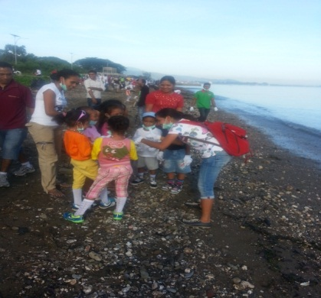
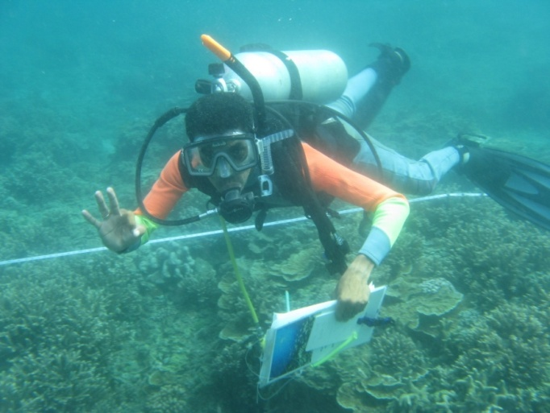
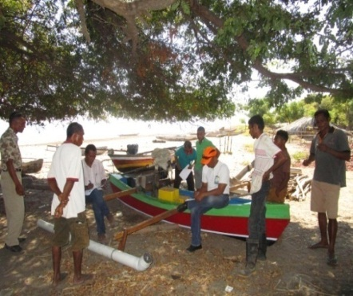
Progress Towards NPOA
Goal 2: Ecosystem approach to management of fisheries and other marine resources
Total Actions | Completed | On-Going | Not Started
9 | 6 | 3 | 0
On-Going
Fish-stock assessment
Program integrated on crocodile management
Environmental education in coastal areas
Biological monitoring on MPAs areas
Continuation mangrove replantation
Social economic survey of fishermen and fish folks
Constructing fresh water aquaculture

Slide 9
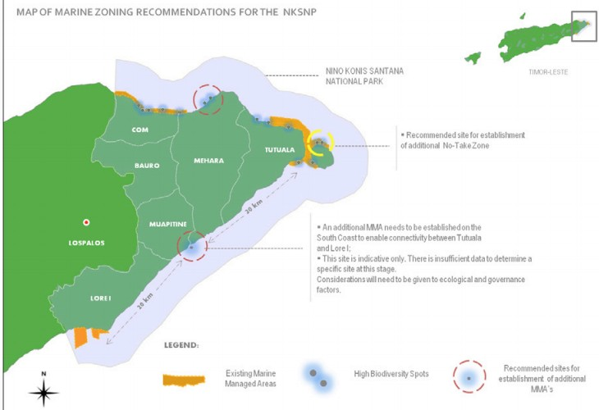
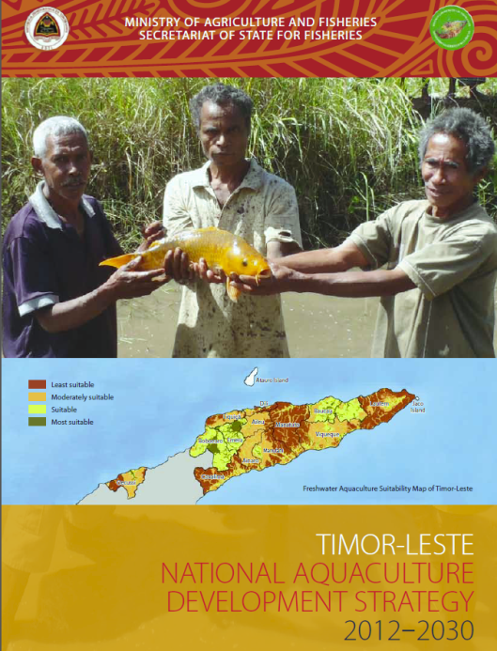
Cont..... Goal 2........
Completed
Government and CTSP have concluded a
comprehensive participatory mapping of
Marine Spatial Planning at Nino Konis Santana
National Park.
Completed comprehensive participatory
mapping exercise in priority areas
Have Developed a Aquaculture Development
plan part of Timor Leste Strategic Plan
National Legislation on marine resource
conservation

Slide 10
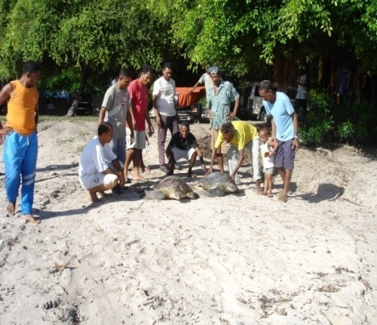
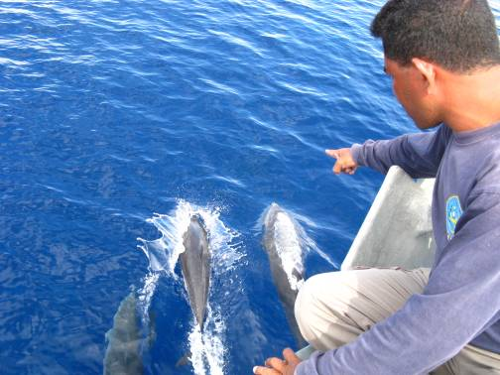
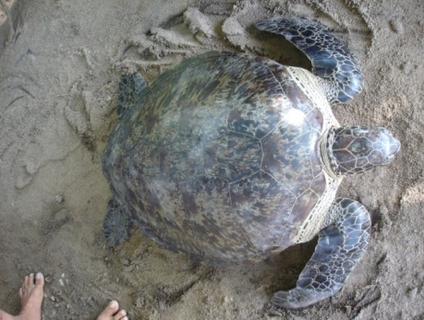
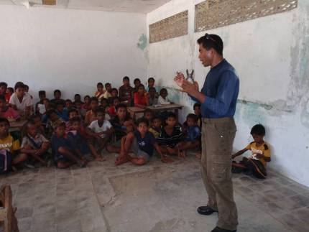
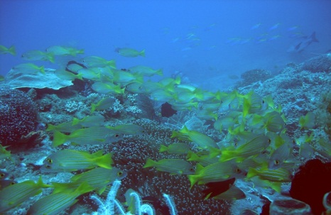
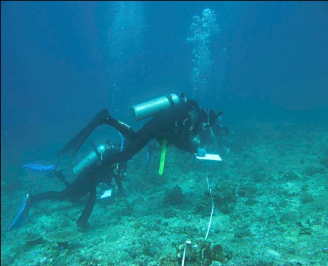
Progress Towards NPOA
Goal 3: Marine Protected Areas (MPAs) established and effectively managed
Total Actions | Completed | On-Going | Not Started
8 | 6 | 2 | 3
On-Going :
National Grand Strategy on PAs and PA network development
Zoning and management plan for Nino Konis Santana National Park (Marine Park);
Propose to the Council of Minister the formal declaration of two new protected areas: Ataúru;
Study on cost estimate and sustainable financial plan for protected areas such of Ataúru and Batugadé
Strengthening ecotourism sector contribution to protected area sustainable management of coastal and marine resources.

Slide 11
Progress On-Going....
Discussion with the Indonesian Government on the establishment of a trans-boundary
protected area network;
2. Develop and implement capacity building
activities targeting mainly Environmental
Managers in the Fisheries, Environment and
Forestry Directorates (Central Government)
and local government officers.
3. MPA efectiveness Management Tools

Slide 12
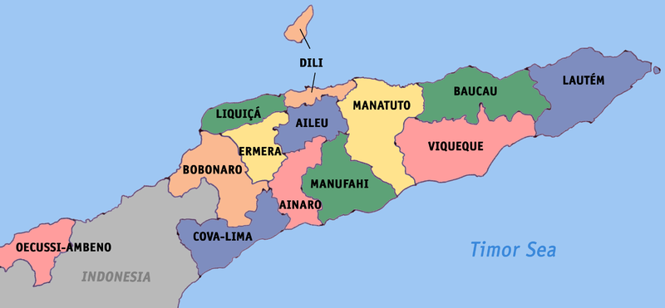
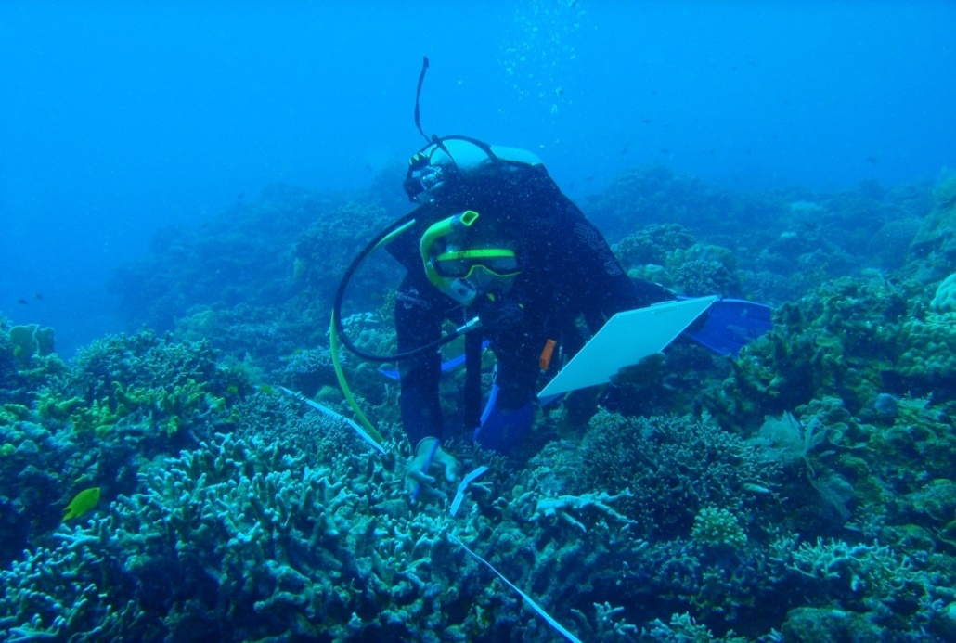
Progress MPAs in Timor Leste
NKSNP
CI
NKSNP in Lautem
MPA Ataouro in Dili (on going)
MPA Batugade in Bobonaro (og)
MPA Cristo Rei in Dili (planning
MPA Kaitehu in Liquica (planning))
Batugade
CTP

Slide 13
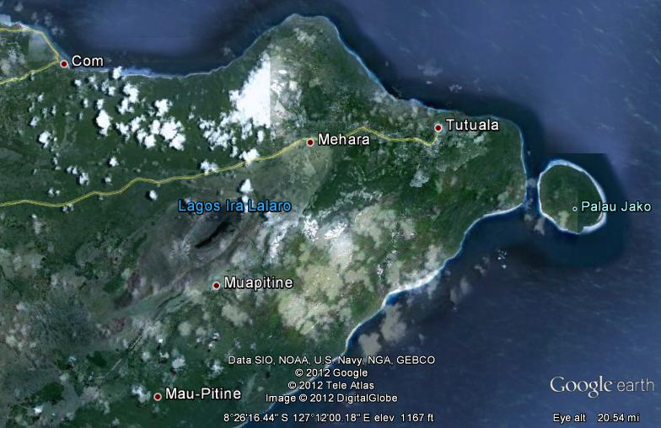
NTZs of Nino Konis Santana NP
Com
Zoon
Jaco Island
No of MPAs
Com
Zoon
Pereveno
Hilapuna
Lore I
Pereveno
Hilapuna
Lore 1

Slide 14
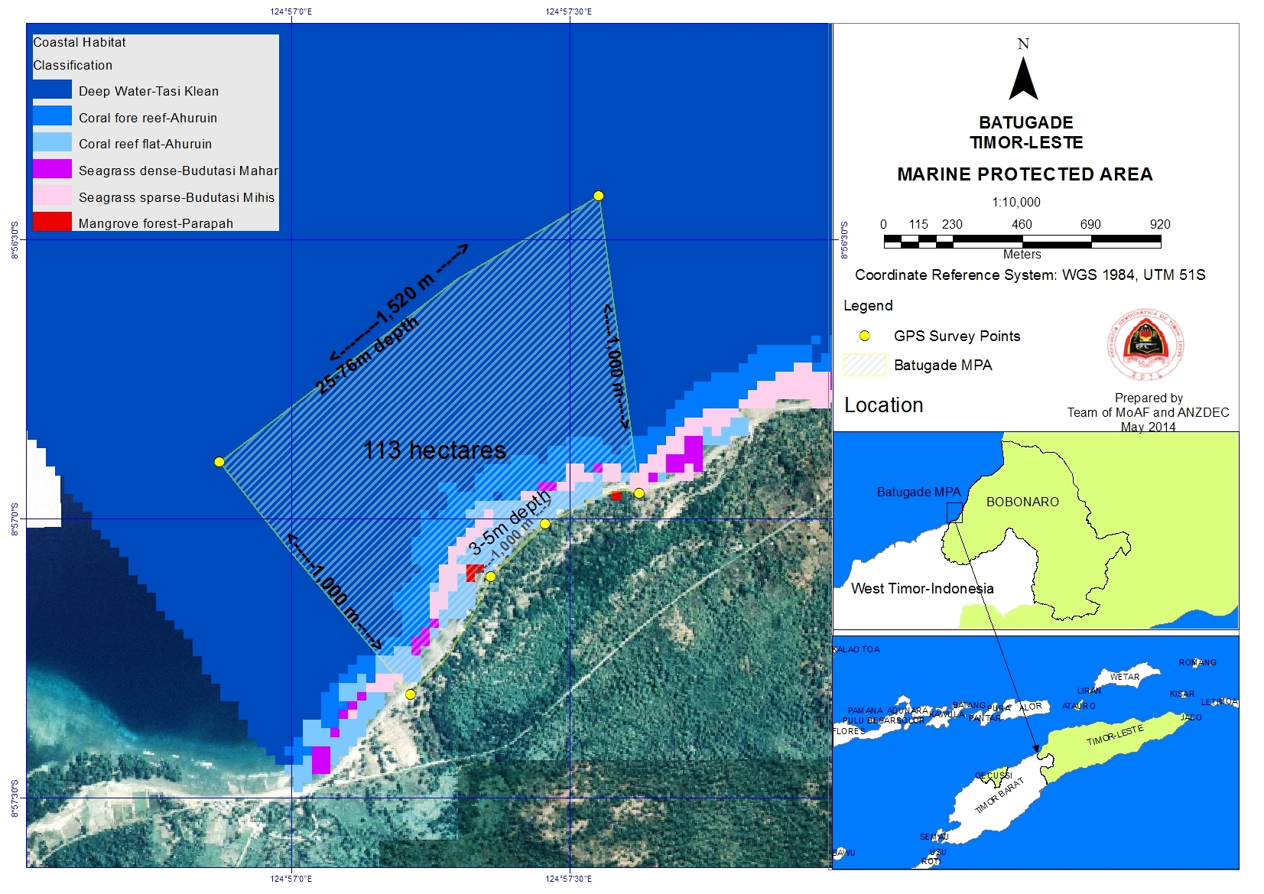
MPA Mapping in Batugade, 2014

Slide 15
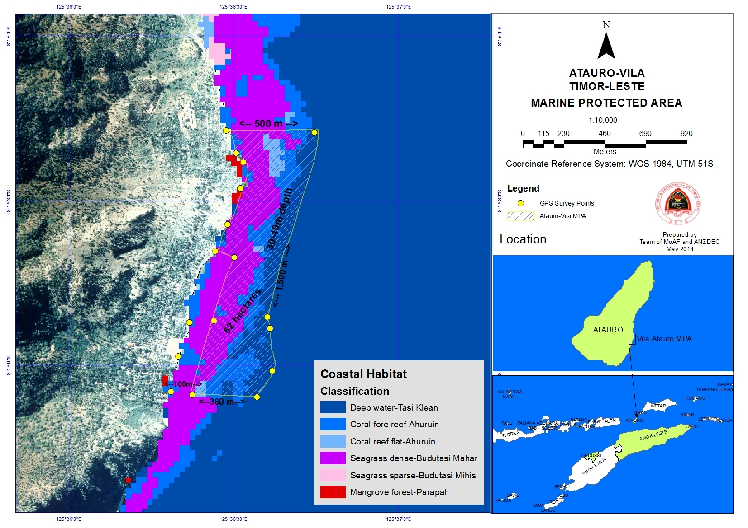
MPA Mapping in Atauro, 2014

Slide 16
Progress Towards NPOA
Goal 4: Climate Change Adaptation Measures Achieved
Total Actions | Completed | On-Going | Not Started
8 | 6 | 2 | 0
Completed : Adopt coral reef resilient to climate change principles in the MPA zoning/network design 2. Develop and implement early warning and response plan to climate adaptation 3. Coastal rehabilitation program to anticipate climate change impacts 4. Start to strictly implementing commitment to UNFCCC 5. Establish a Research Center on Climate Change 6. Develop and operate national information network on climate change early warning and response.

Slide 17
CCA-On-Going
Finalize studies on social resilient / vulnerability to
Climate Change impacts
. Development and implementation of community
awareness on early warning system that lead by
Ministry of Transportation and Communication

Slide 18
Activities CCA :
Global Climate Change Alliance-GCCA, MAF and GIZ, 4
Years
Coastal Resilience, MAF, MCIA and UNDP
To’os ba Moris Diak (TOMAK), DFAT and MA
AVANSA Project, MAF and USAID
Dili-Ainaro Corridor
Strengthening Agricultural Productivity (SAPIP), GAFSP

Slide 19
Progress Towards NPOA
Goal 5:Threatened Species Status Improving
Total Actions | Completed | On-Going | Not Started
7 | 2 | 4 | 1
Completed
Birds species indentify completed by Florestry
Has Finalized Zoning of Marine Component of the NKSNP

Slide 20
On-Going
Timor Leste going to finalishe the cost-benefit analysis for the adhesion to CITES
Aassessment on threat status of species under different ecosystem categories to culminate the gaps identified by NBSAP;
Started discussion on the development of a threatened species act and have produced at least on draft management plan for the most threatened species and/or habitat identified by NBSAP
Marine mammals (dugong, whale, dolphin)

Slide 21
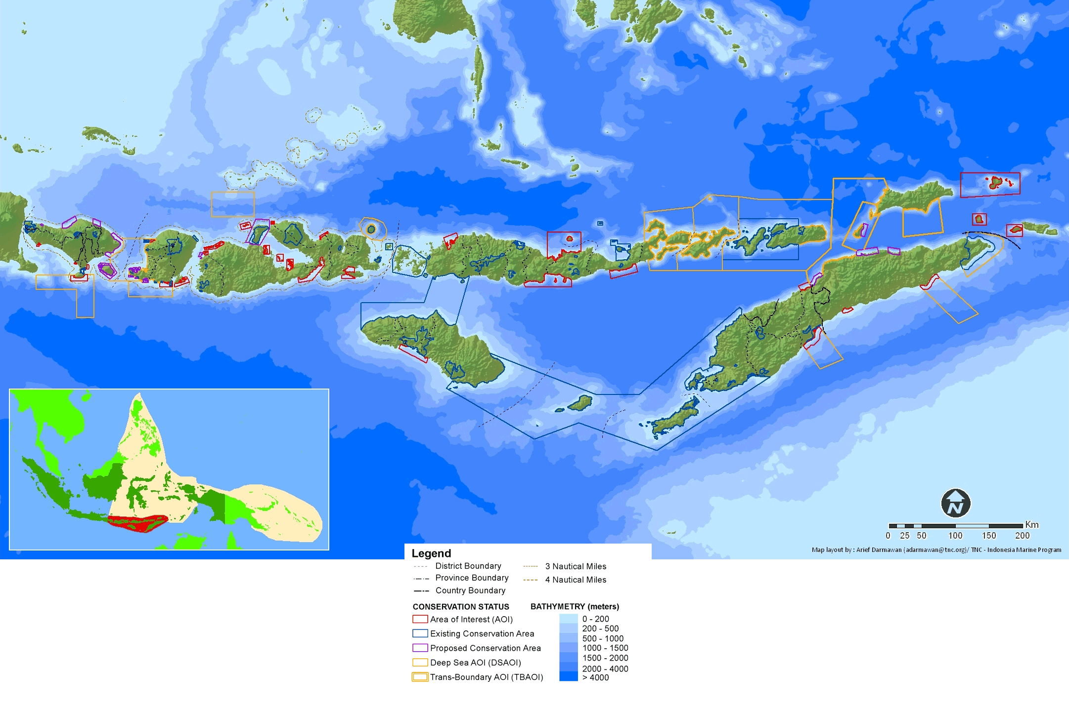
Not Started
Timor Leste Goverment wich have been pointed out priority site under
Lesser Sunda protected area design.

Slide 22
Progress Towards NPOA
Goals | Accomplishments
Cross Cutting Activities Seascapes (National Seascape ) | Going to be integrated to regional management concept
EAFM (stocking findings for ecosystem approach to fisheries management | Marine Rapid Assessment Project ( in Nino Konis Santana National Park, Manatuto, Dili (Atauro) in 2009, 2012 and 2016 as well as have presented the results. Fish and coral reefs biomass in 2014 and 2015 by NOAA (TL and NOAA)
MPA (Nat. grand strategy on PAs & PA network development | Government and CTSP have concluded a comprehensive participatory mapping of MSP at Nino Konis Santana National Park. Resulted 5 NTZs & number of zoning has been done (within NKSNP). Lunched LMMA Ma’abat at Manatuto Municipality (2013) by CTSP, LMMA & MAF CTP-ADB establish MPA Atauro & Batugede 2015 (Reg. by Ministry Diploma act)
CCA (Region wide early action CA plan) for nearshore for Marine & coastal env. Developed & implemented | 1. Adopt (ass) coral reef resilient to climate change principles in the MPA zoning/network design 2. Develop and implement (adopt) early warning and response plan to climate adaptation 3. Coastal rehabilitation program to anticipate climate change impacts (act) 4. Start to strictly implementing commitment to UNFCCC 5. Establish a Research Center on Climate Change 6. Develop and operate national information network on climate change early warning and response.
Threatened species (status improving) | Endemic & endangers species protection
Notes:
Such as reefs, fishes conducted by CI expertize. For 2009 conducted by CDU and AIMS, 2012 by CI and 2016 also by CI

Slide 23
Progress of NPOA and CTI M&E Indicators
Goal | Total Actions | Completed | On-Going | Not Started
Seascapes | 0 | 0 | 0 | 0
EAFM | 9 | 6 | 3 | 0
MPA | 8 | 0 | 5 | 3
CCA | 8 | 6 | 2 | 0
Threatened Species | 7 | 2 | 4 | 1

Slide 24
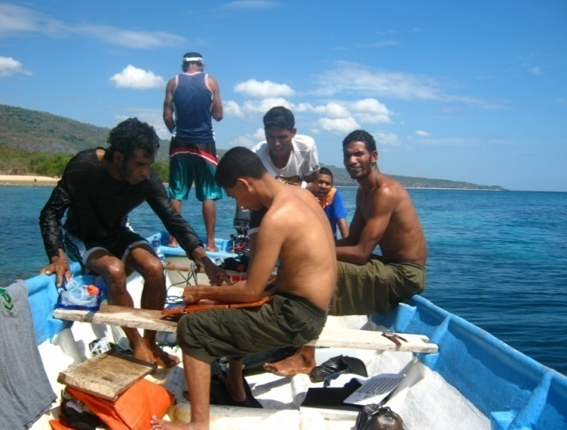
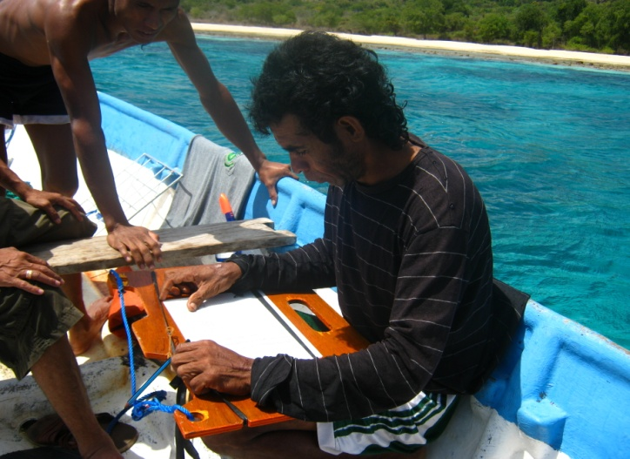
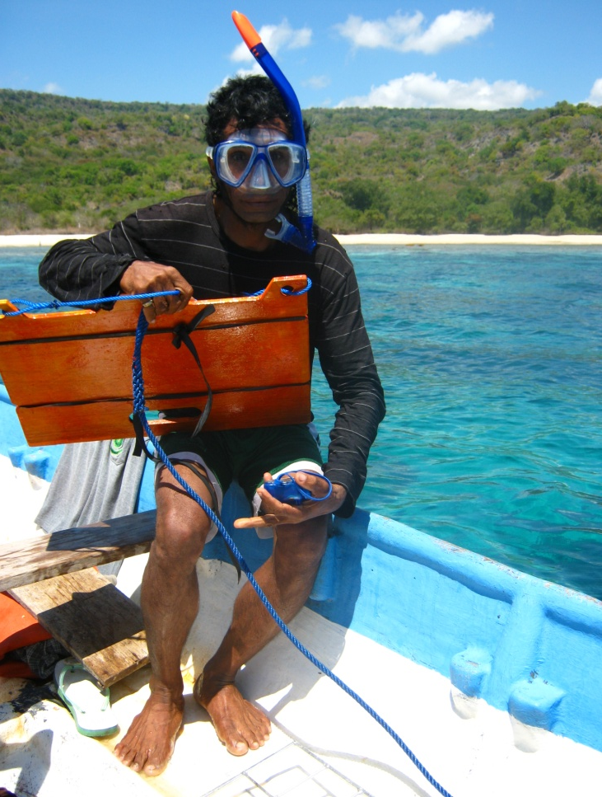
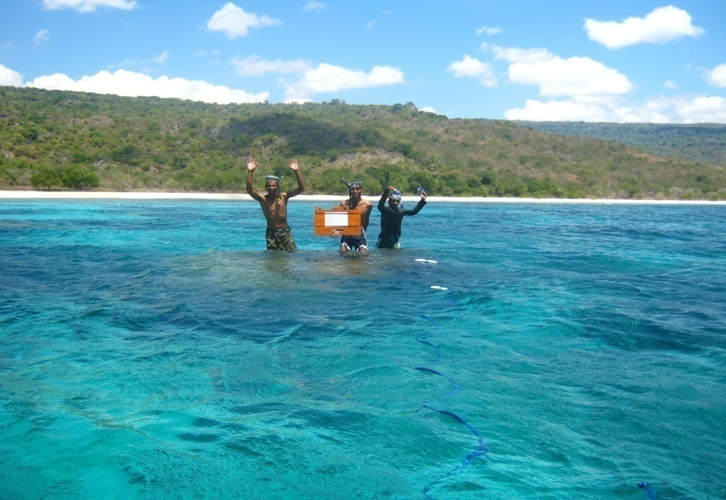
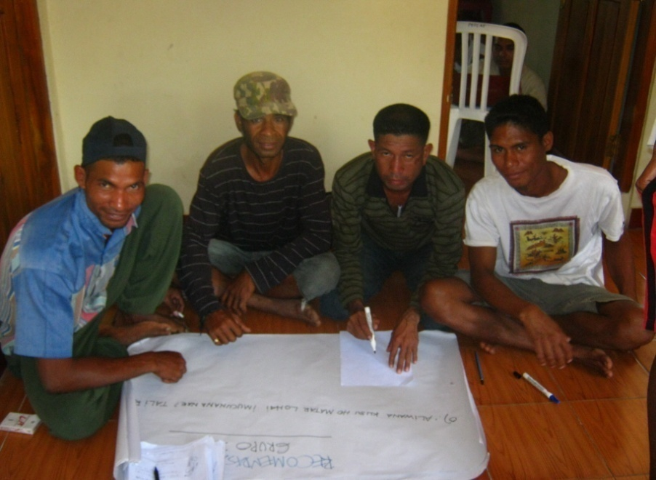
Lessons Learned: i.e NKSNP

Slide 25
Challenges:
Lack of Publick awereness
Law Inforcemant
Limited human resources
Limited of Infracstructure and Public
Facilities
Limited of Financial support

Slide 26
Next Steps
Need to improve Publick awereness Need to improve Law Inforcemant
Need to improve capacity building for human resources (Expert and technical )
Need to improve Infracstructure and Public Facilities
Need Financial support

