Slide 1
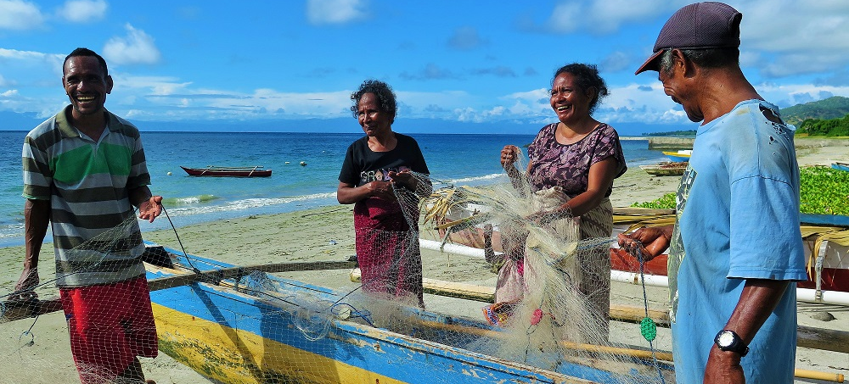
SOM14
14th Senior Officials’ Meeting
12 - 13 December 2018
Manila, Philippines
SESSION 11.1: WOMEN LEADERS’ FORUM
Presented by Chair of Women Leaders’ Forum (WLF)

Slide 2
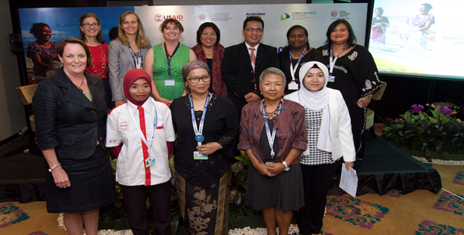
Outline
WLF 2018 Activities:
Update progress of SOM-13 recommendations and matters raised in Prep-SOM meeting in October 2018
Partners’ Activities
WLF 2019 Roadmap
CTI WLF Database
CTI WLF Ambassador and Chair
SOM- 14 Recommendations

Slide 3
1. Progress for SOM-13 Decisions
The development process of the Terms of Reference for both WLF Ambassador and Chair to start by December 2017 for SOM-14 approval;
Agreed to populate the WLF members directory;
Acknowledged and agreed to explore potential cooperation and provide full cooperation and participation in existing partners & collaborators programs with the support from Regional Secretariat and partners.
Urged the Regional Secretariat to ensure gender equality and women empowerment elements are incorporated in the Regional Plan of Action (RPOA) review process;
Agreed to initiate the development of a CTI-CFF Gender Policy with the support from partners and collaborators;
Agreed to undertake a stock-take of existing gender policies within CT6 Member Parties;
Urged Regional Secretariat to work with partners to ensure gender measures are embedded in all phases of programming, budgeting, and in the CTI M&E Operations Manual; and
Agreed to continue representing CTI-CFF in regional and international events.
Notes:
10.2. Women Leaders Forum (WLF) (Annex 10.2, Attachment 10.2.a)
10.2.1. Acknowledged the following:
10.2.1.1. Women related programs by partners and
collaborators with a view to learn, adapt and
replicate relevant programs in other CT6 areas;
10.2.1.2. WLF activities throughout 2017;
10.2.1.3. The appointment of Prof Dato’ Noraieni Hj
Mokhtar as the CTI WLF Ambassador and Ms.
Agnetha Vave Karamui as the Chair of WLF;
10.2.1.4. The development process of the Terms of
Reference for both WLF Ambassador and Chair to
start by December 2017 for SOM-14 approval;
The 13th CTI-CFF Senior Officials’ Meeting 16
10.2.1.5. Agreed to populate the WLF members directory;
and
10.2.1.6. Acknowledged and agreed to explore potential
cooperation and provide full cooperation and
participation in existing partners & collaborators
programs with the support from Regional
Secretariat and partners.
10.2.2. Urged the Regional Secretariat to ensure gender equality
and women empowerment elements are incorporated in
the Regional Plan of Action (RPOA) review process;
10.2.3. Agreed to initiate the development of a CTI-CFF Gender
Policy with the support from partners and collaborators;
10.2.4. Agreed to undertake a stock-take of existing gender
policies within CT6 Member Parties;
10.2.5. Urged Regional Secretariat to work with partners to ensure
gender measures are embedded in all phases of
programming, budgeting, and in the CTI M&E Operations
Manual; and
10.2.6. Agreed to continue representing CTI-CFF in regional and
international events.

Slide 4
Partners’ Activities
Acknowledge and appreciate program updates from:
Coral Triangle Centre (CTC) and the USAID and US Department of Interior (DOI) for the continued support to WLF i.e. Intergenerational Learning Program and the Australian Government for women economic empowerment project in Arafura Sea under the SeaNet project;
Gender programs of the USAID Oceans and Fisheries Partnership in two (2) learning sites in Bitung, Indonesia and General Santos, Philippines which can form the basis for further comprehensive gender studies in CT6;
World Wide Fund for Nature (WWF) program for Financial Inclusion and Empowerment for Women in Coastal Communities; and
The Nature Conservancy (TNC) works with women in Papua New Guinea in mangroves which can also form the basis for further comprehensive gender studies in CT6;

Slide 5
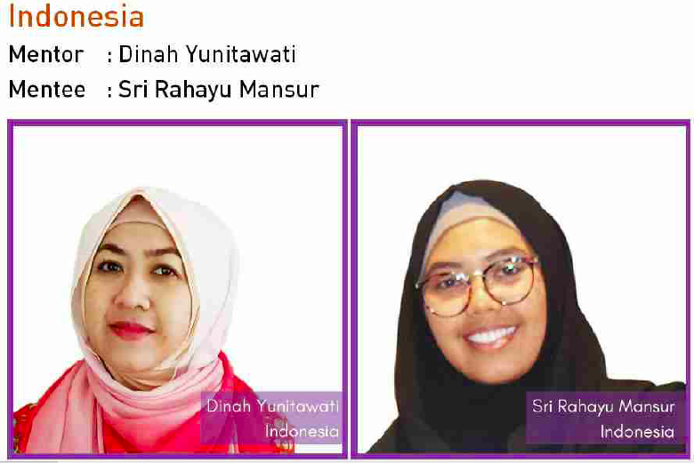
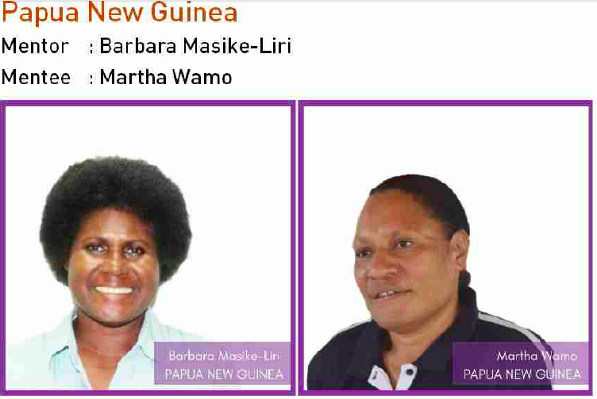
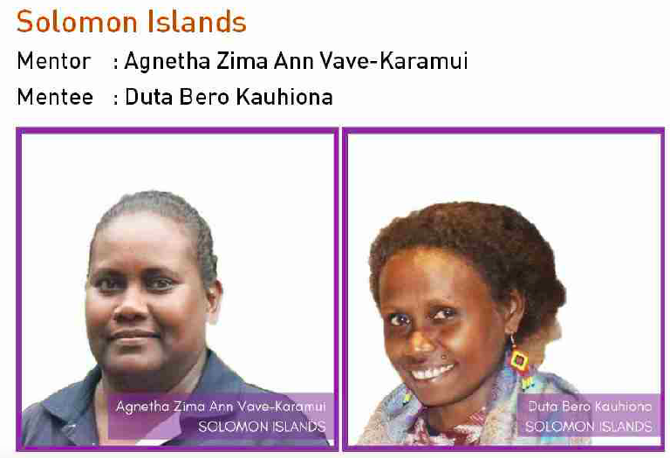
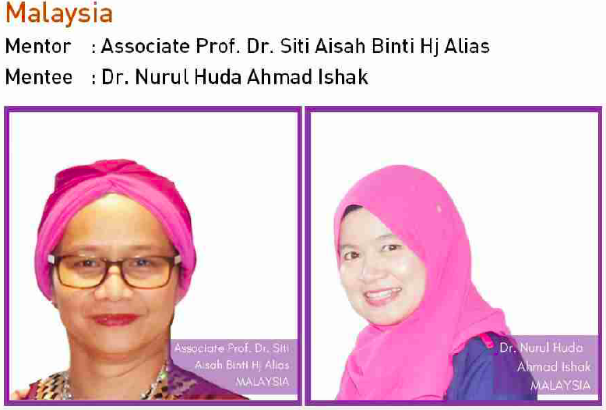
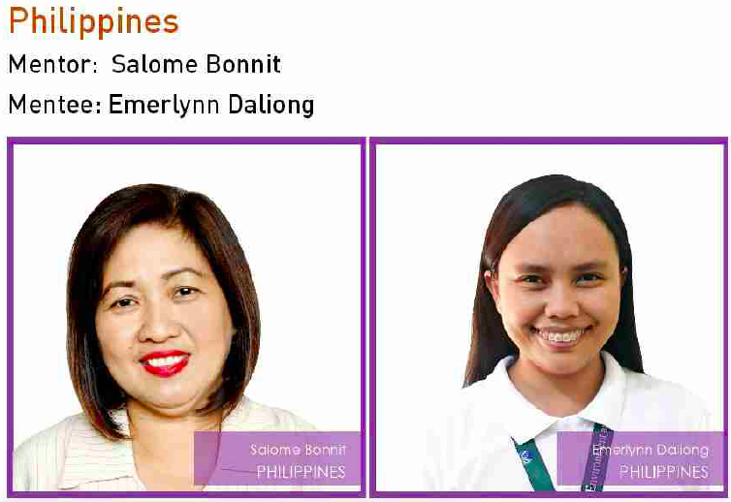
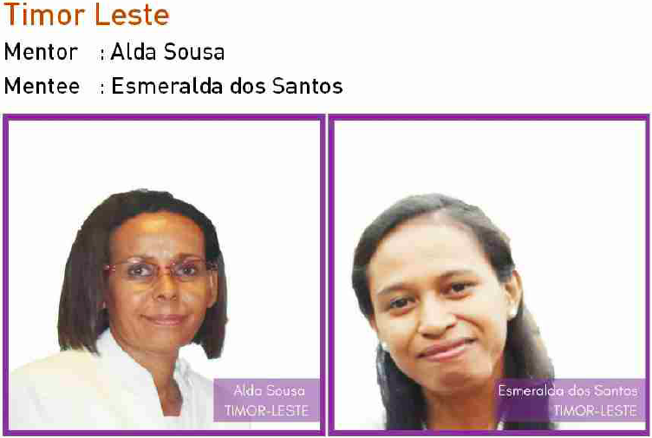
Inter-Generational Leadership Learning Program Mentor and Mentees (CTC)

Slide 6
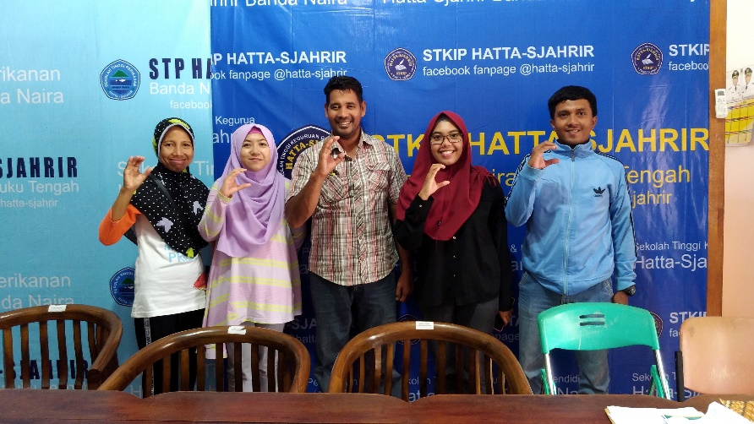
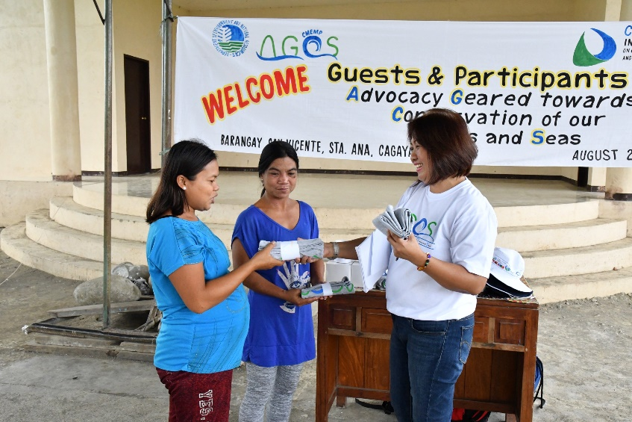
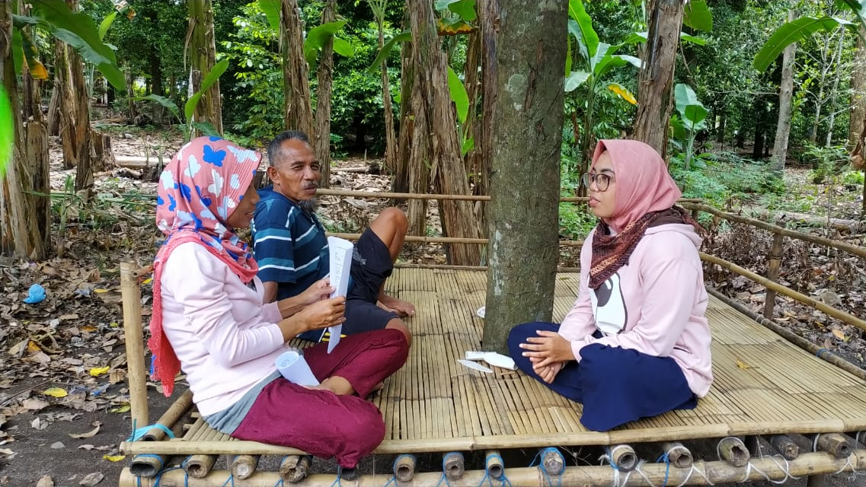
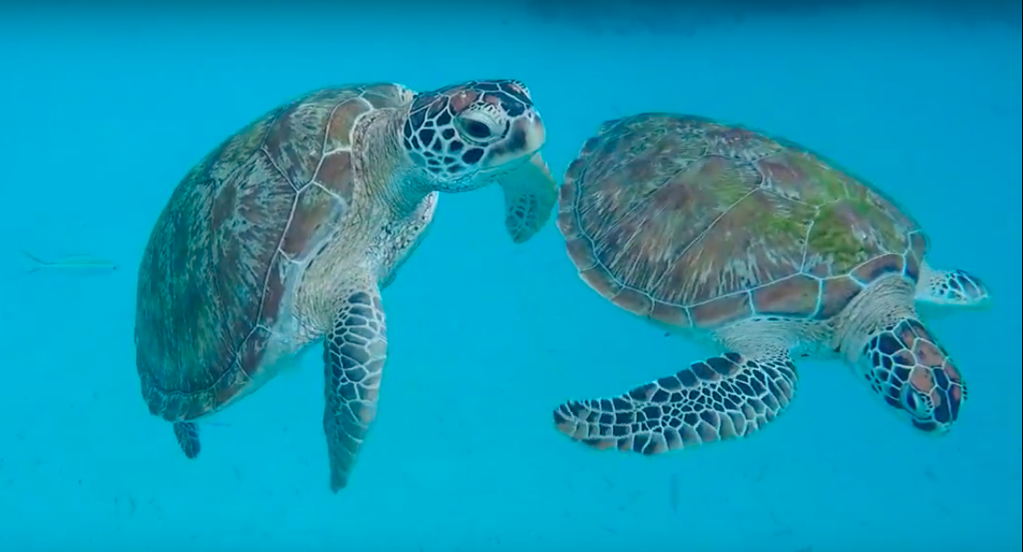
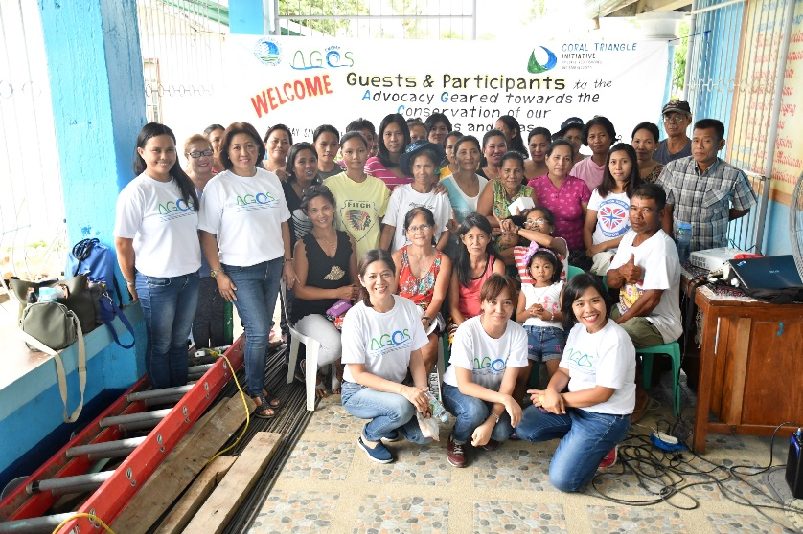
Conservation Challenge Projects

Slide 7
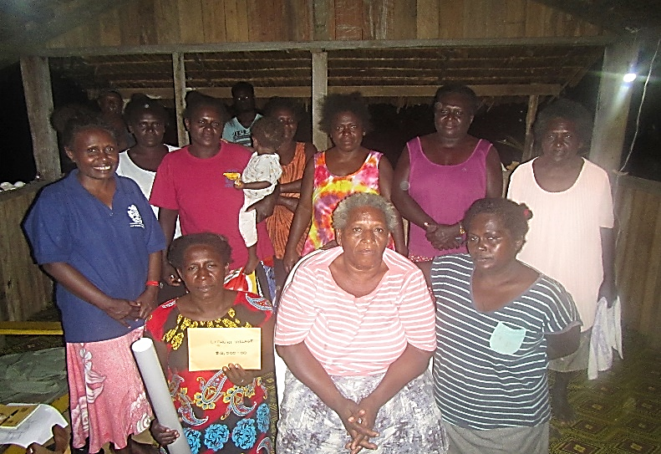
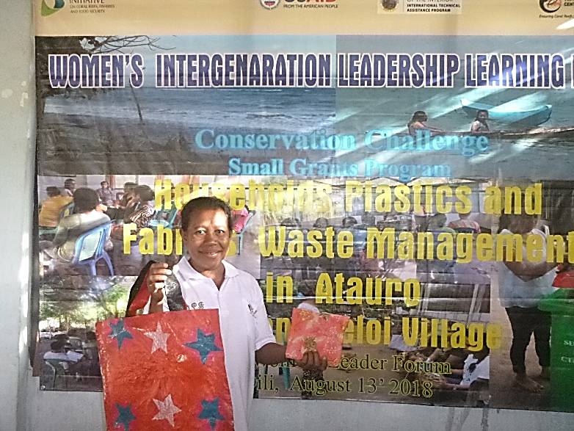
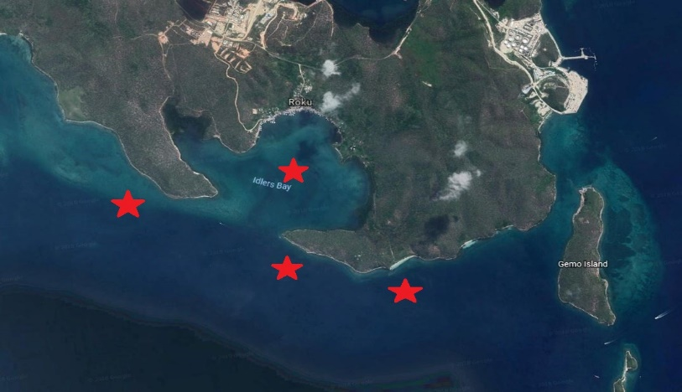
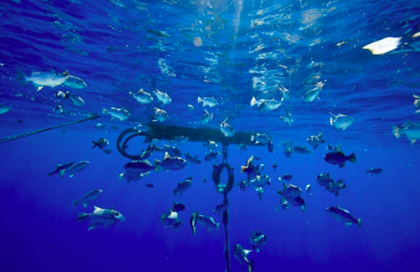
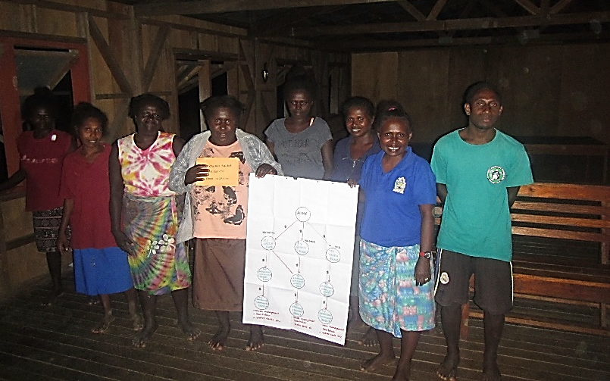
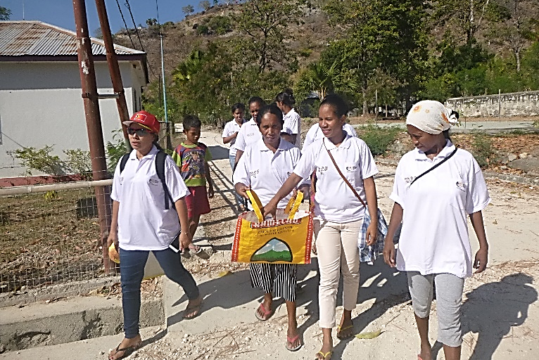
Conservation Challenge Projects

Slide 8
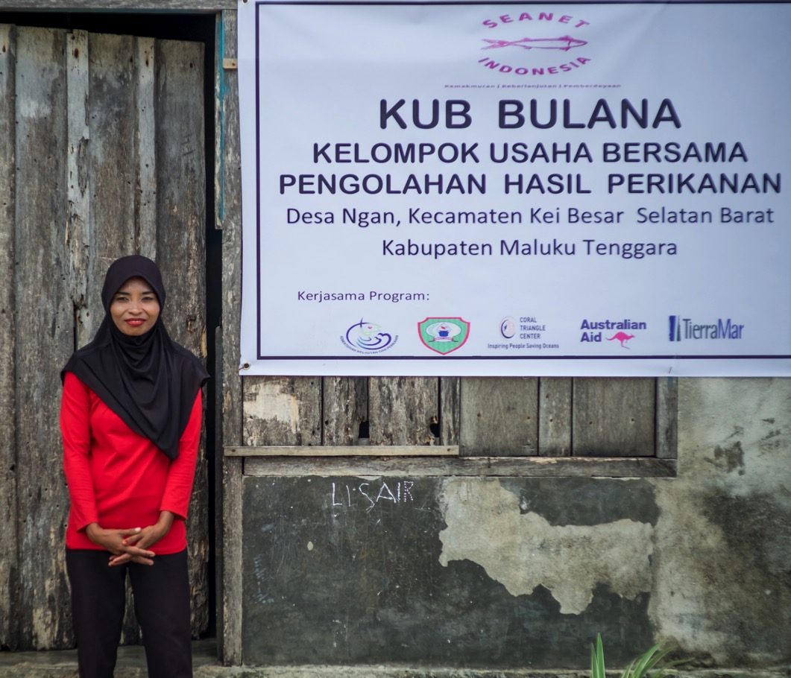
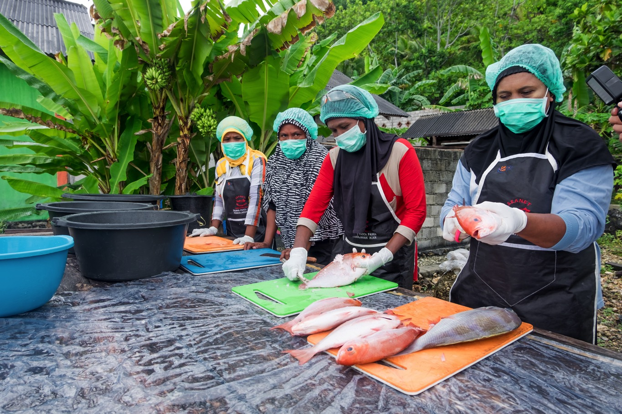
Women In Fisheries Economic Empowerment in the Arafura Sea (Indonesia)
MPA Socialization, Buano Island
MPA Socialization, Buano Island

Slide 9
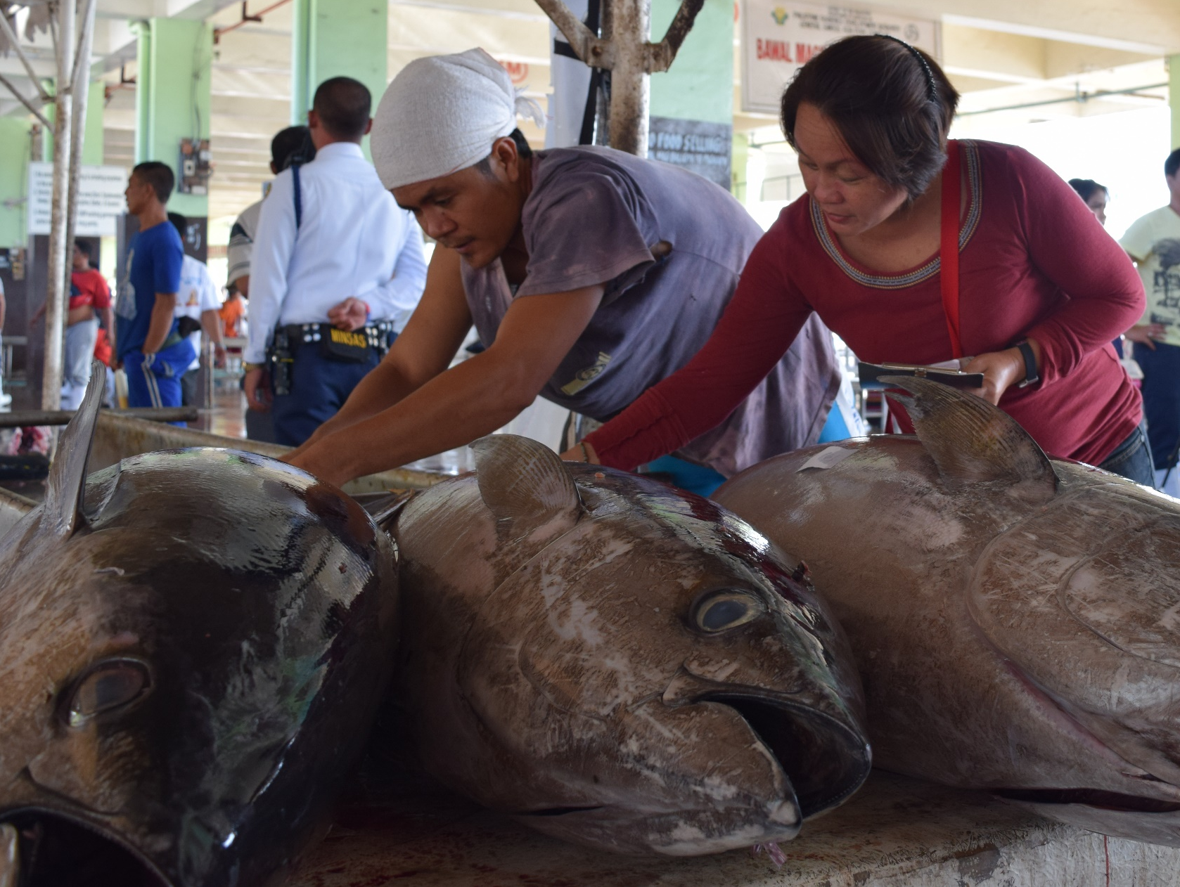
preSOM
14th Senior Officials’ Meeting
10 - 11 December 2018
Manila, Philippines
USAID OCEANS AND FISHERIES PARTNERSHIP
Presented by Arlene Nietes Satapornvanit
Gender Specialist
USAID Oceans

Slide 10
OUR 4 STRATEGIES
Incorporate human welfare and gender considerations throughout all program strategies and activities.
Identify key human welfare concerns and support the development of policy, frameworks, and interventions that address these issues
Key Data Elements on gender and labor considered as part of the CDTS development process
Regional, national, and learning site-level trainings and workshops will feature human welfare and gender equity considerations
Notes:
USAID Oceans incorporates human welfare and gender considerations throughout all program strategy and activities. Through detailed gender and labor studies, USAID Oceans seeks to identify key human welfare concerns and support the development of policy, frameworks, and interventions that address these issues. Key Data Elements on gender and labor will be part of the CDTS development process, and regional, national, and learning site-level trainings and workshops will feature human welfare and gender equity considerations.

Slide 11
Human Welfare and Gender Integration: strategies
Promotion of safe and humane labor practices and gender equity
Capacity building with enhanced, gender sensitive human well-being pillar
Consideration and integration of Human Welfare Key Data Elements in the catch documentation and traceability technology
Prioritization of vulnerable populations through targeted gender interventions
Technical working group on HWGL, partnerships, gender champions, women leaders
Advocacy and legal documents, dissemination of information

Slide 13
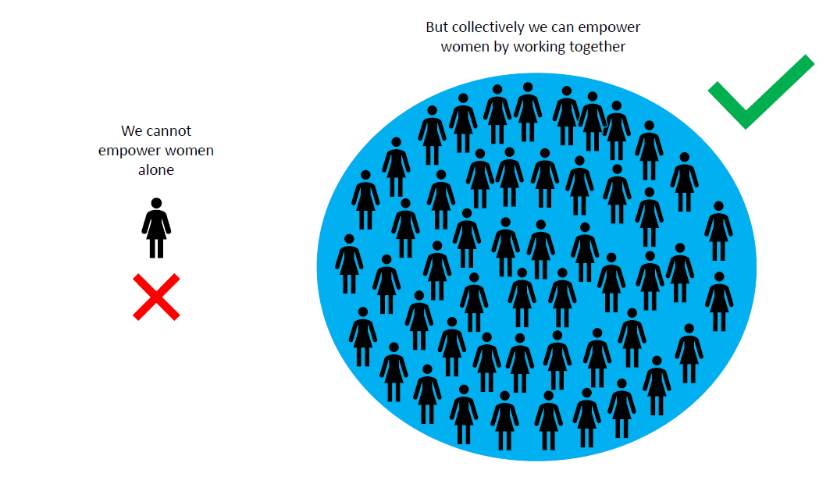

Slide 14
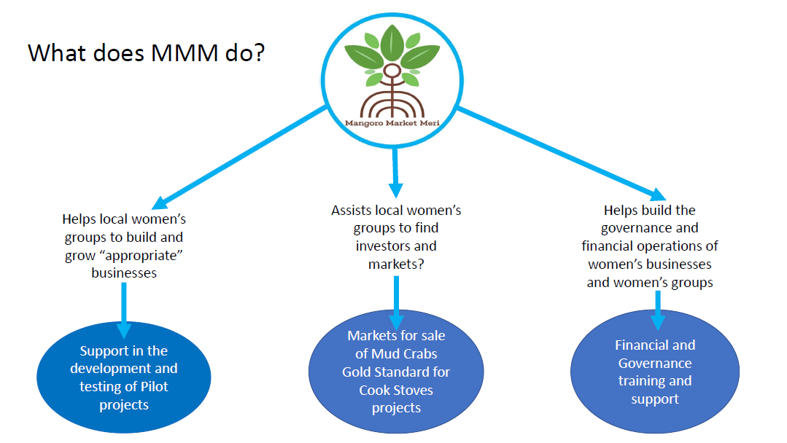

Slide 15
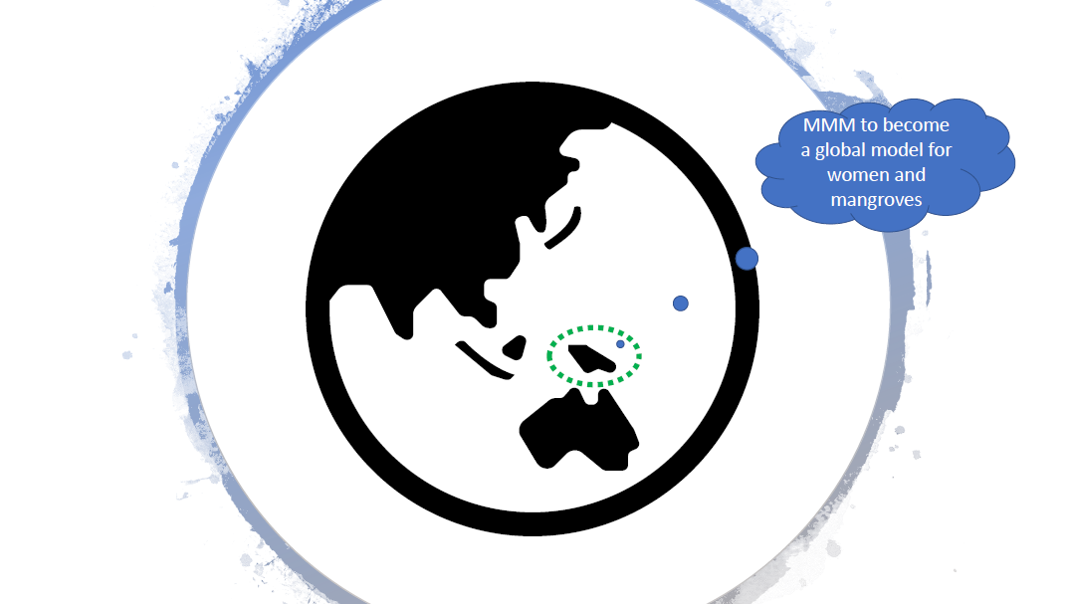

Slide 16
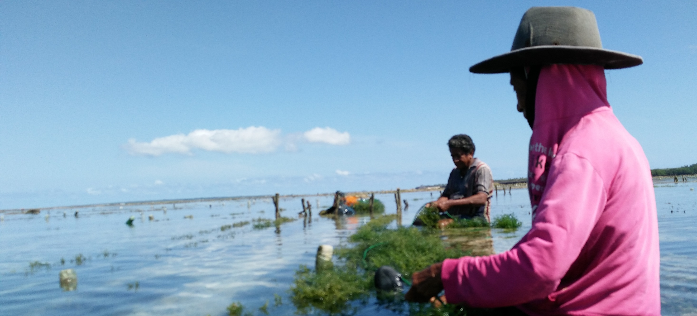
preSOM
14th Senior Officials’ Meeting
10 - 11 December 2018
Manila, Philippines
Financial Inclusion and Empowerment for Women in Coastal Communities
Presented by Jackie Thomas, WWF

Slide 17
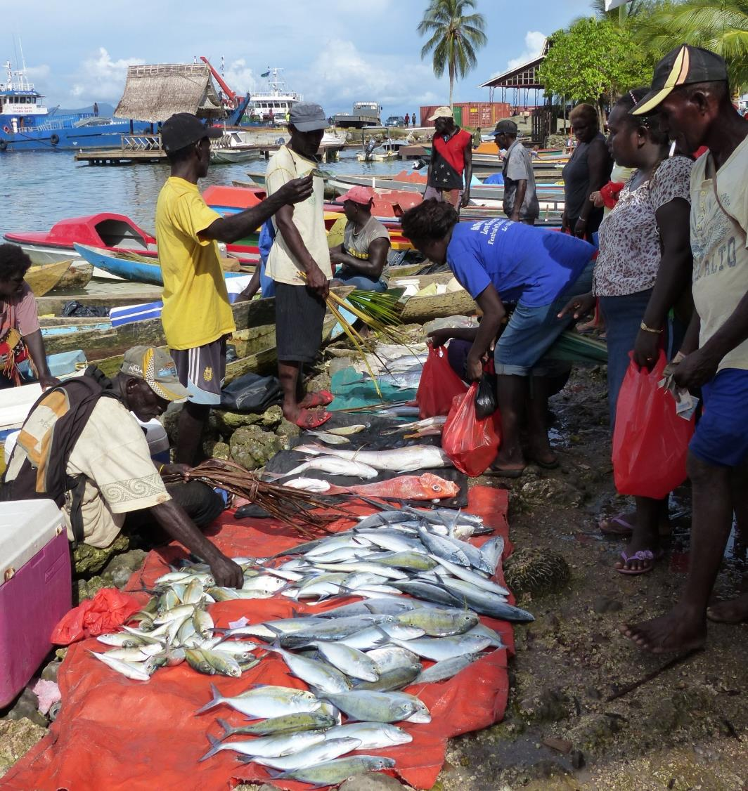
Empowering Women through Financial Inclusion
WWF aims to improve livelihoods & food security of coastal fishing communities where we work
Innovative approaches to sustainable community-based fisheries co-management, linked to empowering women thru financial inclusion
High dependency of coastal communities on fisheries for income, livelihoods, food security
Helps answer Community questions about benefits from conservation & resource management.
© Andrew Smith / WWF

Slide 18
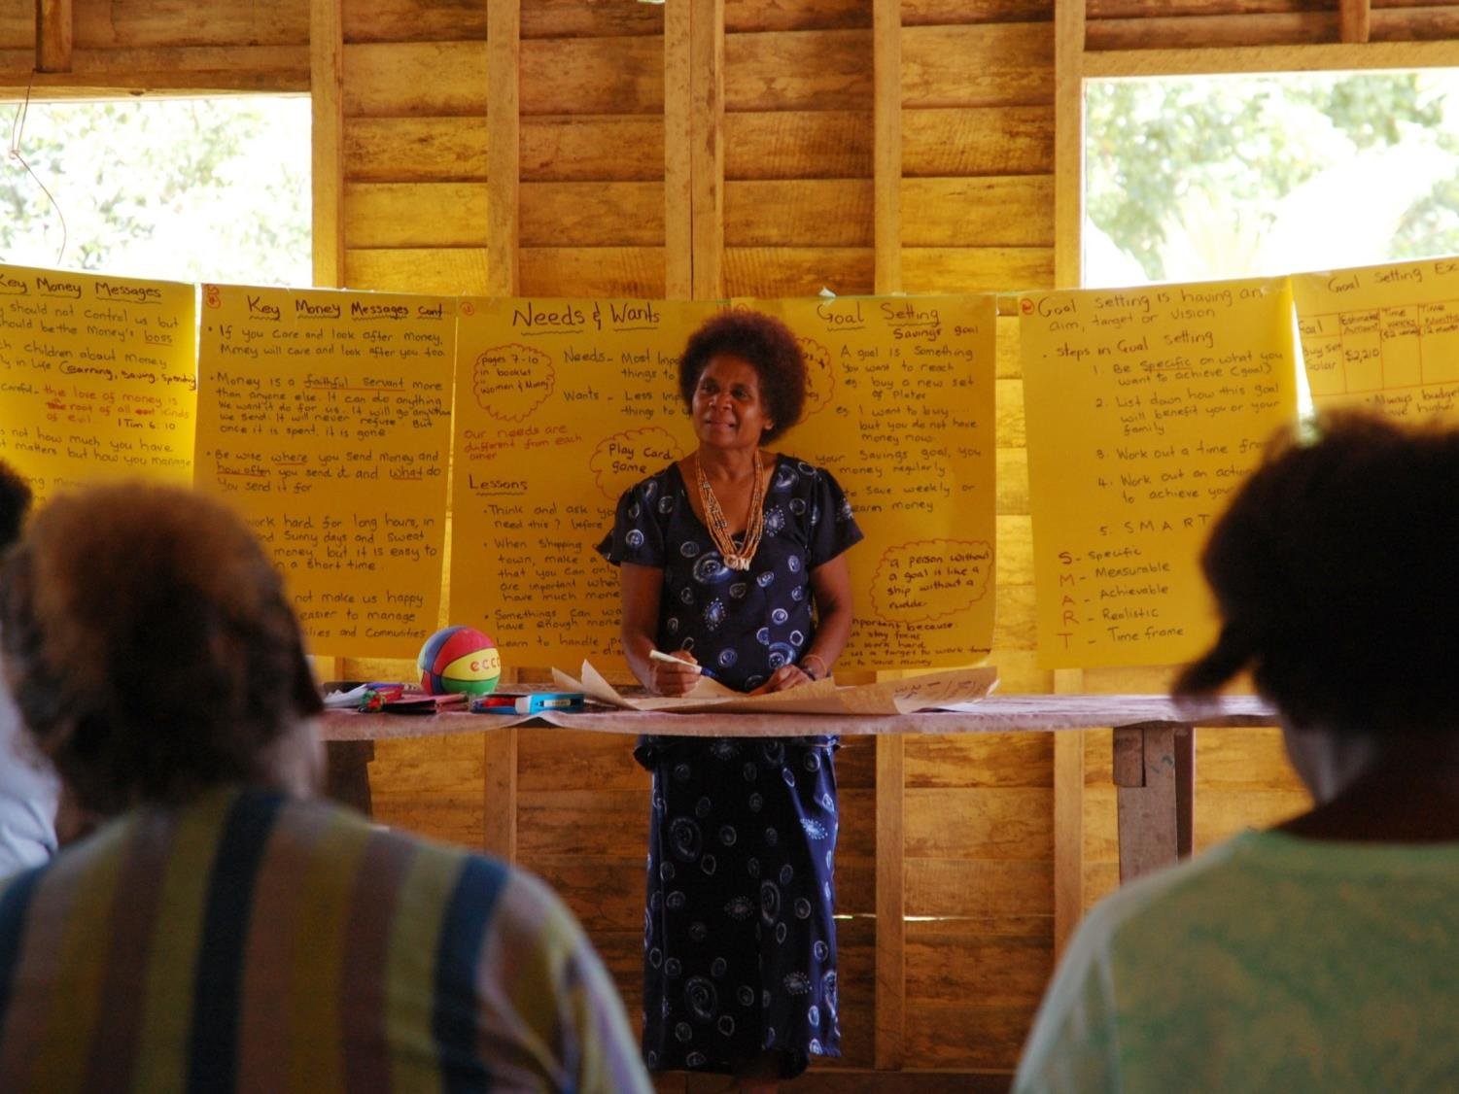
Western Province of the Solomon Islands: Building Capacity of Women, by Women
Working with & through local partners to establish micro-finance mechanisms
Self-sustaining and self-governing mechanisms;
Act as catalysts for small business opportunities for women.
Activities:
Financial literacy, Micro-finance & Small Business training
Facilitate Micro-savings & Loans Schemes through Savings Clubs
Identify small business & sustainable livelihood opportunities
Small Business Planning, Governance, Leadership
© Sara Martin / WWF
Solomon Islands’ Dr Alice Pollard, expert trainer in Micro-Finance mechanisms & Savings Clubs

Slide 19
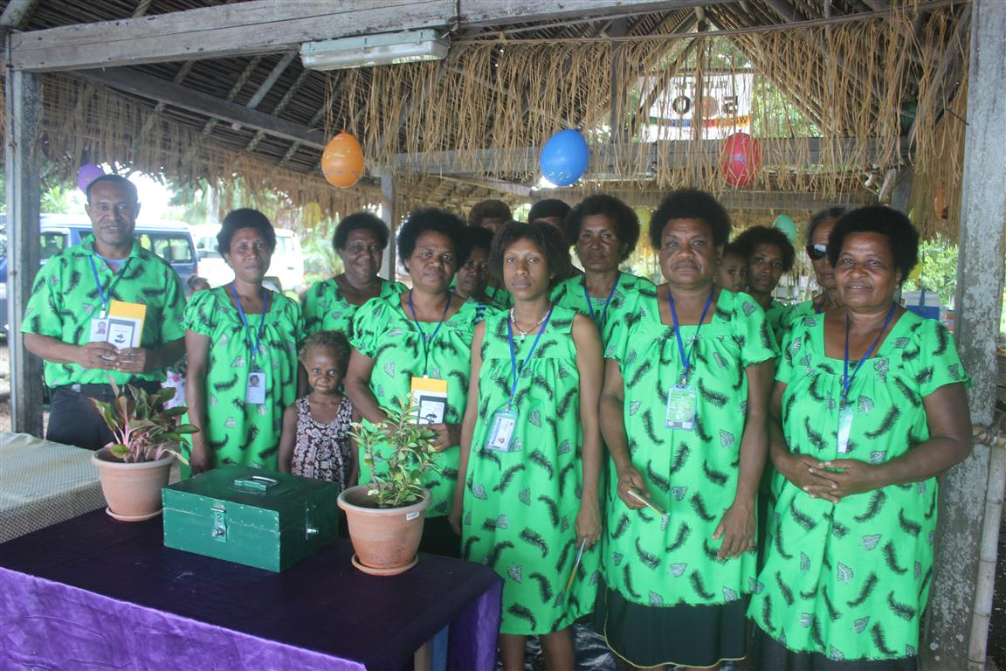
Papua New Guinea – Madang Province Microfinance Village Savings & Loan Concept
Rolling out in 15 Community Based Fisheries management communities in 3 districts of Madang Province (Madang, Sumkar, Bogia)
5 Village Savings groups
WWF supplies savings kits, passbooks, stationery, ID cards, locks/keys, savings box
Training Module developed for Field officers – a guide on how to establish savings groups.

Slide 20
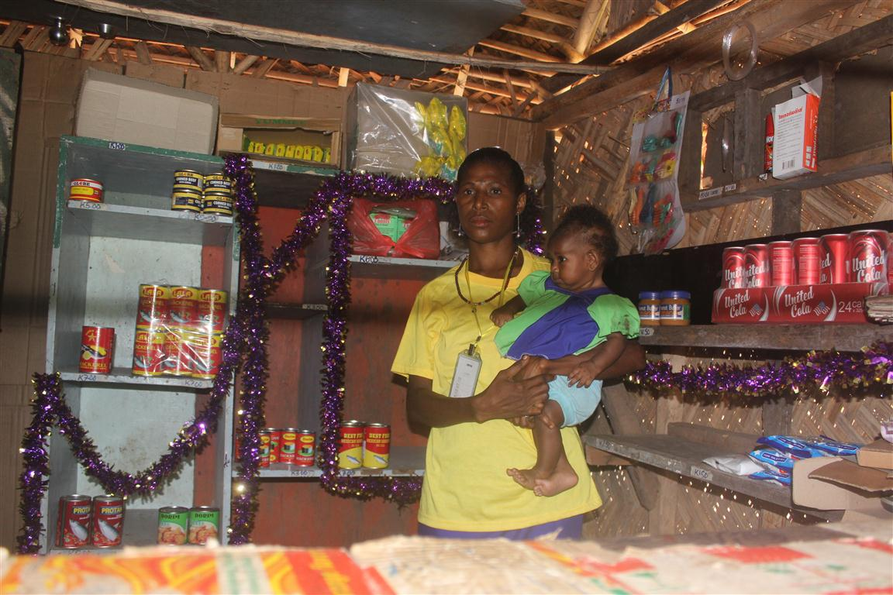
Papua New Guinea – Madang Province
Village Savings & Loan concept based on World Vision’s livelihoods programme
778 members, mostly women
Training on budget & loan management in simple grassroots language, provided in partnership with World Vision,
12,807 PGK (3,800 USD) in group savings; 15-20 micro businesses established.
Members taught banking at their doorsteps, how to get loans from their savings.
Meetings held weekly/fortnightly based on members constitution law
6 monthly meetings to capture challenges experienced, lessons learnt, way forward for improvement.
Sustainability criteria (environmental; socially, ethically; financially) included in saving clubs constitutions & loans

Slide 21
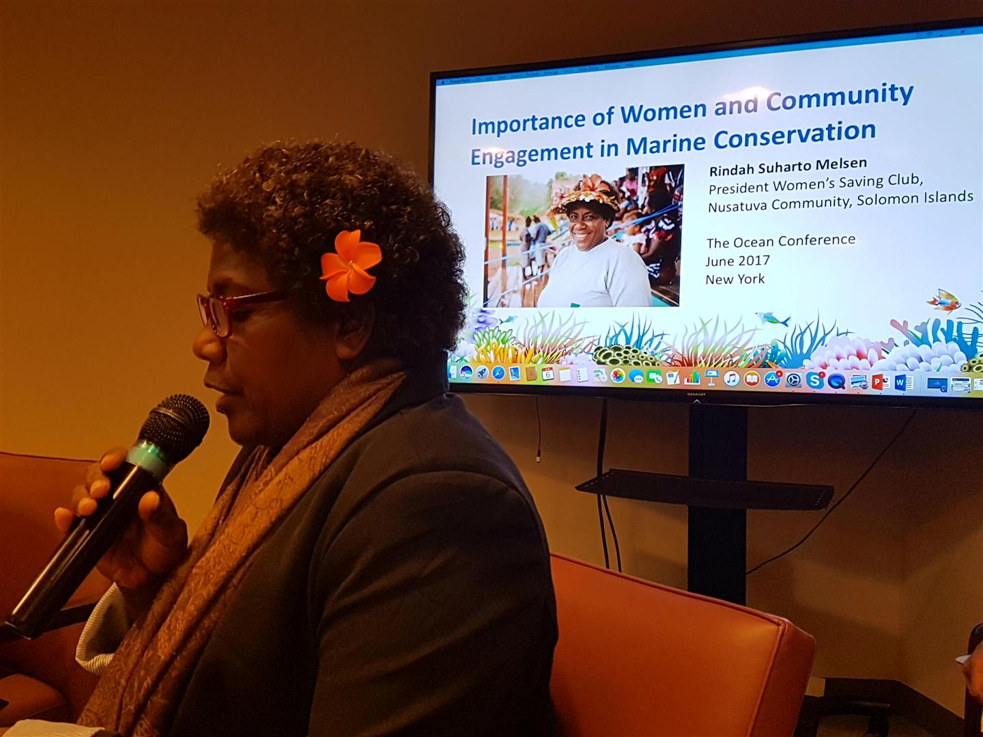
Expanding the Global Reach of Women
Women from coastal communities –
Becoming global advocates for the important role of women in management of their marine resources and as leaders in their communities.
Rindah Melsen, President, Nusatuva Women’s Savings Club, Solomon Islands, UN Oceans Conference, New York, June 2017

Slide 22
Call Meetings
Inter-generational Leadership Learning Program
Initiated Stocktake Gender Policies in CT6
2018 Activities

Slide 23
Prep-SOM Meetings
Prep.SOM.MM – Review of RPOA
Acknowledge the work of WLF despite not being in the formal RPOA to increase the equity, inclusion and impact of the whole CTI.
The cross-cutting forums (LGN, WLF, RBF), for example, were perceived by some respondents as requiring more focus by the Regional Secretariat, given the forums enable private sector, women leaders and local government leaders to support or even lead towards tangible CTI on-the ground impacts as well.
The role of women and minority groups in developing or supporting local level stewardship over natural resources - including coastal – is increasingly being considered as of high additional and strategic value.

Slide 24
2. WLF 2019 Roadmap
Identify learning exchanges / training opportunities (with RS proposed budget)
Identify potential sources of funds
Participate in RPOA 2.0 development
Collate / document Partners’ gender programs [lessons learnt & recommendations]
Appoint new WLF Ambassador for 2019
Identify at least one (1) international participation in 2019 (under RS capacity building budget for one rep)

Slide 25
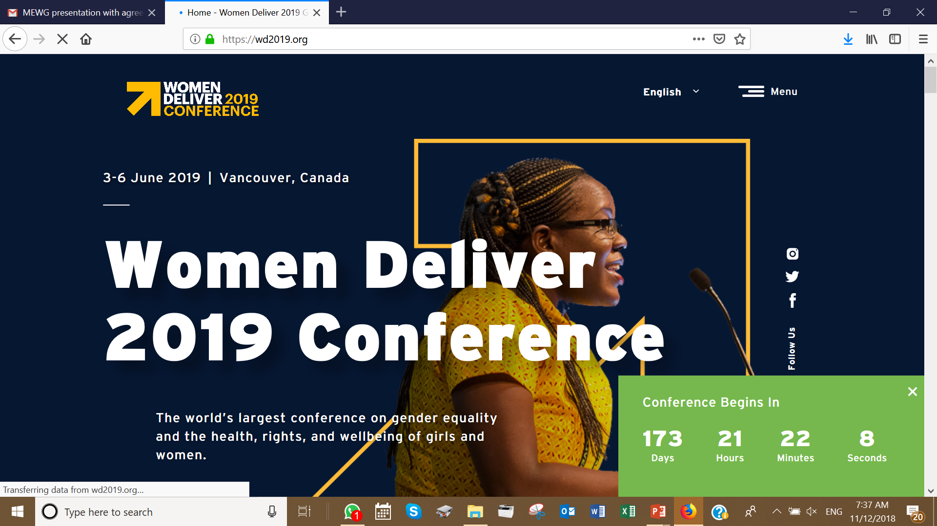
Women Deliver 2019 3-6 June | Vancouver, Canada

Slide 26
2019 CTI WLF Budget
Photo: © MFF Indonesia
Proposed USD24,336.00 allocated for 2019
Originally meant for Gender Policy workshop
[one NCCs for 4 nights incl. lodging and logistical exp. in one of CT3 SEA countries].
However, the amount in total (above) can be deliberated among WLF members on how best to utilize the fund.

Slide 27
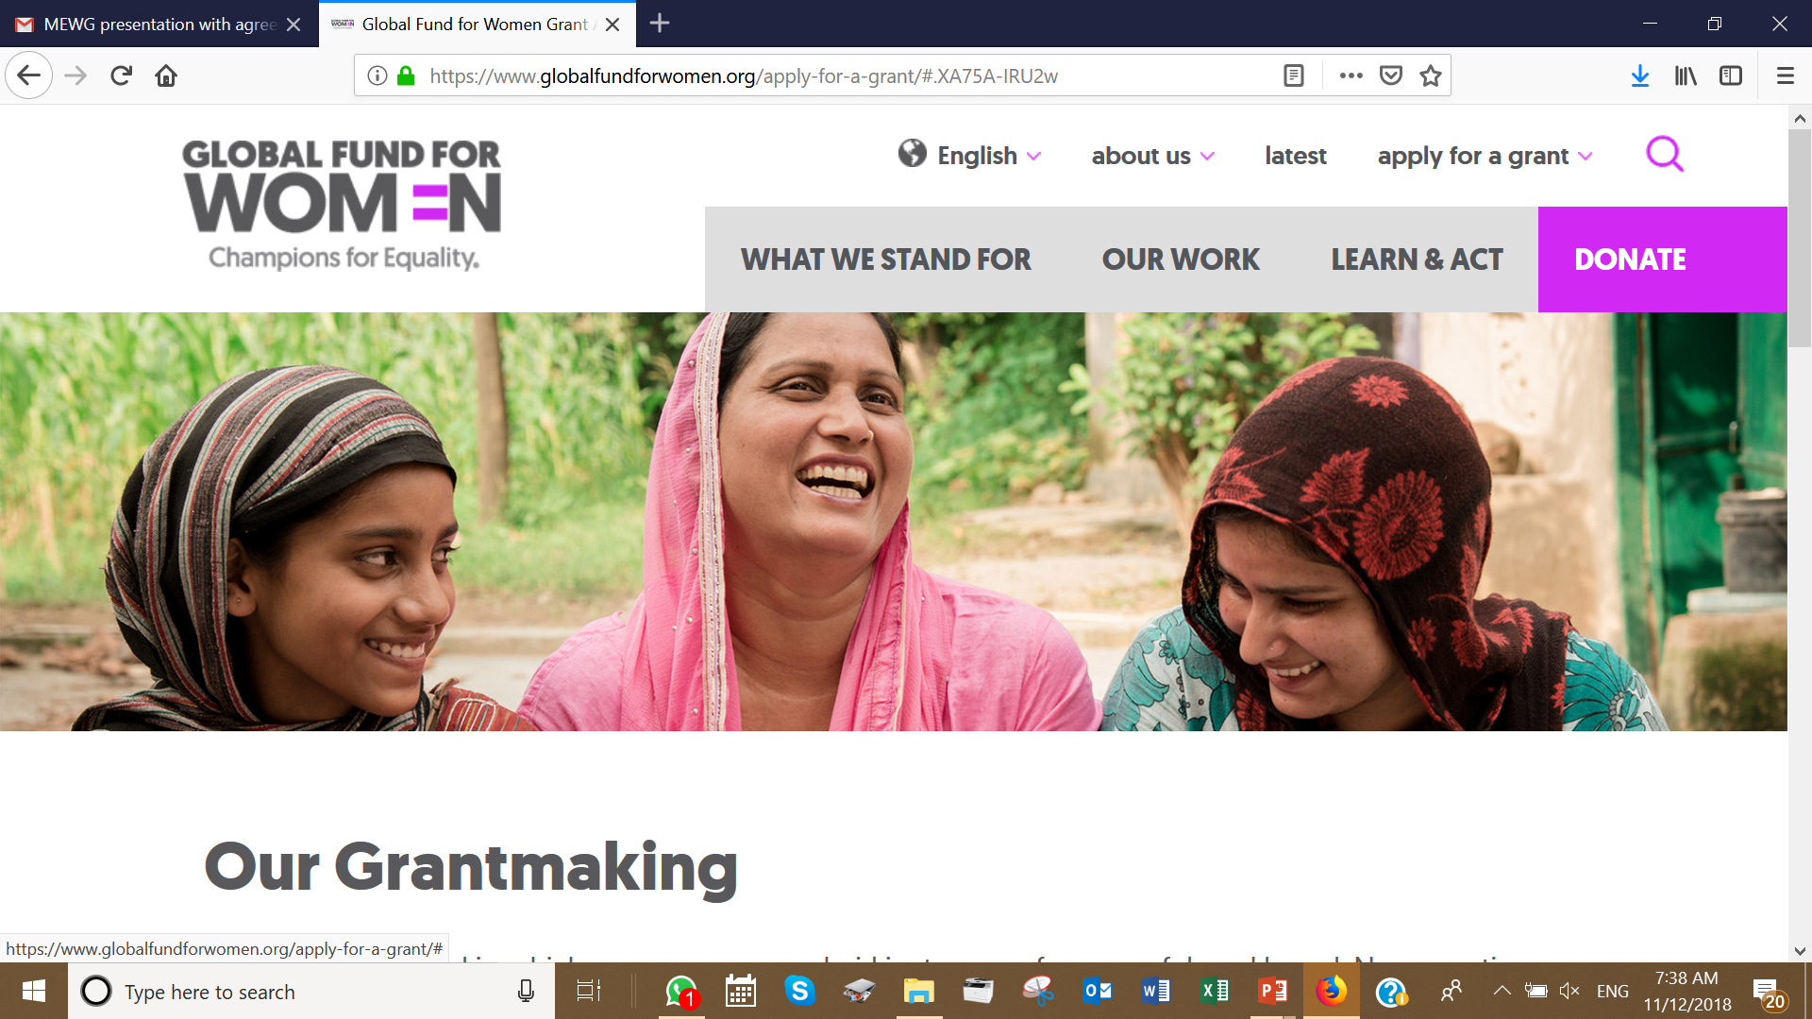
Potential other sources of funds

Slide 28
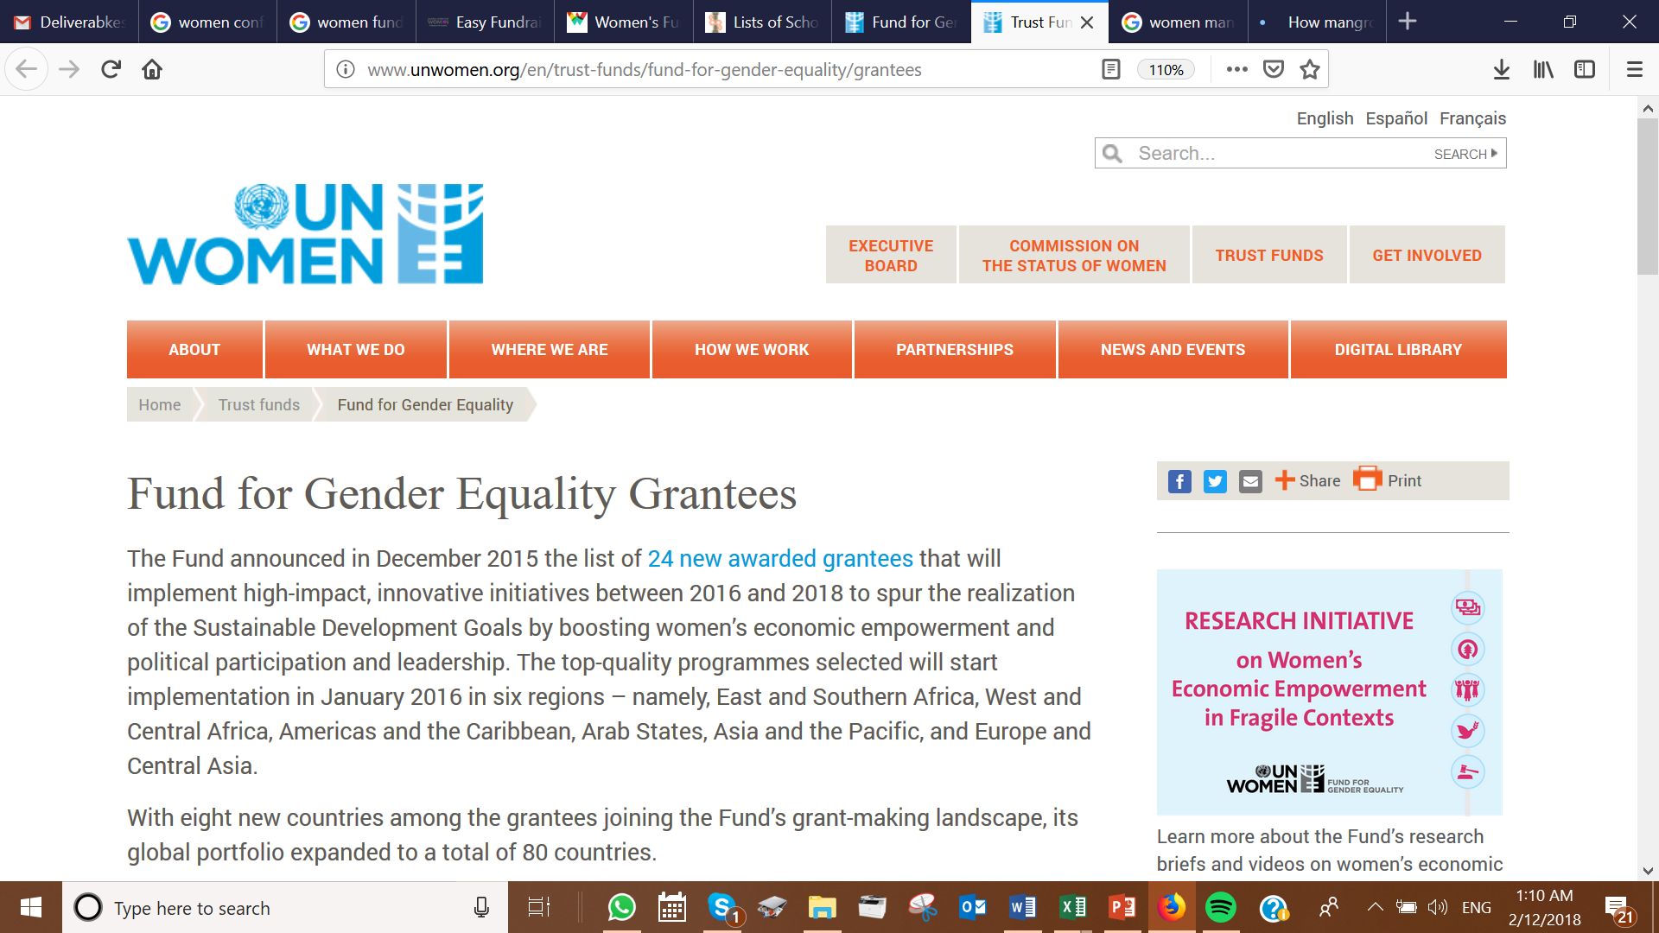

Slide 29
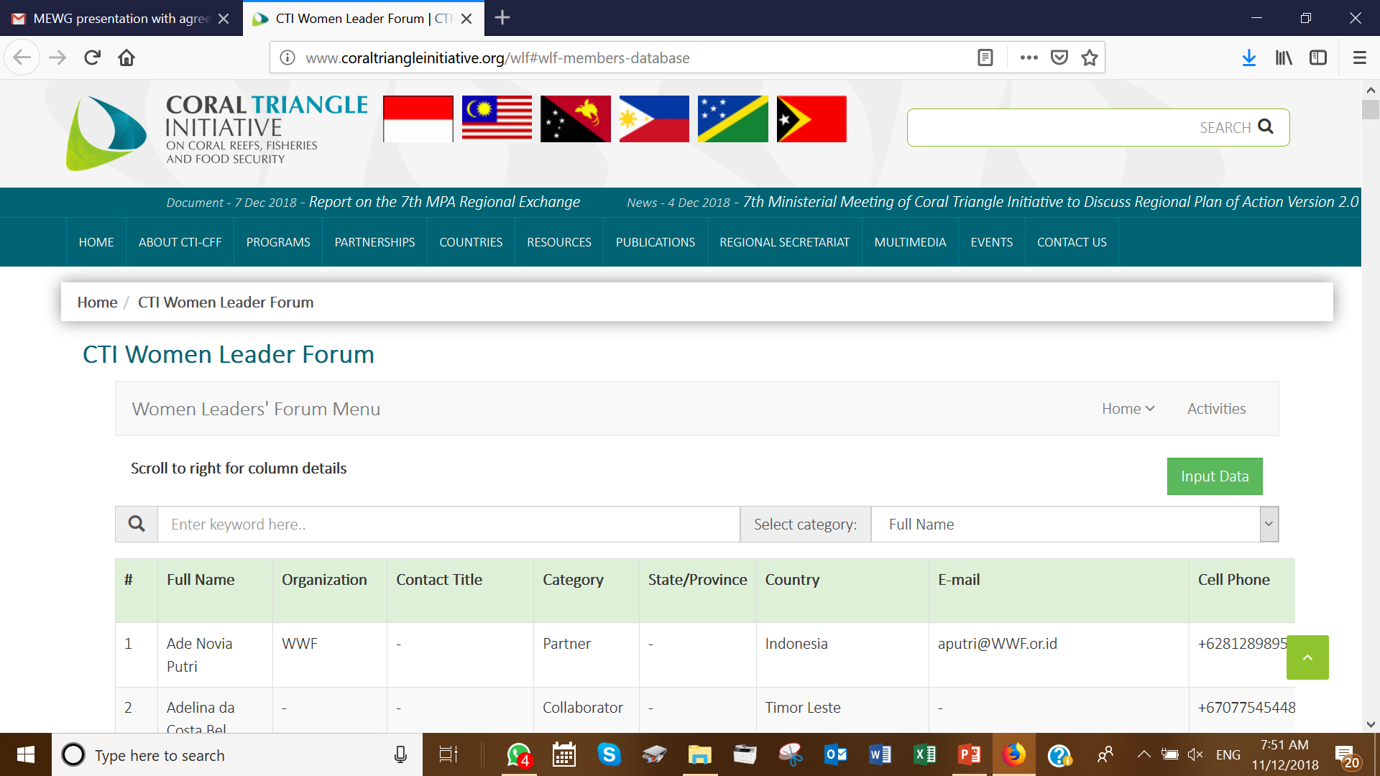
3. WLF Database
http://www.coraltriangleinitiative.org/wlf#wlf-members-database

Slide 30
4. TERMS OF REFERENCES
Ambassador Terms of Reference (TOR)
Chair Terms of Reference (TOR)
Time commitment
The ambassadorial role is voluntary. The suggested duration of the commitment is twelve months commencing 1st January to 31st December; renewable upon further discussion prior to expiration of the term. It is expected that the role of ambassador is performed within the normal course of business. However, the ambassador is free to undertake additional responsibilities at her own discretion.
For full TOR, please refer to Annex 6
Term shall end by 31st December 2018
APPOINTMENT PROCEDURES AND TENURE
The WLF Chair will be chosen from among the members of the CTI-CFF WLF Steering Committee and should be an active member of the CTI-CFF National Coordinating Committee.
The appointment of the CTI-CFF Women Leaders Forum Chair is based on majority agreement with nomination from members of WLF. The tenure of the Chairmanship is for two (2) years, subject to extension of another two (2) years based on members’ recommendations. Otherwise, a fresh election shall be made during pre-SOM meetings or WLF meetings prior to the annual Senior Officials’ Meeting(s).
For full TOR, please refer to Annex 7

Slide 31
WLF Ambassador’s Promotion of CTI-WLF in 2018
MyCoral 2.0 Marine Education Initiative
Earth Day Celebration
Coral Reef Conservation Campaign with Marine Parks Malaysia
Speaker at 2nd Port-City Universities Summit (PUS2018) at National Taiwan Ocean University;
Keynote Address at the Tropical Ocean and Marine Science Symposium: Embracing spirit of SDG-14;
Appreciate CTC’s Intergenerational Learning Program.
https://drive.google.com/file/d/1q7CXs9DwWs5jCKC_ju7D4yET2bSJ1Hiv/view

Slide 32
SOM-14 Recommendations

Slide 33
SOM-14 Recommendations
Acknowledge the uncompleted activities that were unable to be completed in 2018 due to time and financial constraints;
Acknowledge Partners projects and programs from: Coral Triangle Centre (CTC) and the USAID and USDOI for the continued support for WLF; i.e. Intergenerational Learning; Gender programs of the USAID Oceans and Fisheries Partnership in two (2) learning sites in Bitung, Indonesia and General Santos, Philippines which can form the basis for further comprehensive gender studies in CT6; WWF program for Financial Inclusion and Empowerment for Women in Coastal Communities; and The Nature Conservancy (TNC) works with women in Papua New Guinea in mangroves;
Note the importance of the role of women to affect change in marine resource management, waste management, climate change adaptation, amongst others, towards sustainable development
Notes:
Acknowledge the outstanding activities that were unable to be completed in 2018 due to time and financial constraints;
Initiate development of CTI-CFF Gender Policy with support from partners and collaborators
Undertake stock-take of existing gender policies in CT6;
Ensure gender measures are embedded in M&E Operations Manual; and

Slide 34
SOM-14 Recommendations (2)
Continue with the CTI-CFF Gender Policy development with support from partners and collaborators, and ensure the CTI-CFF Gender Policy is integrated in the development of the Regional Plan of Action 2.0 (RPOA 2.0), by July 2019;
Encourage participation of young and marginalized women into CTI-WLF programs;
Accept the financial support from the Regional Secretariat of USD24,336.00 for capacity building programs; subject to SOM-14 approval)
Approve the following:
The Terms of References (TORs) for Ambassador and Chair of WLF for future appointments; and
WLF 2019 roadmap.
Agree for the WLF to call for CT6 nominations for WLF Ambassador and Vice-Chair roles and make appointments of both roles by end of February 2019.
Notes:
Initiate development of CTI-CFF Gender Policy with support from partners and collaborators
Undertake stock-take of existing gender policies in CT6;
Ensure gender measures are embedded in M&E Operations Manual; and

Slide 35
Terima Kasih - Maraming Salamat Tank Iu- Obrigado Tagio Tumas
Photo credits: Pixabay & IYOR Bank/JayneJenkins/FabriceDudenhofer/Yen-YiLee

