Slide 1
Papua New Guinea’s Leadership Report as the Chair of Committee of Senior Officials (CSO) and Council of Ministers (COM)

Slide 2
BACKGROUND
The 5th Ministerial Meeting (MM-5) held in 2014 in Manado, Indonesia acknowledged the election of Papua New Guinea as the Chair and the Philippines as the Vice Chair of the CTI-CFF Council of Ministers for the period of two years from 16 May 2014 to 16 May 2016 and/or such a time when the Ministerial Meeting will be held after 16 May 2016.

Slide 3
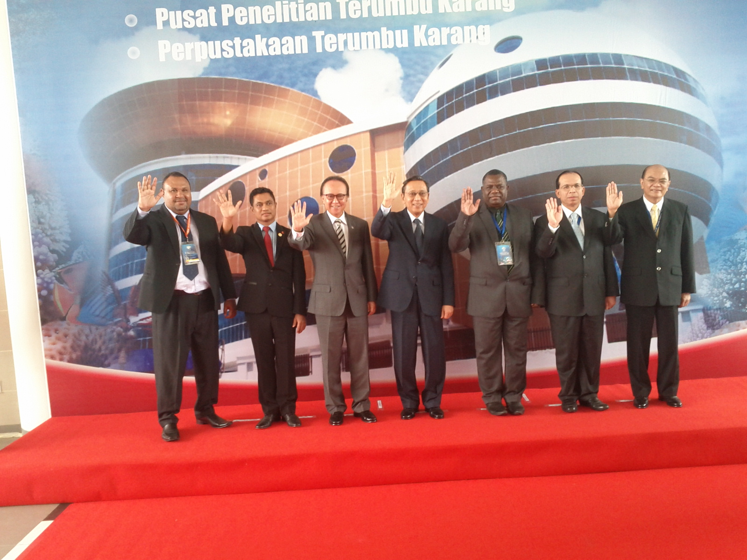
ACCOMPLISHMENTS
Inauguration of CTI-CFF building in May 2014 in Manado, Indonesia.
Ratification of the Agreement on Establishment of CTI-CFF Regional Secretariat by Philippines (2014) and PNG (2016)

Slide 4
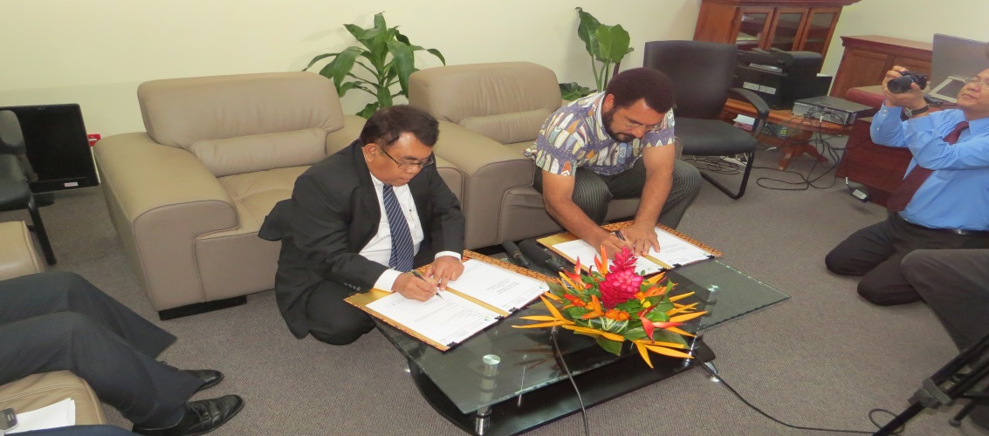
ACCOMPLISHMENTS
Prof. Widi Pratikto, elected Executive Director of the CTI-CFF Regional Secretariat signed his Contract of Employment with Hon. John Pundari, CMG, MP, Minister of Environment and Conservation and Climate Change and Chair of COM on 24th March 2015 in Port Moresby.
Appointment of Executive Director of CTI-CFF Regional Secretariat commenced on 1 April 2015.
Ratification of the Agreement on Establishment of CTI-CFF Regional Secretariat by Philippines (2014) and PNG (2016)

Slide 5
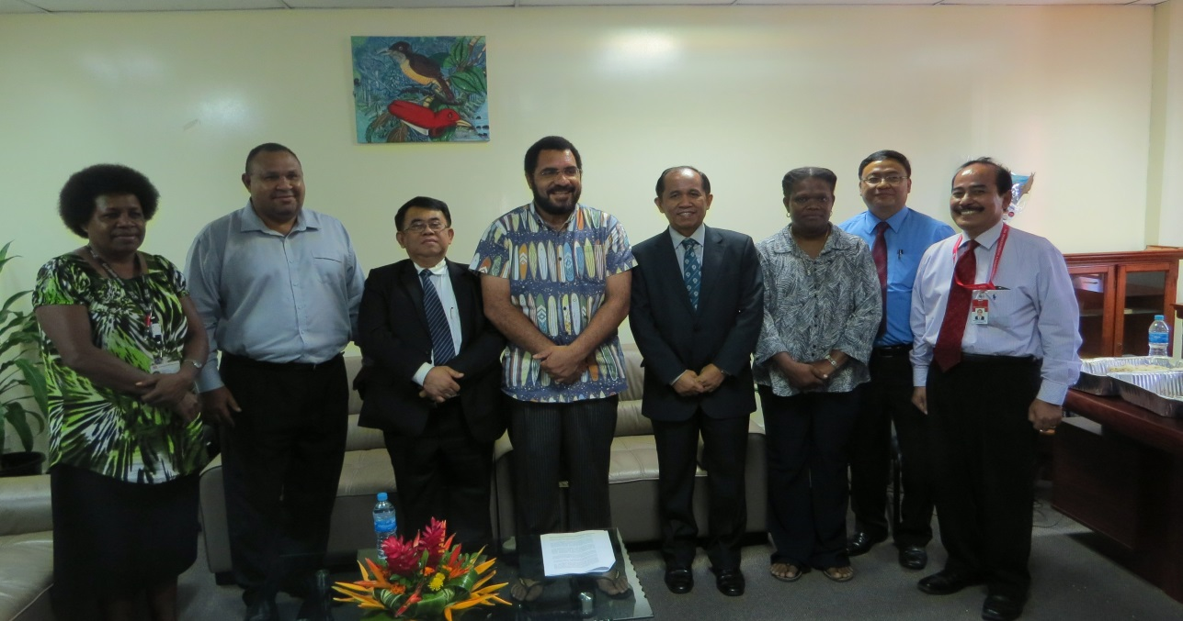
ACCOMPLISHMENTS
The signing of the Executive Director’s Terms of Appointment and Employment Agreement marks a milestone in the CTI-CFF towards institutionalizing the collective vision of a sustainable future of the six countries as articulated in the Leaders Declaration of the CTI-CFF.
Ratification of the Agreement on Establishment of CTI-CFF Regional Secretariat by Philippines (2014) and PNG (2016)

Slide 6
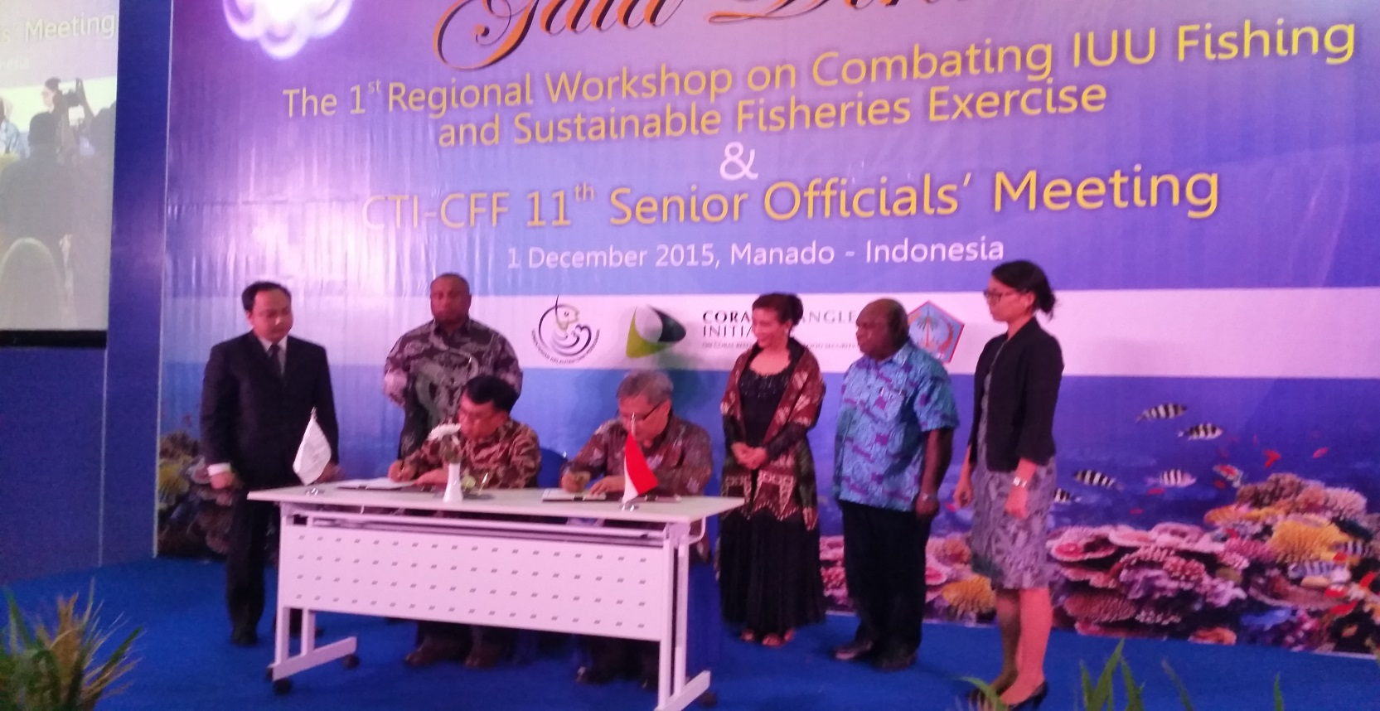
ACCOMPLISHMENTS
Handover of Interim Regional Secretariat to Permanent Regional Secretariat on 1 January 2016.
The Host Country Agreement between the Government of the Republic of Indonesia and CTI-CFF Regional Secretariat was signed on 1 December 2015 in Manado.
Ratification of the Agreement on Establishment of CTI-CFF Regional Secretariat by Philippines (2014) and PNG (2016)

Slide 7
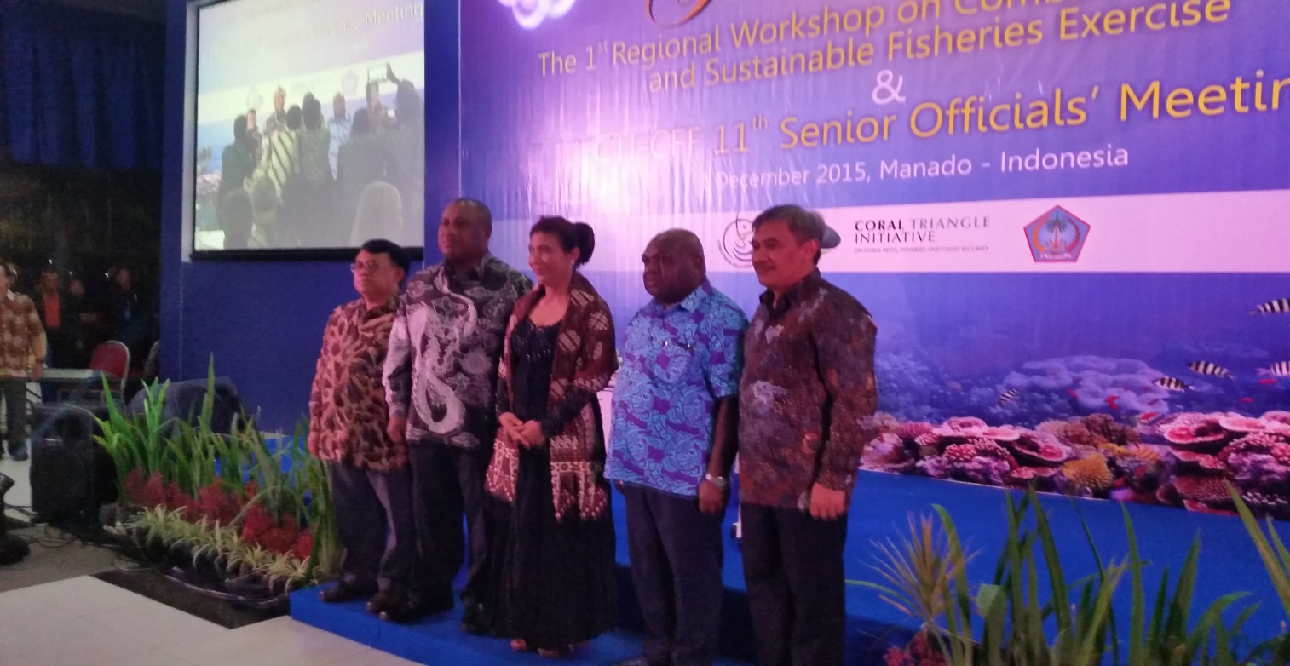
ACCOMPLISHMENTS
Hon. Mao Zemming, Minister for Fisheries and Marine Resources of Papua New Guinea and Her Excellency Susi Pudjiastuti, Minister of Marine Affairs and Fisheries of Republic of Indonesia signed the MOU on IUU Fishing in December 2015 during the 1st Regional Workshop on Combating IUU Fishing and Sustainable Fisheries Exercise
Ratification of the Agreement on Establishment of CTI-CFF Regional Secretariat by Philippines (2014) and PNG (2016)

Slide 8
ACCOMPLISHMENTS
Ratification by the Republic of the Philippines on the Agreement on the Establishment of CTI-CFF Regional Secretariat on 24 November 2014.
Ratification by Papua New Guinea on the Agreement on the Establishment of CTI-CFF Permanent Regional Secretariat on 30th August 2016.
A number of TWG and Cross cutting themes (i.e. WLF, LGN General Assembly) events held
Ratification of the Agreement on Establishment of CTI-CFF Regional Secretariat by Philippines (2014) and PNG (2016)

Slide 9
RATIFICATION
Ratification to the Agreement on the Establishment of Permanent Regional Secretariat by Solomon Islands, Timor-Leste and Philippines in 2014 and PNG in 2016
ANNUAL CONTRIBUTION
The support and assistance from 5 (five) member countries in providing annual contribution to Regional Secretariat.
BRUNEI DARUSSALAM ACCEPTANCE
Process to the application letter of Brunei Darussalam (LOI) to become a new member state of CTI-CFF
ACCOMPLISHMENT

Slide 10
RECOMMENDATION
To acknowledge and appreciate the CTI-CFF Leadership by Papua New Guinea for the period of two years from 2014-2016.
To appreciate the supports of all member countries during Papua New Guinea’s Leadership as the Chair of CTI-CFF Council Of Ministers (COM) and Chair of CTI-CFF Committee of Senior Officials (CSO).

