Slide 1
PARTNER UPDATE (2015) CORAL TRIANGLE CENTER
Mr. Johannes Subijanto Coral Triangle Center

Slide 2
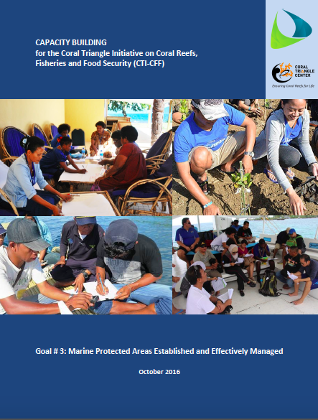
CTI-CFF REGIONAL CAPACITY BUILDING ASSESSMENT
In line with the decision of the CTI-CFF 11th Senior Officials Meeting, CTC led the development of a regional capacity building assessment for CTI-CFF focused on RPOA Goal #3. The assessment covered the following:
What capacity needs have been identified in each CT country?
Who are the capacity providers addressing those capacity needs?
What mechanisms are being used (& are desired) for to address these needs?
What needs are being addressed, and what capacity gaps exist?
The report was produced, in collaboration with the CTI-CFF Regional Secretariat, with support from partners such as USAID, US DOI, NOAA, TNC, CI, WWF and ADB.

Slide 3
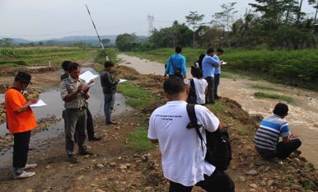
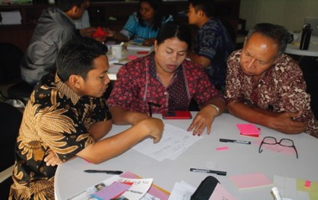
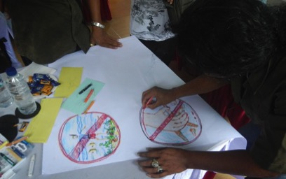
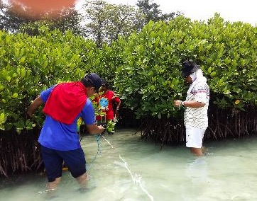
CAPACITY BUILDING IN THE CORAL TRIANGLE
The Coral Triangle Center continues to support the achievement for the CTI-CFF Regional and National Plans of Action through its training and capacity building activities.
25 training modules
MPA
EAFM
Marine Spatial Planning
Threatened Species Monitoring
Economic Valuation
Sustainable Marine Tourism
129 training sessions in the Coral Triangle
2,617 participants

Slide 4
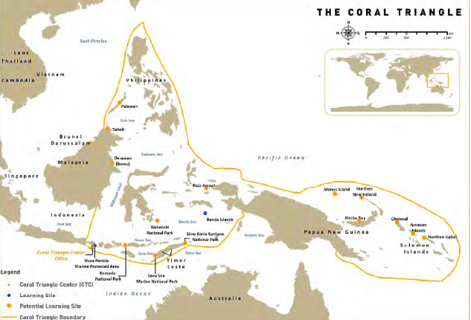
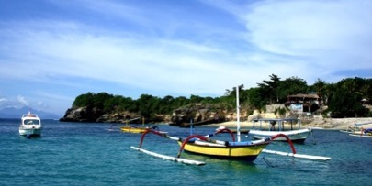
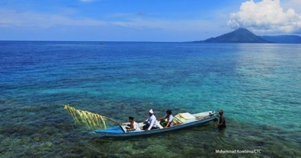
CORAL TRIANGLE MARINE PROTECTED AREA SYSTEM (CTMPAS)
CTC Learning Sites have been successfully nominated to the CTMPAS and received awards from the Ministry of Marine Affairs Indonesia for MPA effectiveness
Nusa Penida MPA in Bali was nominated by Indonesia government as MPA under category-4 (Flagship Site) in CTMPAS during CTI-CFF MPA REX 6 in Dumaquete, Philippines.
·Banda Sea MPA Network in Maluku was nominated by Indonesia government as MPA under category-3 (Priority Development Site) in CTMPAS during CTI-CFF MPA REX 6 in Dumaquete. Philippines.
Nusa Penida
Banda

Slide 5
CTI-CFF REGIONAL SUSTAINABLE MARINE TOURISM TASK FORCE
In line with the decision of the CTI-CFF 11th Senior Officials Meeting, CTC in collaboration with the Indonesia CTI-CFF National Coordinating Committee and the CTI-CFF MPA Technical Working Group, supported the development of the Terms of Reference CTI-CFF Sustainable Marine Tourism Task Force.
The Task Force TOR is being submitted for endorsement at the 12 CTI-CFF Senior Officials Meeting.

Slide 6
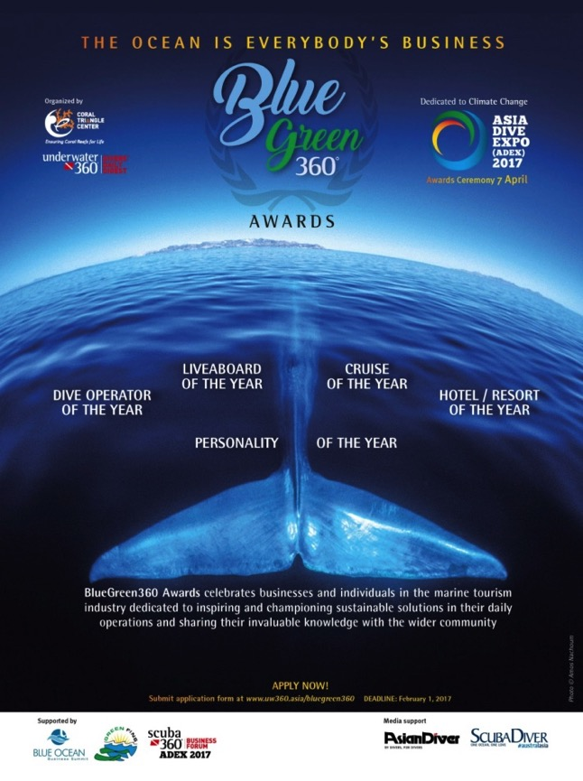
SUSTAINABLE MARINE TOURISM
BlueGreen 360 Awards
Private sector Collaboration: Singapore-based Asia Geographic Magazine Pte., Asia Dive Expo, Scuba Diver Australasia and CTC.
Award launched at the Asia Dive Expo, Singapore, April 2017 to
“.. celebrate businesses and individuals in the marine tourism industry dedicated to inspiring and championing sustainable solutions in their day-to-day operations and sharing their invaluable knowledge with the wider community.”
Categories:
BlueGreen360 - Hotel / Resort of the Year
BlueGreen360 - Liveaboard of the Year
BlueGreen360 - Dive Operator of the Year
BlueGreen360 - Cruise of the Year
BlueGreen360 - Personality of the Year - for outstanding and pioneering contribution to the promotion of sustainable practices in the marine tourism industry.

Slide 7
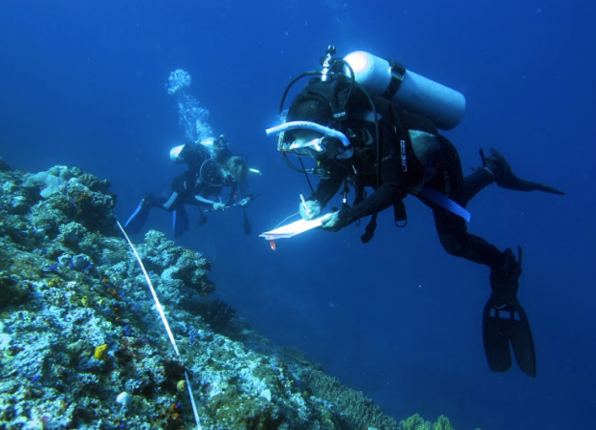
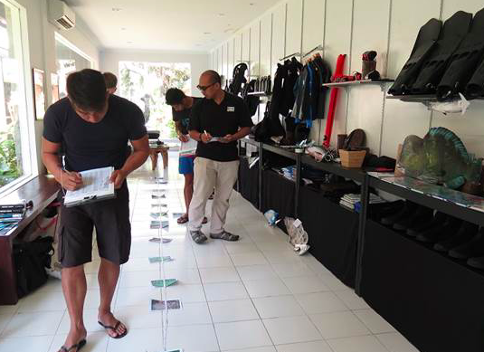
SUSTAINABLE MARINE TOURISM
MOU: Living Seas & CTC on March 19, 2016
Program: Engaging Scuba Divers to Spread the Message on Marine Conservation and Sustainable Tourism
Living Seas - promote and implement code of conduct for divers, increase awareness for marine conservation and practices, supports CTC in reef monitoring & coral planting activities.
CTC - provides training, capacity building & materials on reef health monitoring, code of conduct infosheets etc.
Certificate of completion by guests = funding contribution to CTC

Slide 8
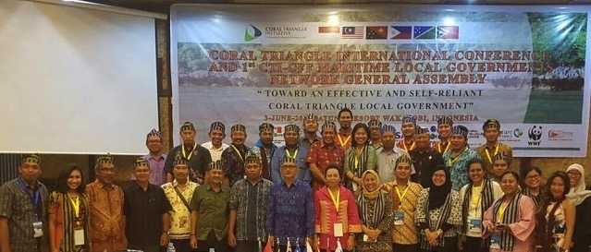
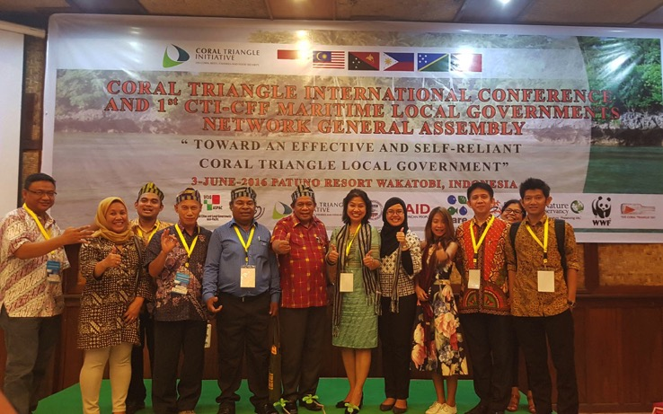
CTI-CFF LOCAL GOVT NETWORK
Strengthening Local Government Leaders in the Coral Triangle 1st CTI-CFF LGN General Assembly, Wakatobi, June 2016
CTC was one of the main convenors and technical adviser to the CTI-CFF LGN General Assembly and continues to provide support to the LGN Task Force to advance its sustainability roadmap.

Slide 9
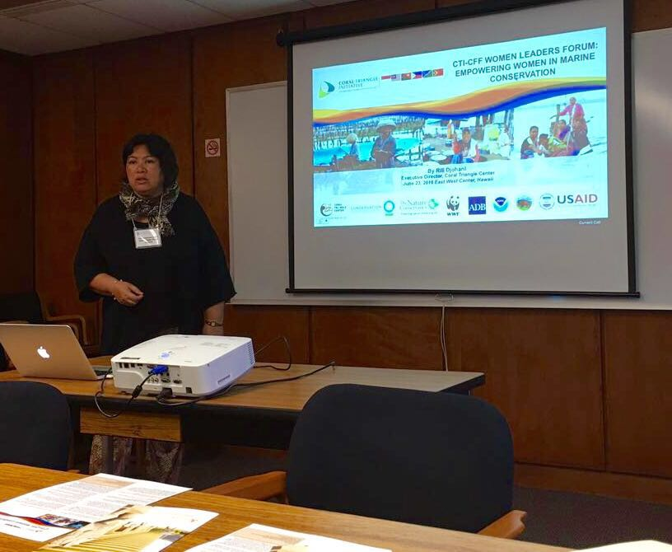
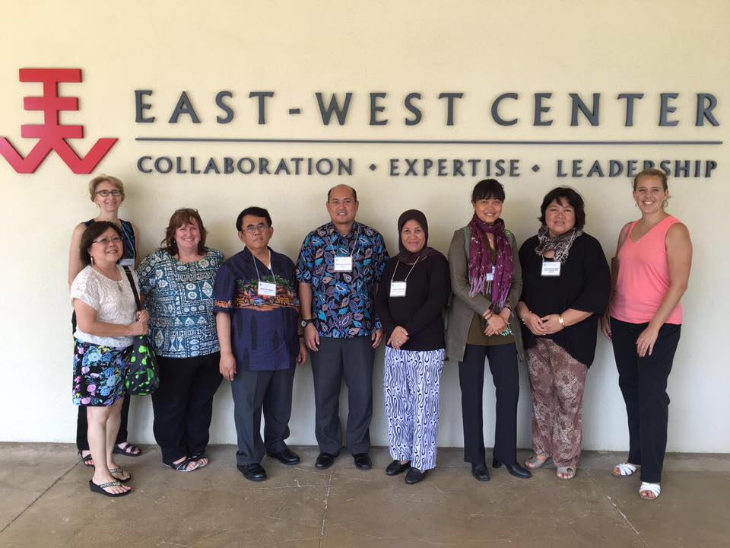
WOMEN LEADERS FORUM
As part of the side events of the International Coral Reef Symposium in Honolulu, Hawaii CTC and the CTI-CFF Regional Secretariat presented the CTI-CFF Women Leaders Forum milestones at the East-West Center on June 24, 2016.
The presentation and meeting were held to explore possible future collaboration to raise women’s capacity and leadership in the Coral Triangle Region. CTC and the East-West Center Leadership Program are now planning joint activities for women leaders in marine conservation.

Slide 10
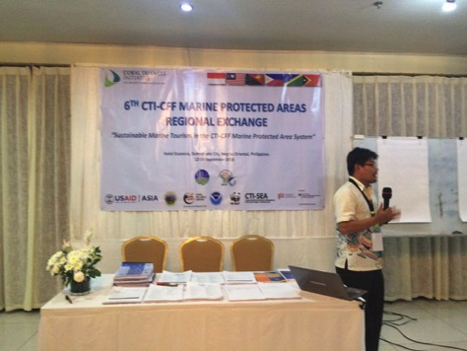
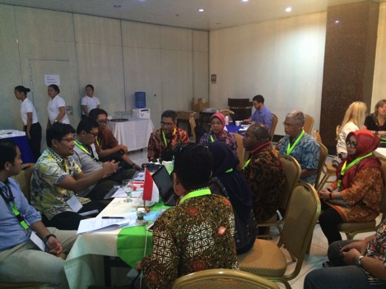
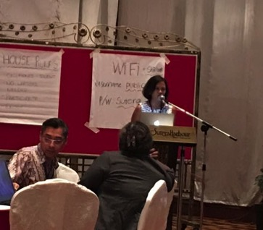
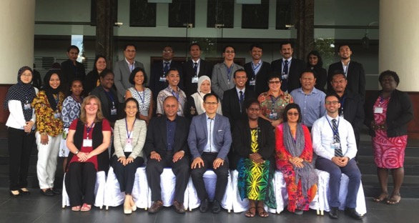
CTI-CFF MPA and CCA REGIONAL EXCHANGES
CTC participated as resource persons at the 6th CTI-CFF MPA Regional Exchange in Dumaguete, Philippines and the CTI-CFF CCA Regional Exchange in Kota Kinabalu, Malaysia

Slide 11
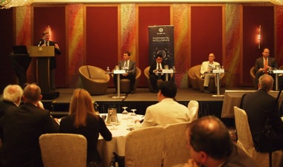
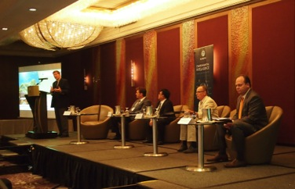
BUSINESS ADVISORY COUNCIL – WORLD OCEAN COUNCIL
CTC, in partnership with APEX Environmental, will present a paper at the WOC Sustainable Ocean Summit to raise the profile of the Coral Triangle region for the business community with the aim to set up a “Regional Ocean Industry Leadership for the Coral Triangle Region.”
WOC Summit, 2015
WOC Summit, 2015

Slide 12
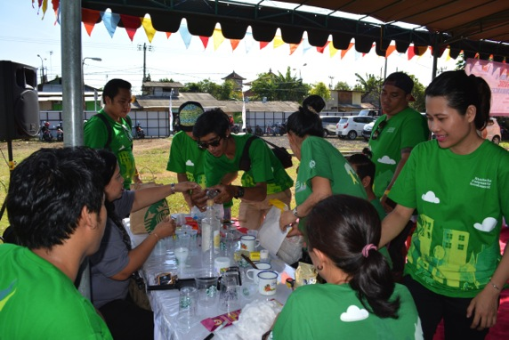
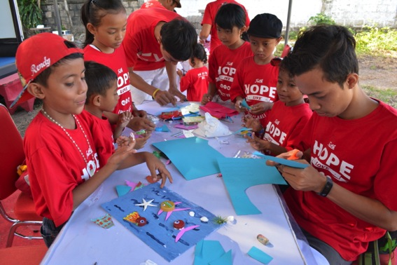
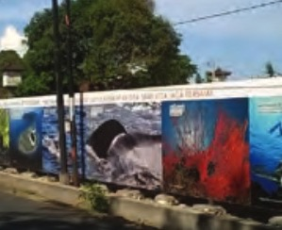
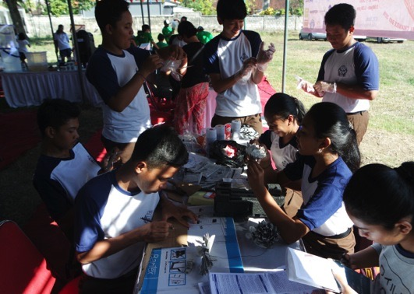
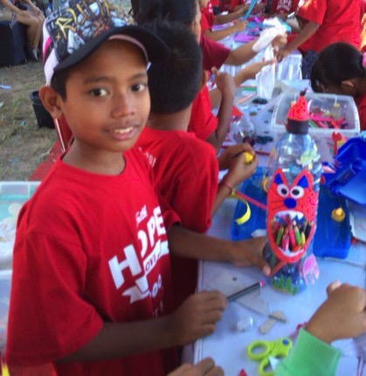
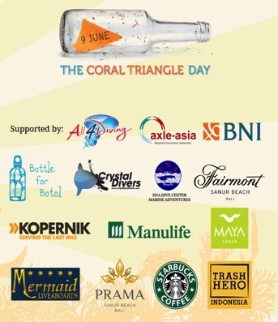
CORAL TRIANGLE DAY 2016

Slide 13
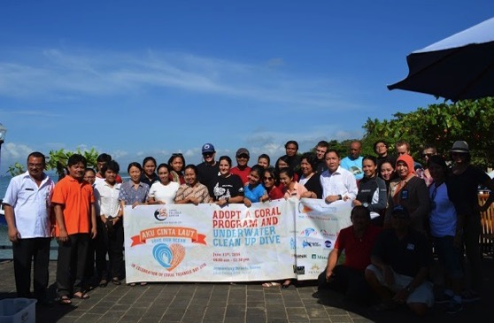
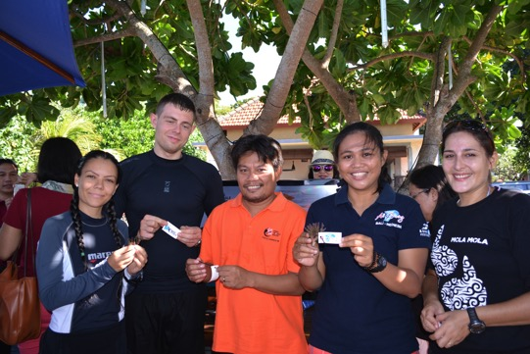
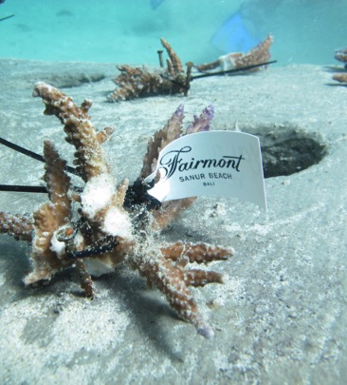
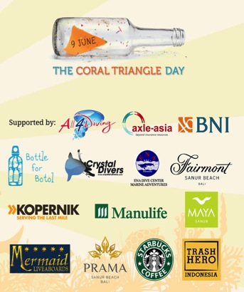
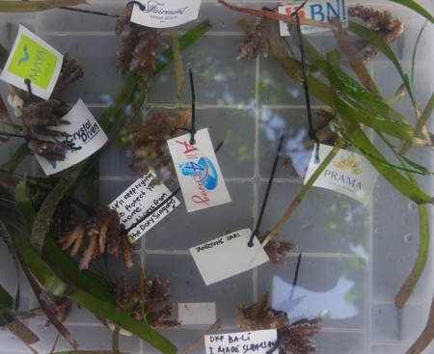
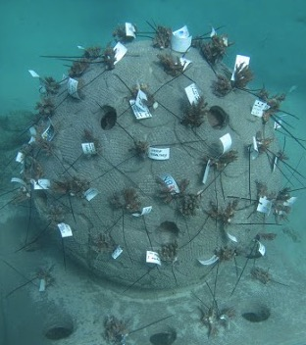
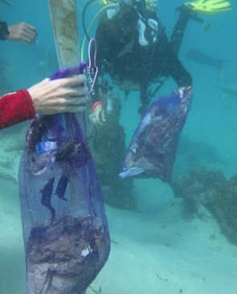
CORAL TRIANGLE DAY 2016

